Slide 1
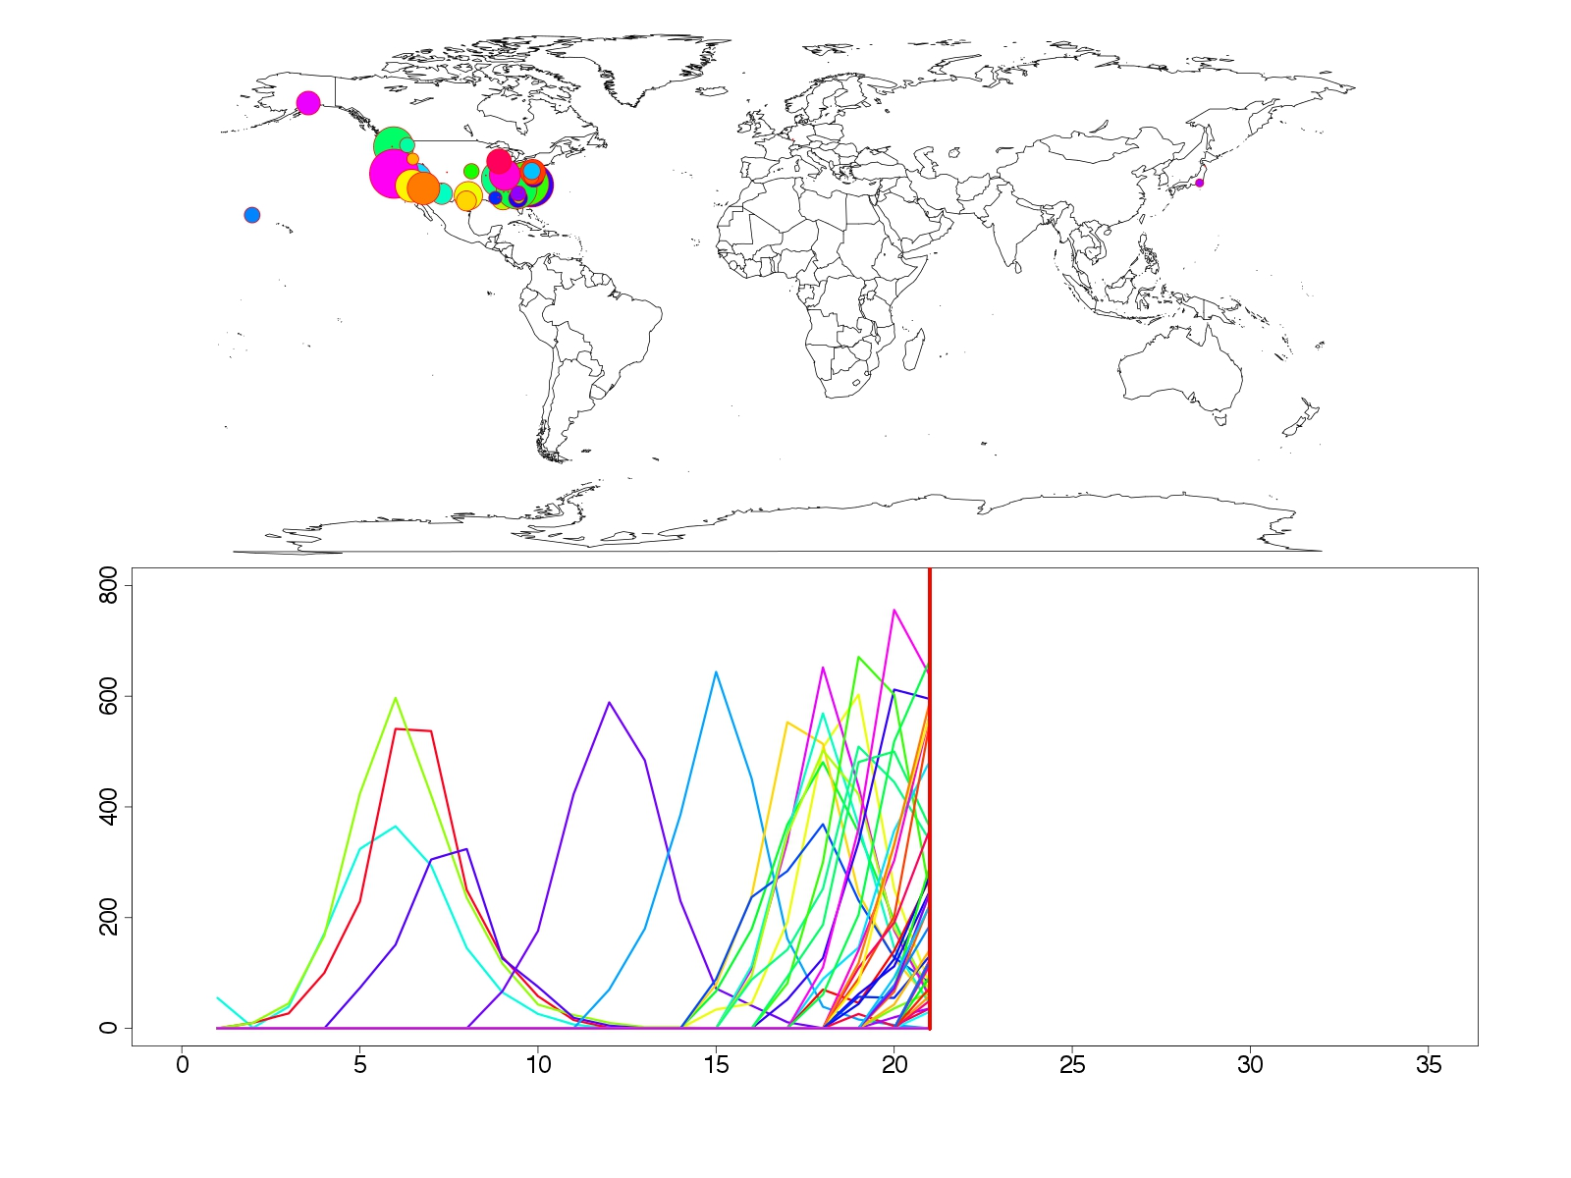
Transmission Dynamics of Pandemic Influenza within the Military Population: Inferences from AFHSC's Defense Medical Surveillance System
Number of Reported Cases
Time (weeks)
David P. Bacon
Director
Center for Atmospheric Physics
SAIC
Steven Riley
Pete Riley
Predictive Science, Inc.
David P. Bacon
Science Applications International Corporation

Slide 2
Acknowledgements
Michal Ben-Nun and Richard Armenta
Predictive Science Inc., San Diego, CA, USA
Angela A. Eick
Armed Forces Health Surveillance Center, Silver Spring, MD, USA
Dylan George
National Center for Medical Intelligence, Fort Detrick, MD, USA

Slide 3
Overview
Background
Spatial patterns in military populations
Incidence patterns for individual military populations
Other interesting questions
Summary

Slide 4
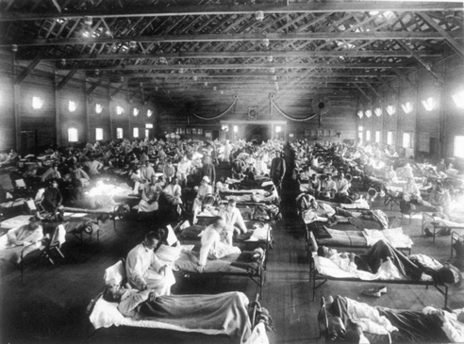
The threat from influenza pandemics necessitates planning and preparation

Slide 5
AFHSC’s DMSS dataset is based on ICD-9 codes

Slide 6
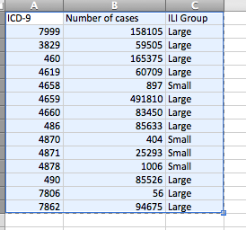
The Marsden-Haug “ILI-small” criteria provides an accurate estimate of CDC ILI cases
Number of cases matching ICD-9 codes in the AFHSC dataset.
Notes:
For reference, these are the definitions of the ICD codes:
The “ILI-large” and “ILI-small” groups are based on whether the codes are used more than 75,000 times during the 4-year period studied by Marsden-Haug et al. (2007).
“ILI-large” is defined by any one of the following codes:
079.99 (7999) = Viral infection NOS
461.9 (4619) = Sinusitis, acute, NOS
465.9 (4659) = Upper respiratory infection, acute, NOS
466.0 (4660) = Bronchitis, acute
486 (486) = Pneumonia, organism unspecified
490 (490) = Bronchitis, not specified as acute or chronic
780.6 (7806) = Fever, nonperinatal
786.2 (7862) = Cough
The “ILI-small” is defined by one of the following codes:
465.8 (4658) = Infectious upper respiratory, multiple sites, acute NEC
487.0 (4870) = Influenza w/ pneumonia
487.1 (4871) = Influenza w/ other respiratory manifestations
487.8 (4878) = Influenza with manifestation NEC

Slide 7
How do we define a “military population?”
For estimating the location of Study ID’s, the DMSS dataset provides:
Service Category (e.g., Army)
Zip3 of Unit (e.g., 921)
UIC (e.g., FFNHS)
DMISID CAT (e.g., HOLLOMAN AFB)
DMISID (e.g., 356) -> Zip5 (e.g., 92134)
=> Military Population Zip (MPZ): Location of individual at time they presented to the clinic.

Slide 8
Simple epidemic models explain the trajectory of incidence
Slide credit: Marc Lipsitch

Slide 9
The basic reproductive number
“The average number of secondary cases generated by a typically infectious individual over the entire course of their infection”
2
1
3
4

Slide 10
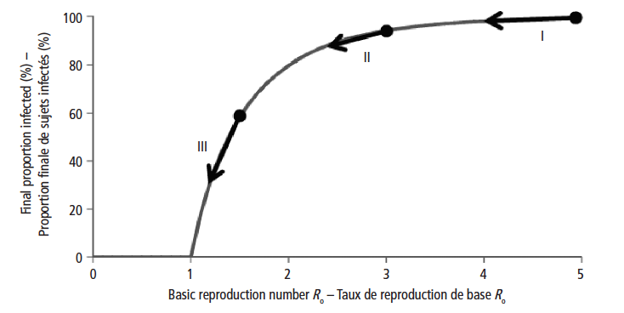
R0 and the cumulative attack rate
Source: WER 2009

Slide 11
Overview
Background
Spatial patterns in military populations
Incidence patterns for individual military populations
Other interesting questions
Summary

Slide 12
The 2009 H1N1 pandemic in US military populations is suggestive of a global wave from west to east
Movie 1: ILI-small-world-zip5-movie.qt

Slide 13
Within CONUS, the 2009 H1N1 pandemic was more synchronized in the largest bases
Movie 1: ILI-small-usa-zip5-movie.qt

Slide 14
The 2009 H1N1 pandemic was significantly larger than the subsequent 2010-2011 H3N2 seasonal epidemic
Movie 1: ILI-small-side68-usa-movie.qt

Slide 15
The data suggest the presence of waves (with San Diego as an arbitrary starting point)

Slide 16
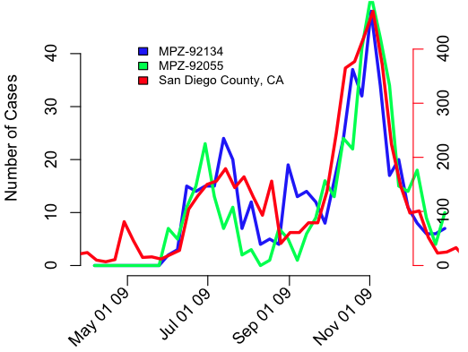
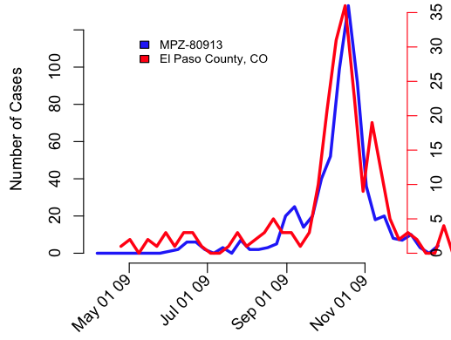
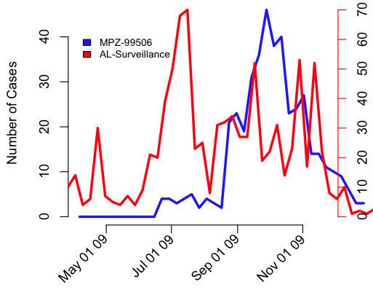
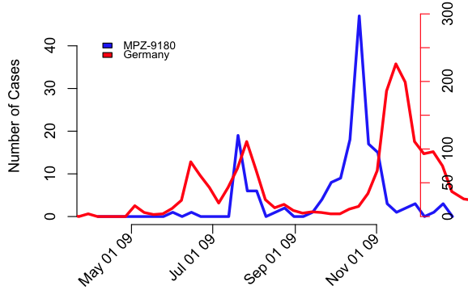
Incidence in military populations often matched local civilian populations

Slide 17
These patterns were consistent for many locations for which civilian and military data were available
Correlation
Lag

Slide 18
Overview
Background
Spatial patterns in military populations
Incidence patterns for individual military populations
Other interesting questions
Summary

Slide 19
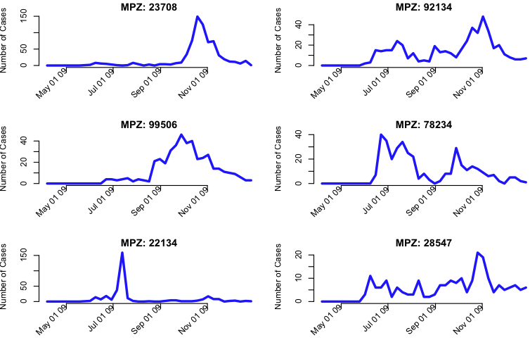
Base profiles show a range of characteristics

Slide 20
We used a simple model of change in transmissibility and depletion of susceptibles
Parameter | symbol | Estimated?
Generation time | T_{g} | Fixed (2.6 days)
Time of first infection | t₀ | yes
Basic reproduction number | R₀ | yes
Time of R₀ drop/rise | t₁ | yes
Duration of R₀ reduction/increase | Δt | yes
Value of R₀ during change | R* | yes
Effective population size | N_{eff} | yes
Baseline noise | φ_{noise} | yes

Slide 21
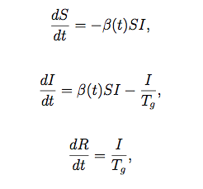
We can model the one- and two-peaked profiles using a seven parameter model.
R
t1
R*
R0
T0
Δt
Time
S = number of susceptible individuals
I = number of infectious individuals
R = number of recovered individuals
β = transmission rate
T_{g}=infectious period
R₀= βT_{g}=Basic reproduction number

Slide 22
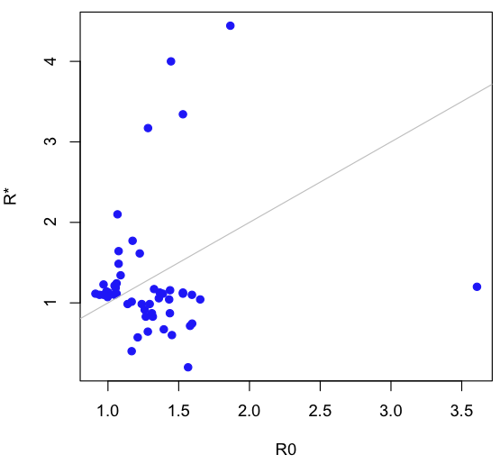
We obtained parameter estimates for the top 50 bases (by volume of ILI-small)

Slide 23
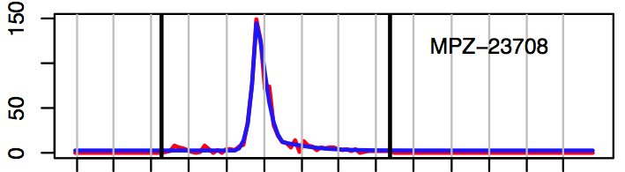
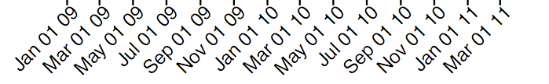
Many of the military populations are well fitted with a single peaked profile, such as this at Portsmouth Naval Medical Hospital.
Parameter | Model A | Model B
T₀ (week) | 38.5 | 38.2
R₀ | 1.39 | 1.37
t₁ (week) | 4.28
Δt (week) | 6.27
R* | 1.11

Slide 24
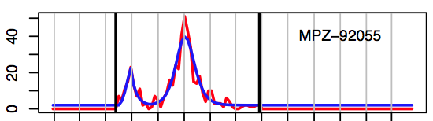
Most remaining cases are fit with a two-peak profile, such as at Camp Pendleton, CA.
Parameter | Value
T₀ (week) | 23.5
R₀ | 1.27
t₁ (week) | 3.16
Δt (week) | 6.75
R* | 0.83

Slide 25
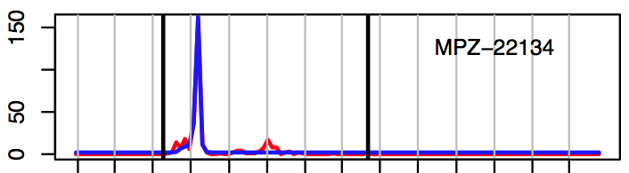
Some of the profiles are quite unique, such as the Marine training base at Quantico, VA.
Parameter | Model A | Model B
T₀ (week) | 23.8 | 27.4
R₀ | 3.61 | 3.02
t₁ (week) | 0
Δt (week) | 3.89
R* | 1.2

Slide 26
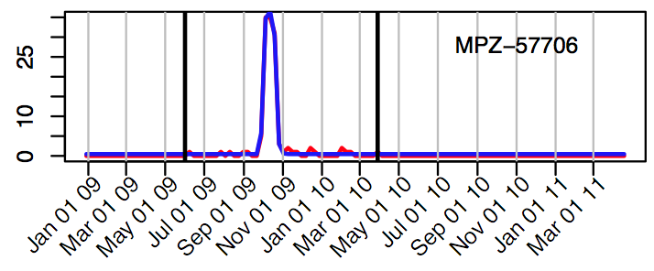
Other ‘outlier’ events are also fit well by the seven-parameter model, where a smaller R0 captures the leading and trailing portion of the profile, such as Ellsworth AFB, SD.
Parameter | Model A | Model B
T₀ (week) | 38.5 | 39.4
R₀ | 1.86 | 1.70
t₁ (week) | 2.58
Δt (week) | 1.18
R* | 4.44

Slide 27
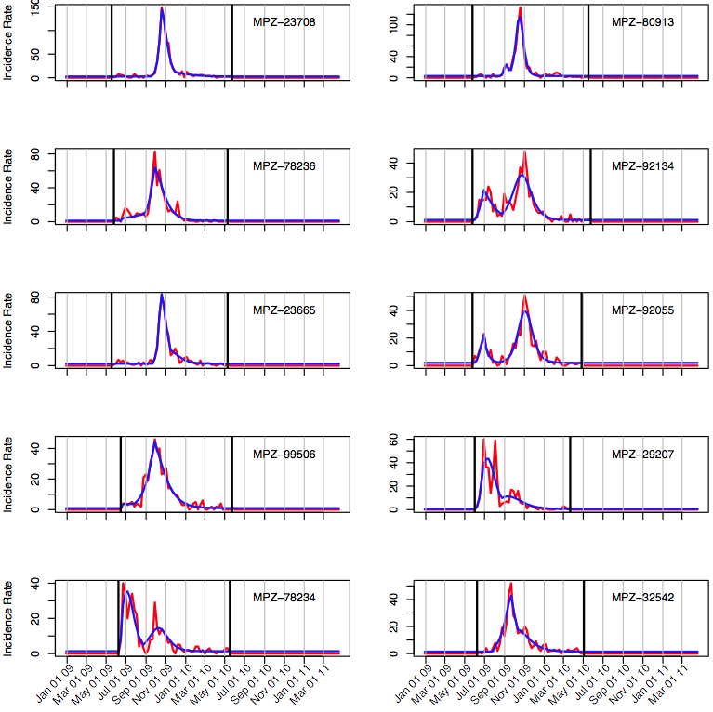
The largest 10 military populations by zip code

Slide 28
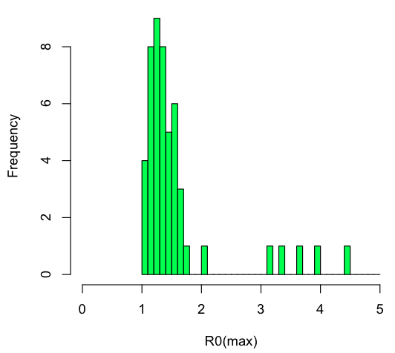
The model fits produced R0 values that are clustered about a median value that matches results that were estimated in civilian populations
Median R₀(max) = 1.35
Mean R₀(max) = 1.59
Standard deviation = 0.76

Slide 29
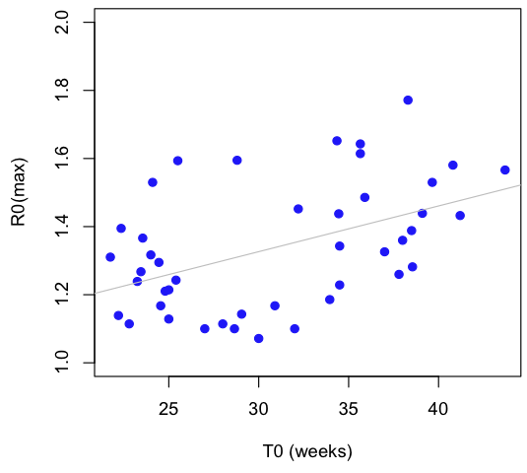
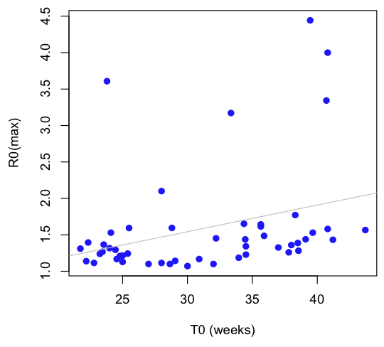
There is no obvious evidence from the AFHSC/DMSS data that R₀ decreased during the course of the 2009 H1N1 pandemic. In fact, the reverse may be true.

Slide 30
R0 and the cumulative attack rate
Source: WER 2009

Slide 31
Overview
Background
Spatial patterns in military populations
Incidence patterns for individual military populations
Other interesting questions
Summary

Slide 32
Analysis of AFHSC’s DMSS data, together with development of military-specific stochastic metapopulation models can lead to robust, actionable framework for estimating the transmission dynamics of new pathogens.

Slide 33
We have had to infer population sizes
The values we are getting at the moment are nominal (very small)
These populations are likely well known
Model accuracy would improve substantially with accurate “denominator” data
If these population sizes are not well known (at a particular time) we may be able to gain insight from the noise term

Slide 34
The military population has a very different age structure than the civilian population

Slide 35
The earlier (summer) wave of the 2009 pandemic had higher apparent severity than the fall wave

Slide 36
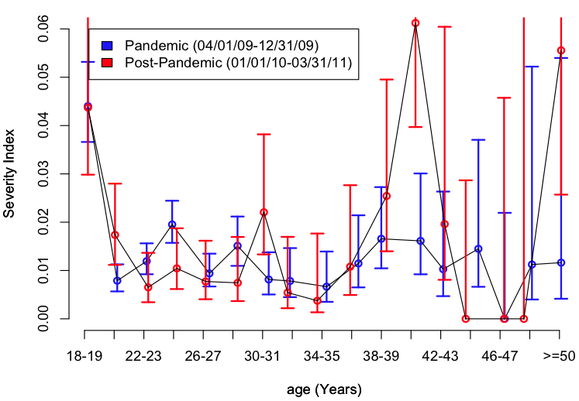
A disproportionate number of the youngest military age group suffered severe disease during the 2009 influenza pandemic and the following seasonal epidemic

Slide 37
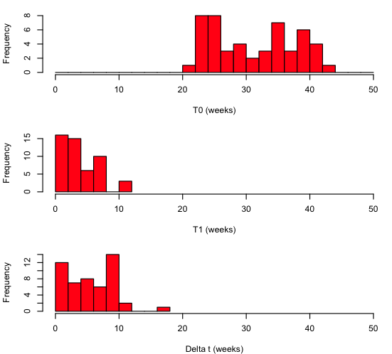
The model fits provide temporal information on the: (1) time of first infection; (2) point in time when R₀ changed; and (3) duration over which R₀ was modified.

Slide 38
Using inferences drawn from the 2009 H1N1 pandemic, we can simulate a range of similar, or novel pandemics
Movie 1: sim001a-map-ts-rev4.qt

Slide 39
What if this was the only information we had?

Slide 40
Even with several bases reporting outbreaks, our confidence in predicting the ultimate outcome would be poor

Slide 41
Once the initial bases had peaked, however, we would be able to predict both the total number of cases and estimate a severity index for all subsequent bases

Slide 42
Simulations – where we plan to go from here
Apply same analysis to seasonal influenza for 2010-2011 season
How could model help with H5 and the H3N2 variant?
With the inferences from the fits, we can make predictions
We do need the denominator data

Slide 43
Overview
Background
Spatial patterns in military populations
Incidence patterns for individual military populations
Other interesting questions
Summary

Slide 44
Summary
Analysis of AFHSC’s DMSS data is yielding genuine insight
Synchronicity between many military and civilian populations suggests
Military populations act as sentinels AND
Civilian datasets could be used to understand spatial transmission dynamics within the military
Some military populations not synchronous
Parsimonious modeling of the military bases yields reasonable estimates for R0 and other important parameters
So far: proof of concept
Simulation studies can be used to develop forecasting capabilities based on the results presented here
These analysis and similar could be run routinely during pandemic and non-pandemic influenza seasons

Slide 45
Unused slides

Slide 46
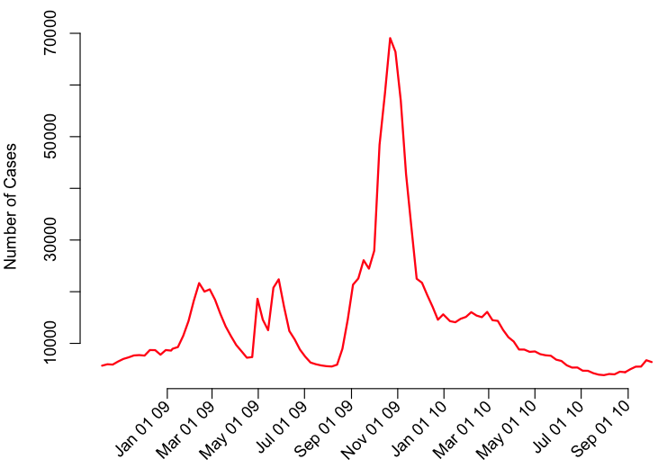
What is the relationship between the pandemic profiles at military installations and the civilian population?
CDC ILI reported by sentinel providers

Slide 47
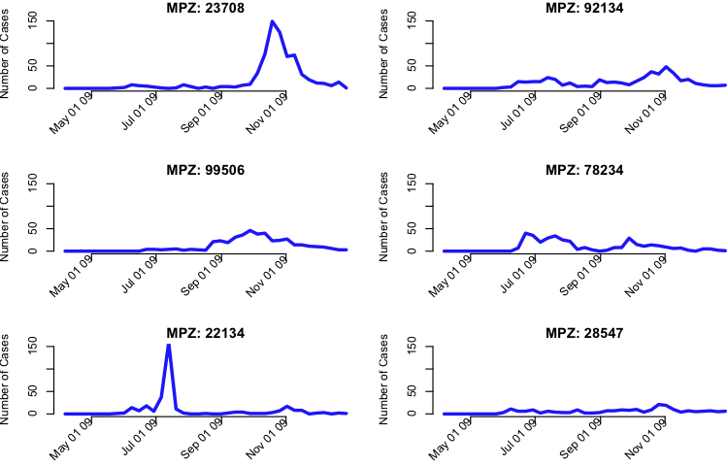
The total number of susceptibles at each base is a crucial parameter for effective modeling

