Slide 1
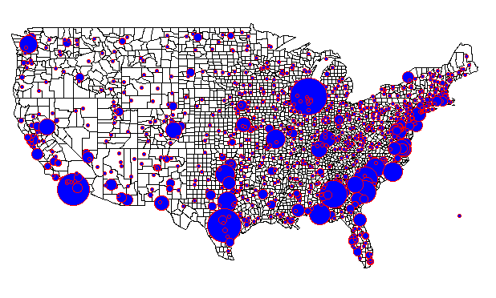
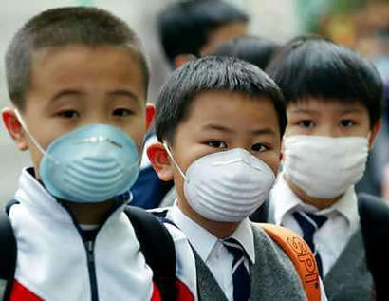
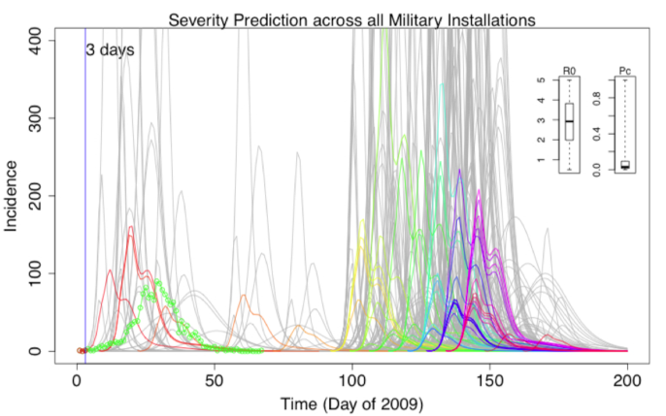

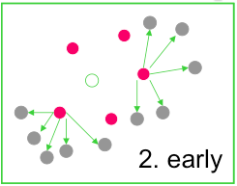
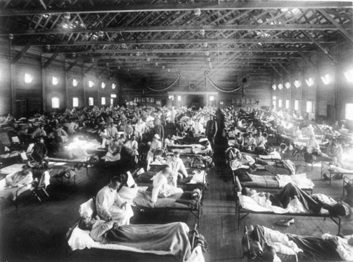
Rapid assessment of pandemic impact using clinical episode data from spatially distinct military populations January, 2013
David P. Bacon
Director
Center for Atmospheric Physics
SAIC
Steven Riley
Pete Riley
Predictive Science Inc.
David P. Bacon
Science Applications International Corporation

Slide 2
Acknowledgements
NCMI / DTRA / AFHSC
Funded by NCMI contract W81XWH-10-A-0026/DO001 to SAIC
Predictive Science
Imperial College London

Slide 3
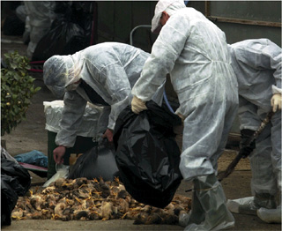
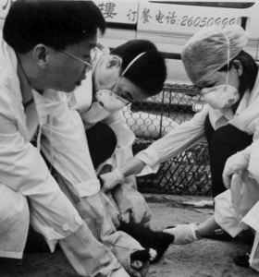

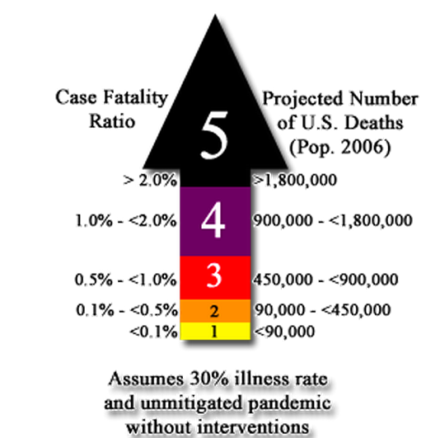

Slide 4
Alternate models for interaction of ecological science and health policy

Slide 5
Overview
Background and key parameters
Features of the 2009 pandemic
Disease dynamics of 2009
Simulating worrisome future scenarios
Conclusions and future work
Notes:
Scientific intro
Description of data - patterns seen
Estimating properties of 09 pandemic
Simulation of possible future pandemics
Future work

Slide 6
Severity matrix
High
Explicit interventions unlikely to be justified either for containment or mitigation
Implement most stringent interventions and watch carefully for the population response to the new infection: apparently high Ro may drop rapidly when high CFR fully appreciated
R0
Consider carefully the cost of non-containment then the costs and benefits of mitigation
Most stringent
Intervention, for containment or effective mitigation
Low
Low
IFR
High
Adapted: WER 2009

Slide 7
The basic reproductive number
“The average number of secondary cases generated by a typically infectious individual over the entire course of their infection”
2
1
3
4

Slide 8
Simple epidemic models explain the trajectory of incidence
S
I
R

Slide 9
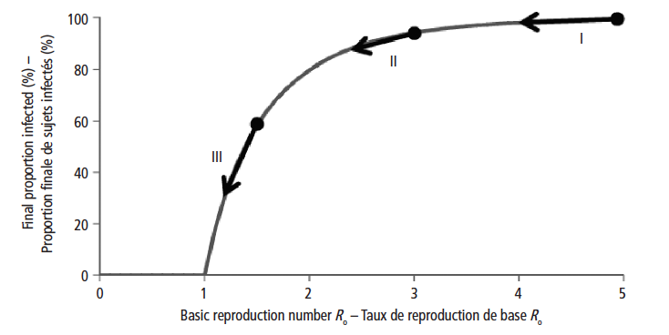
R₀ and the cumulative attack rate
Source: WER 2009

Slide 10
Severity pyramid
Deaths
CFR
Severe cases
IFR
Cases
Infections

Slide 11
Severity matrix
High
Explicit interventions unlikely to be justified either for containment or mitigation
Implement most stringent interventions and watch carefully for the population response to the new infection: apparently high Ro may drop rapidly when high CFR fully appreciated
R0
Consider carefully the cost of non-containment then the costs and benefits of mitigation
Most stringent
Intervention, for containment or effective mitigation
Low
Low
IFR
High
Adapted: WER 2009

Slide 12
Overview
Background and key parameters
Features of the 2009 pandemic
Disease dynamics of 2009
Simulating worrisome future scenarios
Conclusions and future work
Notes:
Scientific intro
Description of data - patterns seen
Estimating properties of 09 pandemic
Simulation of possible future pandemics
Future work

Slide 13
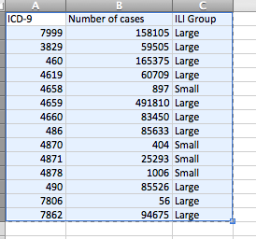
The Marsden-Haug “ILI-small” criteria consistent with CDC ILI cases.
Number of cases matching ICD-9 codes in the AFHSC dataset.
Notes:
For reference, these are the definitions of the ICD codes:
The “ILI-large” and “ILI-small” groups are based on whether the codes are used more than 75,000 times during the 4-year period studied by Marsden-Haug et al. (2007).
“ILI-large” is defined by any one of the following codes:
079.99 (7999) = Viral infection NOS
461.9 (4619) = Sinusitis, acute, NOS
465.9 (4659) = Upper respiratory infection, acute, NOS
466.0 (4660) = Bronchitis, acute
486 (486) = Pneumonia, organism unspecified
490 (490) = Bronchitis, not specified as acute or chronic
780.6 (7806) = Fever, nonperinatal
786.2 (7862) = Cough
The “ILI-small” is defined by one of the following codes:
465.8 (4658) = Infectious upper respiratory, multiple sites, acute NEC
487.0 (4870) = Influenza w/ pneumonia
487.1 (4871) = Influenza w/ other respiratory manifestations
487.8 (4878) = Influenza with manifestation NEC

Slide 14
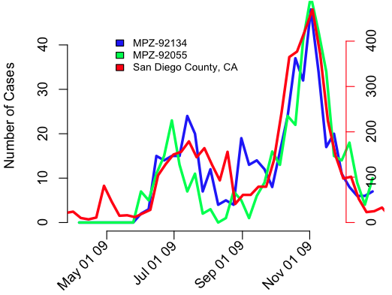
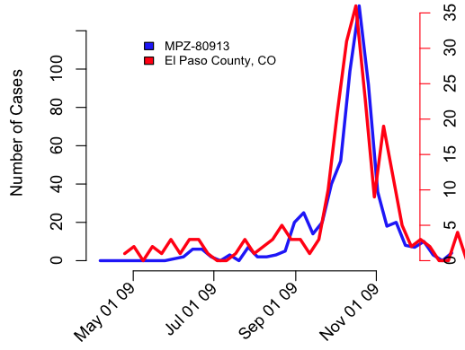
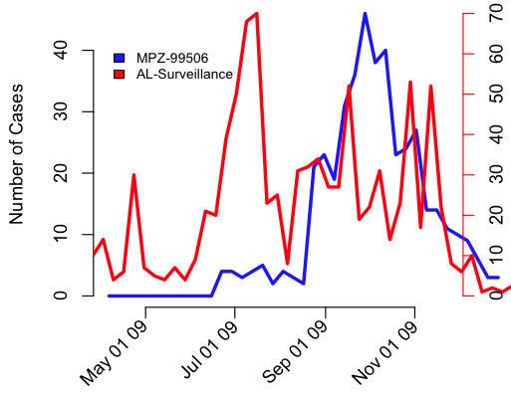
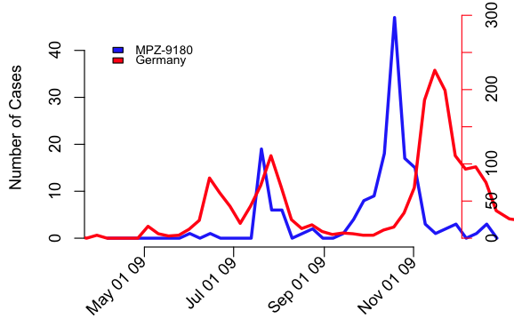
Synchronisation between civilian and military populations
AK

Slide 15
Correlation of peak times
Outliers: Camp Lejune, Quantico.
Notes:
Camp Lejune-28547
-Marine base in North Carolina in Onslow County
-Marine Training facility supported by 5 satellite facilities:
-Marine Corps Air Station New River
-Camp Geiger
-Stone Bay
-Courthouse Bay
-Camp Johnson
-Greater Sandy Ridge Training Area
- More than 12,000 Marines going through Marine Combat training yearly
-More than 150,000 active duty, dependent, retirees and civilians supported
-Has several schools on base that are part of the Camp Lejeune Dependent Schools
Quantico-22134-Marine
-Located near Traingle, Virginia in Southern Prince William County, northern Straffod County and southeastern Fraquier County.
-3,460 Family members
-1,227 Students
-2,232 Civilian employees
-Major training institution for Marine and federal law enforcement agencies
-There are 4 schools located at Quantico, 3 primary schools and one middle/high school. They are part of the DDESS-DODEA

Slide 16
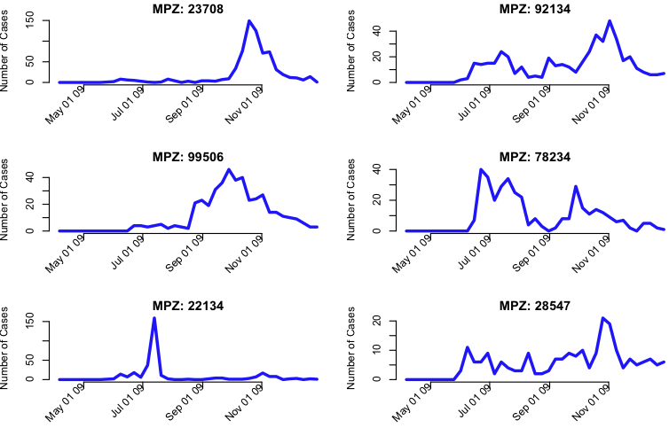
Base epidemic profiles

Slide 17
Overview
Background and key parameters
Features of the 2009 pandemic
Disease dynamics of 2009
Simulating worrisome future scenarios
Conclusions and future work
Notes:
Scientific intro
Description of data - patterns seen
Estimating properties of 09 pandemic
Simulation of possible future pandemics
Future work

Slide 18
Transmissibility changes over time
R
t1
R1
R0
t0
duration
Time

Slide 19
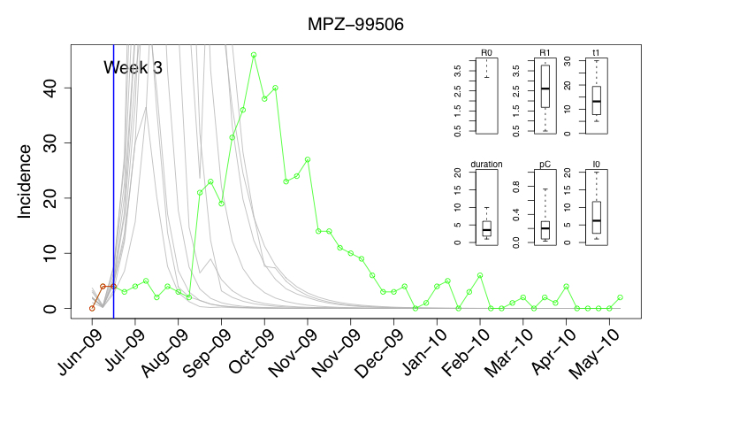
Estimation of Severity for 2009 Pandemic

Slide 20
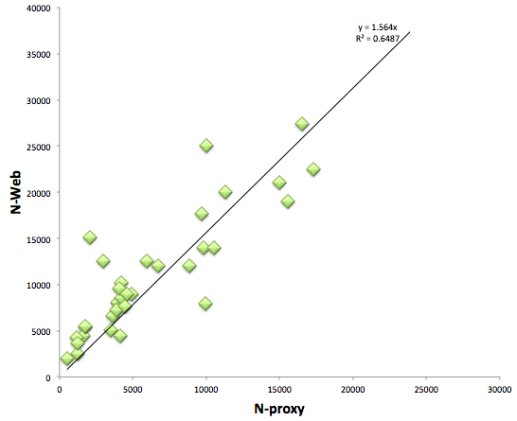
Estimate of Ntotal from AFHSC clinical visits
Outliers: Mayport naval Station, 29 Palms, Ft. Riley,
Notes:
(2000,15000): Mayport Naval Station-32228
-15 miles from Jacksonville, Florida
-15,150 Active duty
-32,000 Family Members
-1,260 Civilians
(3000,12500): Twentynine Palms-92278-Marine
-Located in 29 Palms California, 60 miles from Palm Springs
-12,500 Active duty
-24,000 family members
-21,000 DoD contractors
-1,200 retirees
(10000,25000): Ft. Riley- 66442
-Located in Northeast Kansas on the Kansas River between Junction City and Manhaten in Greary and Riley Counties.
-Has a daytime population of 25,000
-Population assigned served: 42,264
-9,252 Active duty enlisted
- 1,117 Officers
-12,020 family members
- 16,249 retirees
-3,626 Civilian employees
-Geary County Unified School District 475-5 elementary schools and 1 middle school located on campus

Slide 21
The largest 8 military populations by zip code

Slide 22
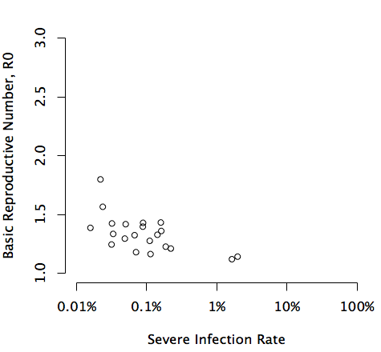
The model fit estimates R₀ and pC for each base over 10,000
Implement most stringent interventions and watch carefully for the population response to the new infection: apparently high Ro may drop rapidly when high CFR fully appreciated
High
Explicit interventions unlikely to be justified either for containment or mitigation
Best case R0
Consider carefully the cost of non-containment then the costs and benefits of mitigation
Most stringent
Intervention, for containment or effective mitigation
Low
Low
Worst case IFR
High
Outliers: Ft. Stewart, Ft Bragg
Notes:
pC=0.8: Ft. Stewart-31314-Army
-Located in Hinesville, Liberty County, Georgia. Near Savannah Georgia
-Soldier population of 15,875
-3,356 Civilian Employees
-20,035 Soldiers
-4,087 Civilian Employees
-32, 751 military family
-total population of 56,873
-Used to train 50,000 reserve component soldiers yearly.
-DoDEA operates 3 elementary schools on base
pC = 0.99999: Ft. Bragg-28310- Army
-Located in Cumberland and Holk Counties in North Carolina
-52,800 Active Duty Soldiers
-12,624 Reserve and temporary duty students
-8-757 Civilian employees
-3,516 Contractors
-62,962 Family members
-98,507 army retirees and family members

Slide 23
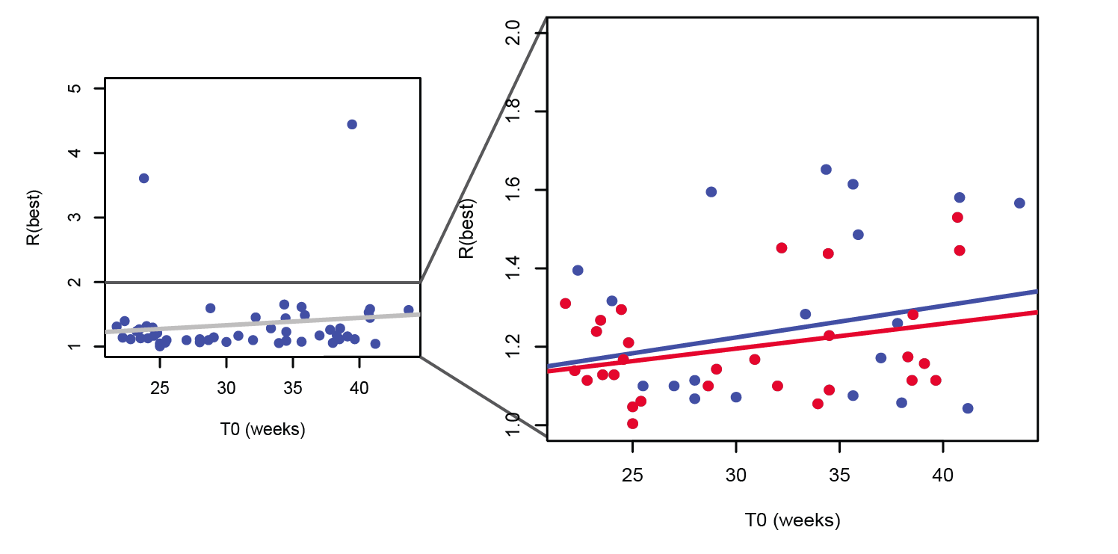
Increasing intrinsic seasonality
Red points are the top 30 bases.
Notes:
Red points are the top 30 bases.

Slide 24
Overview
Background and key parameters
Features of the 2009 pandemic
Disease dynamics of 2009
Simulating worrisome future scenarios
Conclusions and future work
Notes:
Scientific intro
Description of data - patterns seen
Estimating properties of 09 pandemic
Simulation of possible future pandemics
Future work

Slide 25
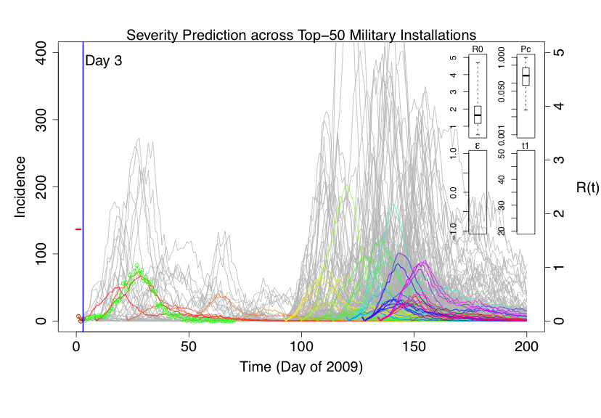
Pandemic prediction based on estimates from early bases

Slide 26
Overview
Background and key parameters
Features of the 2009 pandemic
Disease dynamics of 2009
Simulating worrisome future scenarios
Conclusions and future work
Notes:
Scientific intro
Description of data - patterns seen
Estimating properties of 09 pandemic
Simulation of possible future pandemics
Future work

Slide 27
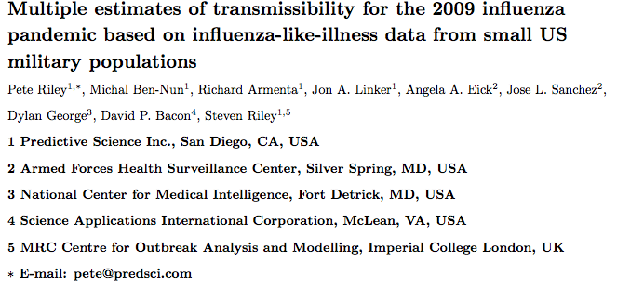
Manuscripts
Paper 1 in revision for PLoS Computational Biology:
Paper 2:
Rapid assessment of pandemic impact using clinical episode data from spatially distinct military populations, Pete Riley, Michal Ben-Nun, Angela A. Eick, Jose L. Sanchez, Dylan George, David P. Bacon, and Steven Riley, In prep.

Slide 28
Conclusions
DMSS data could be useful in real-time for assessing pandemic severity
“Simple models” of 2009 capture key parameters
Accurate population size will improve estimates
Single analytical framework can address planning and response goals

Slide 29
Future Directions
A prototype tool to perform analysis described here
Clearly adds to available tool set
Substantial additional motivation for making key data be available more quickly
Additional modeling science to enable seasonal use
Winter 12/13 proving to be an excellent example
Process of ongoing tool / scientific refinement

Slide 30
UNUSED SLIDES
Notes:
Scientific intro
Description of data - patterns seen
Estimating properties of 09 pandemic
Simulation of possible future pandemics
Future work

Slide 32
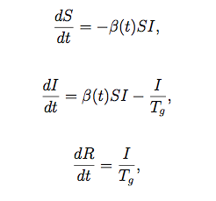
We can model the one- and two-peaked profiles using a seven parameter model.
R
t1
R1
R0
t0
δυρατιον
Time
S = number of susceptible individuals
I = number of infectious individuals
R = number of recovered individuals
β = transmission rate
T_{g}=infectious period
R₀= ∴βεταT_{g}=Basic reproduction number

Slide 33
The data suggest the presence of some wave activity, originating in San Diego and propagating away from there.

Slide 34
Overview
Background
Spatial patterns in military populations
Properties of the 2009 pandemic at military installations
Simulating possible future pandemics
Future work
Notes:
Scientific intro
Description of data - patterns seen
Estimating properties of 09 pandemic
Simulation of possible future pandemics
Future work

Slide 35
Parsimonious models can be applied at the level of each base to recover the essential epidemiological parameters, including R₀.
Parameter | symbol | Estimated?
Generation time | T_{g} | Fixed (2.6 days)
Time of first infection | t₀ | yes
Basic reproduction number | R₀ | yes
Time of R₀ drop/rise | t₁ | yes
Duration of R₀ reduction/increase | Δt | yes
Value of R₀ during change | R* | yes
Effective population size | N_{eff} | yes
Baseline noise | φ_{noise} | yes

Slide 36
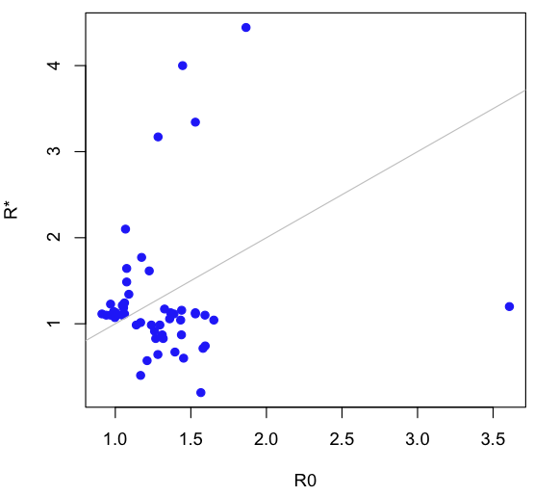
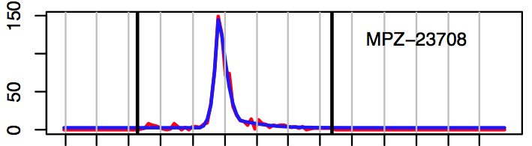
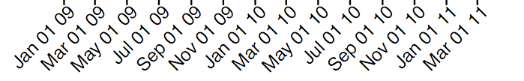
Many of the military populations are well fitted with a single peaked profile, such as this at Portsmouth Naval Medical Hospital.
Parameter | Model A | Model B
T₀ (week) | 38.5 | 38.2
R₀ | 1.39 | 1.37
t₁ (week) | 4.28
Δt (week) | 6.27
R* | 1.11

Slide 37
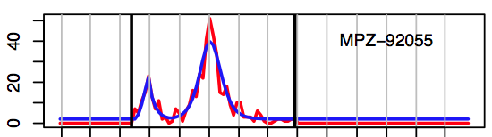
Most remaining cases are fit with a two-peak profile, such as at Camp Pendleton, CA.
Parameter | Value
T₀ (week) | 23.5
R₀ | 1.27
t₁ (week) | 3.16
Δt (week) | 6.75
R* | 0.83

Slide 38
Pandemics can have a substantial effect on society.

Slide 39
The effects of influenza pandemics within the military population can be even more significant.

Slide 40
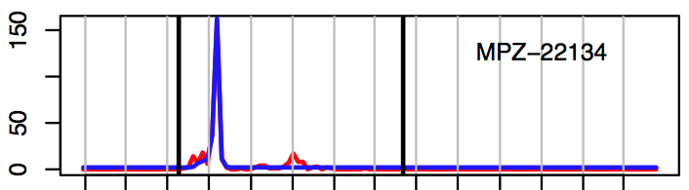
Some of the profiles are quite unique, such as the Marine training base at Quantico, VA.
Parameter | Model A | Model B
T₀ (week) | 23.8 | 27.4
R₀ | 3.61 | 3.02
t₁ (week) | 0
Δt (week) | 3.89
R* | 1.2

Slide 41
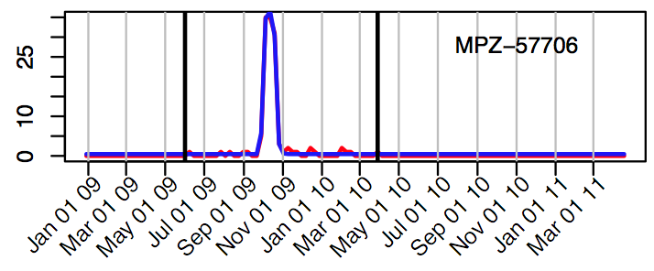
Other ‘outlier’ events are also fit well by the seven-parameter model, where a smaller R0 captures the leading and trailing portion of the profile, such as Ellsworth AFB, SD.
Parameter | Model A | Model B
T₀ (week) | 38.5 | 39.4
R₀ | 1.86 | 1.70
t₁ (week) | 2.58
Δt (week) | 1.18
R* | 4.44

Slide 42
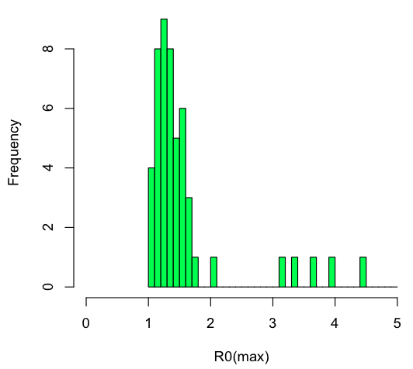
The model fits produced R0 values that are clustered about a median value that matches results that were estimated in civilian populations
Median R₀(max) = 1.35
Mean R₀(max) = 1.59
Standard deviation = 0.76

Slide 43
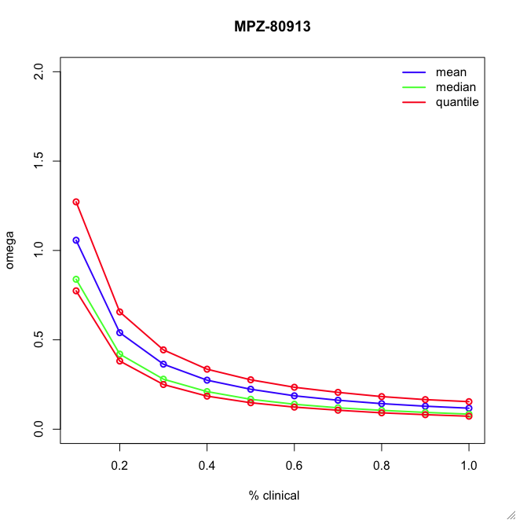
To avoid Neff, we need independent estimate for total number of active personnel – cannot determine from model fits

Slide 44
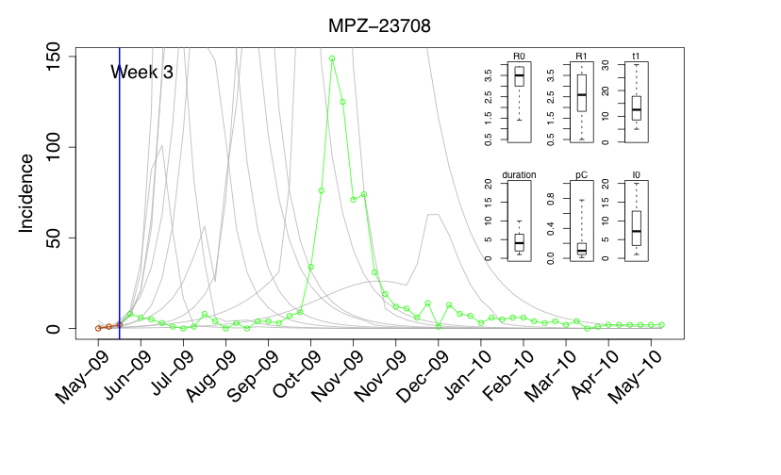
Estimation of Severity for 2009 Pandemic

Slide 45
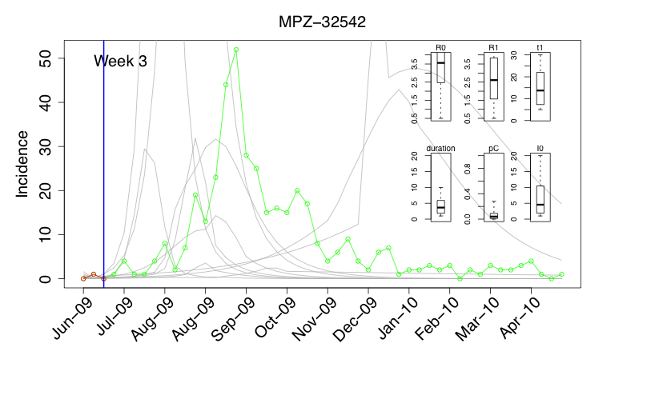
Estimation of Severity for 2009 Pandemic

Slide 46
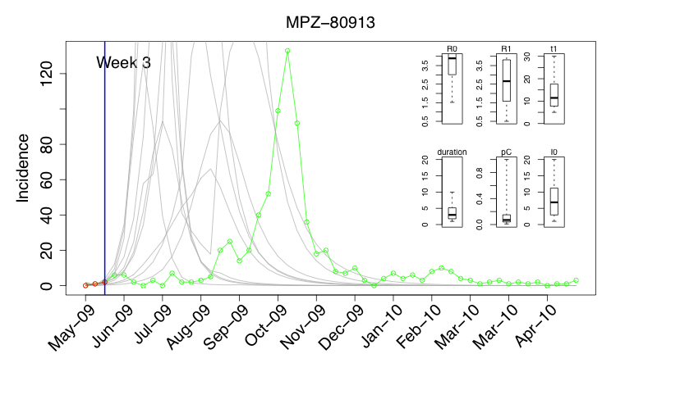
Estimation of Severity for 2009 Pandemic

Slide 47
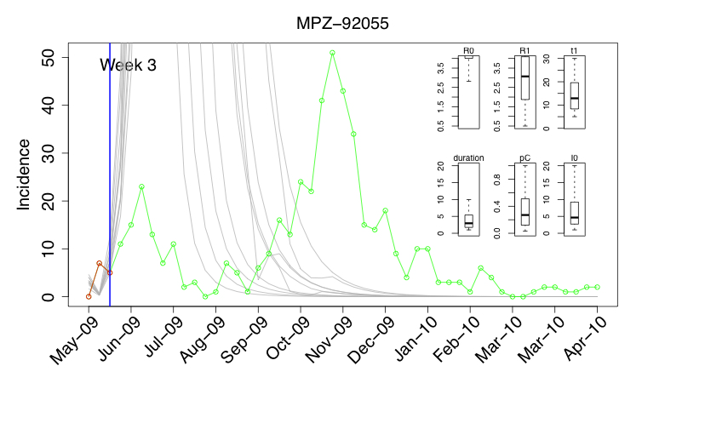
Estimation of Severity for 2009 Pandemic

Slide 48
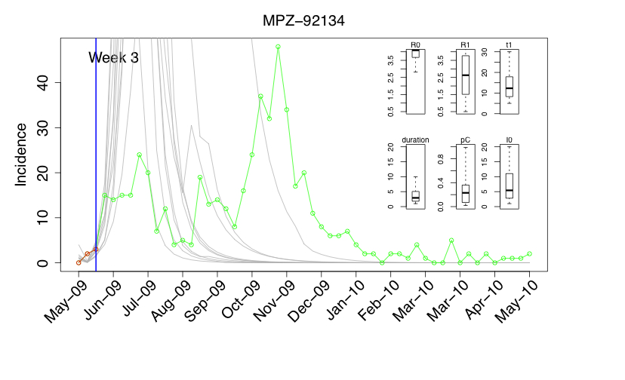
Estimation of Severity for 2009 Pandemic

Slide 49
Overview
Background
Spatial patterns in military populations
Properties of the 2009 pandemic at military installations
Simulating possible future pandemics
Future work
Notes:
Scientific intro
Description of data - patterns seen
Estimating properties of 09 pandemic
Simulation of possible future pandemics
Future work

Slide 50
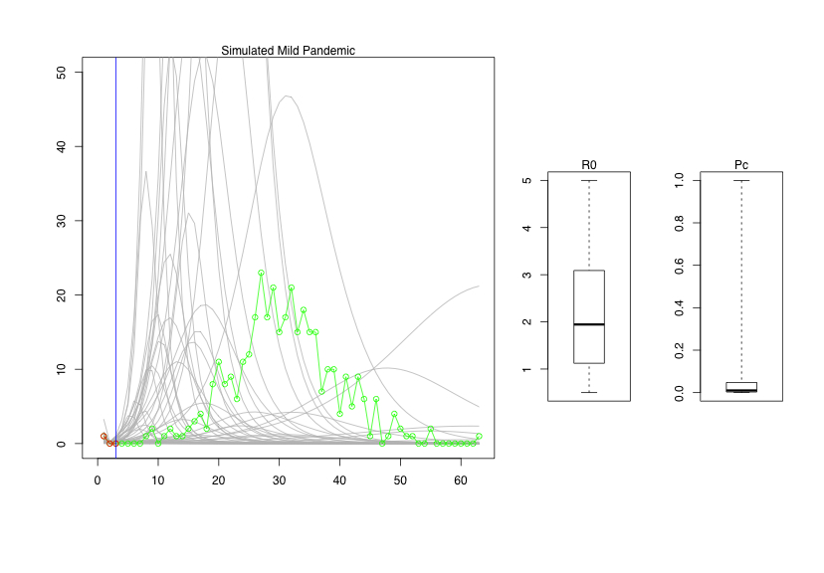
Estimation of Severity for a Simulated Mild Pandemic

Slide 51
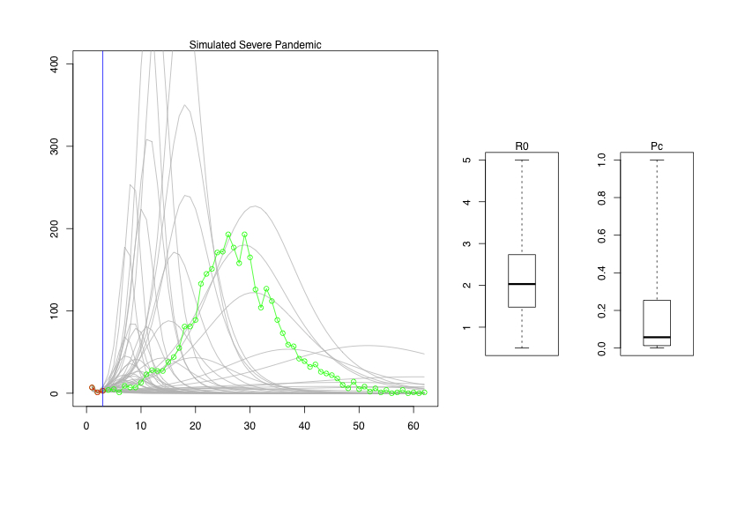
Estimation of Severity for a Simulated Severe Pandemic

Slide 52
Simulations – where we plan to go from here
Apply same analysis to seasonal influenza for 2010-2011 season
How could model help with H5 and the H3N2 variant?
With the inferences from the fits, we can make predictions
We do need the denominator data

Slide 53
Overview
Background
Spatial patterns in military populations
Properties of the 2009 pandemic at military installations
Simulating possible future pandemics
Future work
Notes:
Scientific intro
Description of data - patterns seen
Estimating properties of 09 pandemic
Simulation of possible future pandemics
Future work

Slide 54
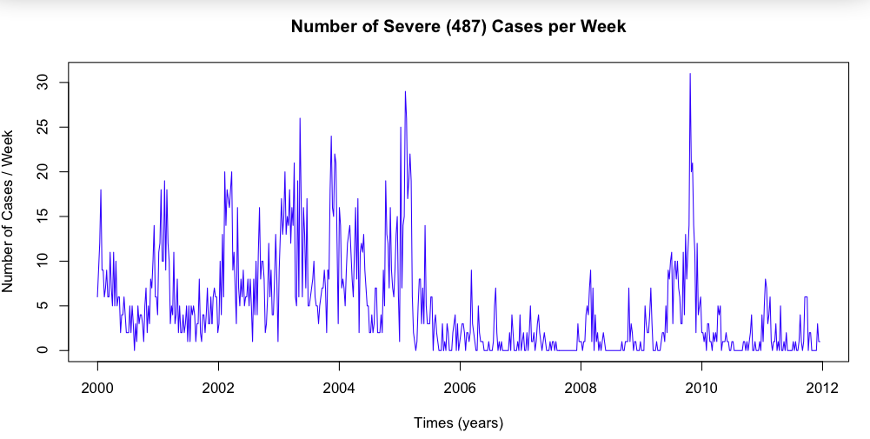
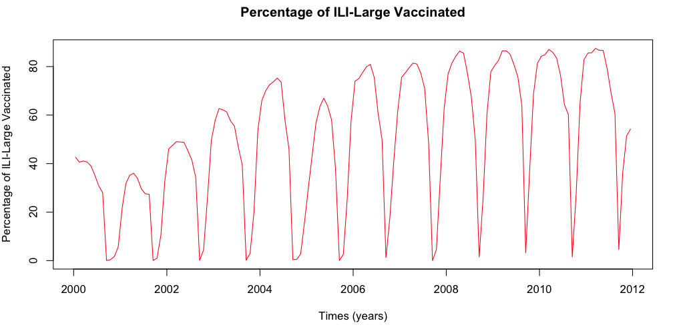
Miscellaneous Points: Drop in severe cases in 2005 can be explained by increased vaccinations

Slide 55
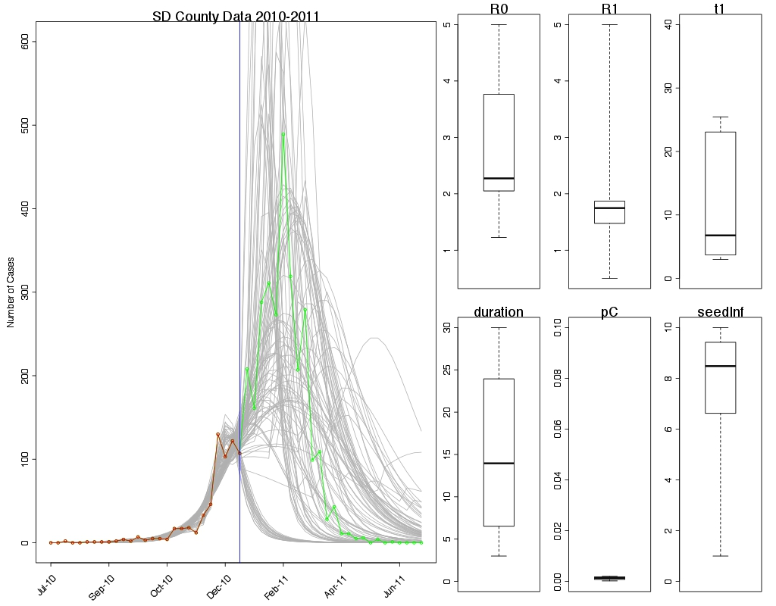
Miscellaneous Points: Real-time testing with civilian data proving to be illuminating…

Slide 56
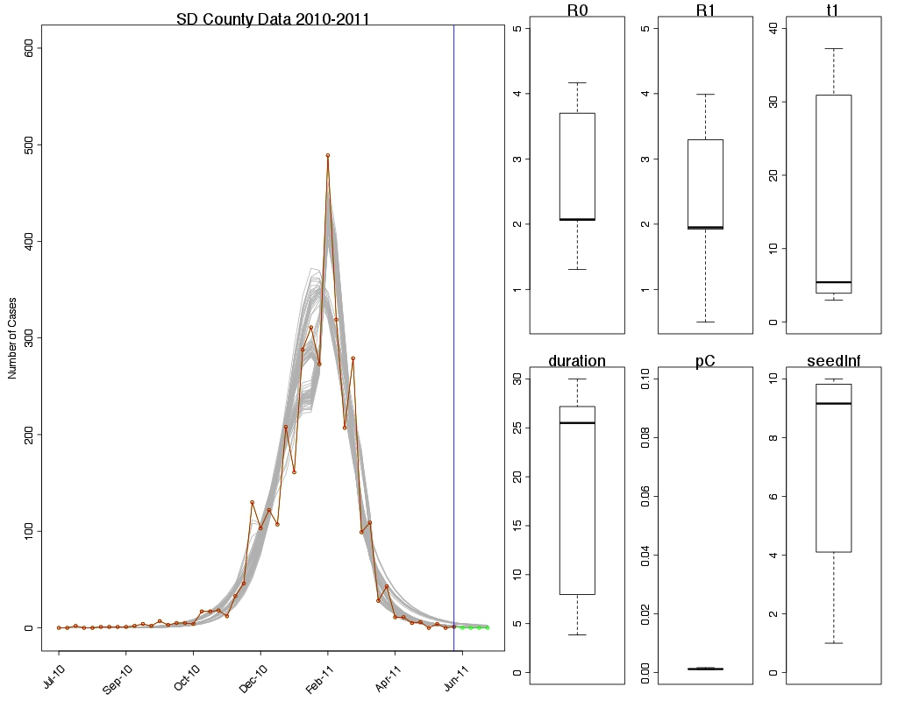
Miscellaneous Points: Real-time testing with civilian data proving to be illuminating…

Slide 57
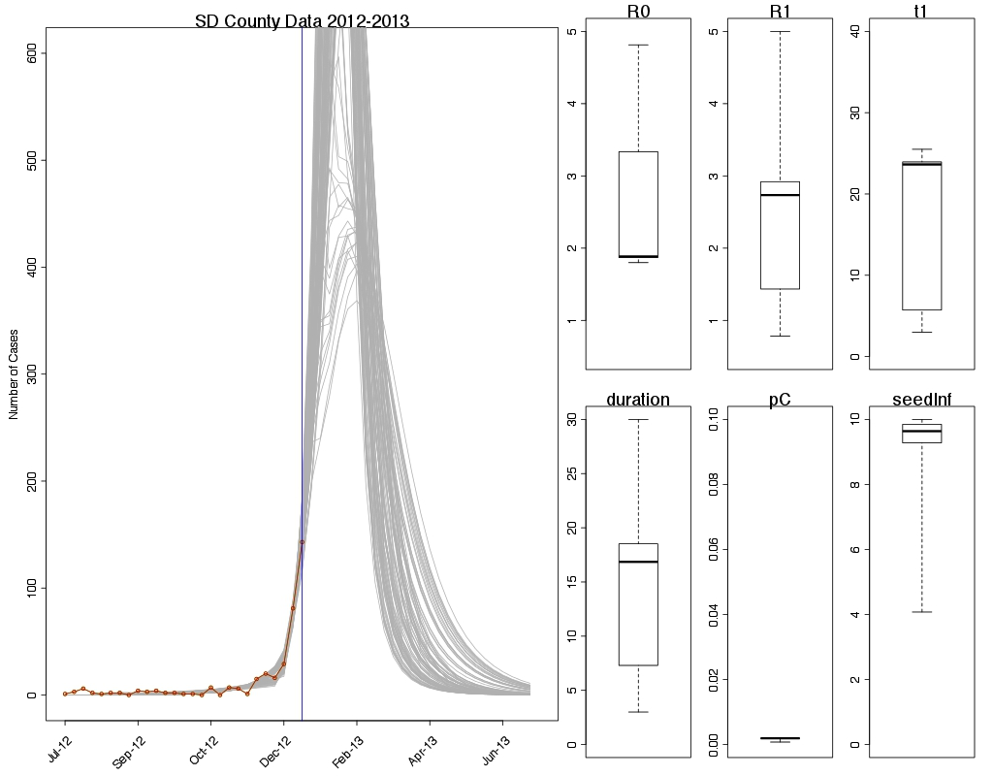
Miscellaneous Points: Real-time testing with civilian data proving to be illuminating…

Slide 58
Miscellaneous Points: Can analyze seasons for over last decade…

Slide 59
Miscellaneous Points: Can analyze seasons for over last decade…

Slide 60
Miscellaneous Points: Severity by age for last 10 influenza epidemics

Slide 61
Miscellaneous Points: Introduce age-structured analysis

Slide 62
Miscellaneous Points: Introduce age-structured analysis – Severity by Age

Slide 63
Summary
Analysis of AFHSC’s DMSS data has yielded genuine insight into the transmission dynamics at, and between military bases;
The synchronicity between military and civilian populations suggests that either:
1. DMSS data could act as sentinels for both the military and civilian population; or
2. Civilian datasets could be used as sentinels for estimating transmission dynamics within the military
Parsimonious modeling of the military bases yields reasonable estimates for R0 and other important parameters;
Simulation studies can be used to develop forecasting capabilities based on the results presented here;
These analysis and similar could be run routinely during pandemic and non-pandemic influenza seasons

Slide 64
Unused slides

Slide 65
Understanding transmission dynamics of infectious diseases within the military population presents a number of unique issues.

Slide 66
The earlier (summer) wave of the 2009 H1N1 pandemic was more severe than the fall wave.

Slide 67
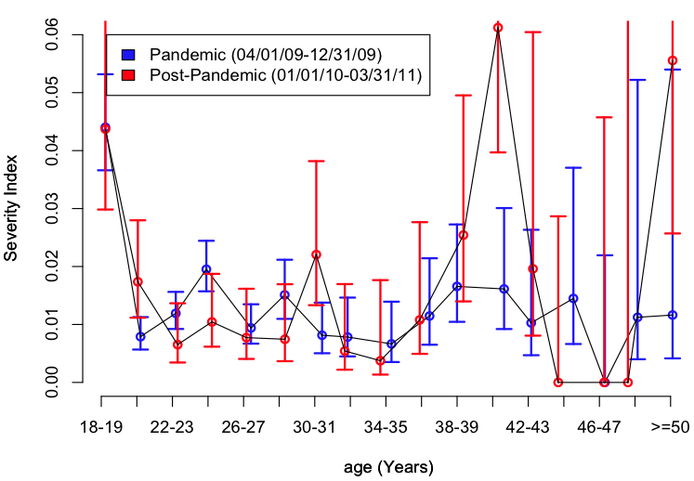
A disproportionate number of younger people were affected both during the 2009 influenza pandemic and the following seasonal epidemic.

Slide 68
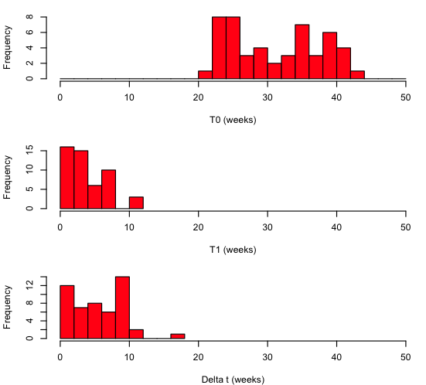
The model fits provide temporal information on the: (1) time of first infection; (2) point in time when R₀ changed; and (3) duration over which R₀ was modified.

Slide 69
What if this was the only information we had?

Slide 70
Even with several bases reporting outbreaks, our confidence in predicting the ultimate outcome would be poor.

Slide 71
Once the initial bases had peaked, however, we would be able to predict both the total number of cases and estimate a severity index for all subsequent bases.

Slide 72
AFHSC’s DMSS dataset provides a large, rich, unique, and reliable estimate of clinically reported cases tagged by ICD-9 codes.

Slide 73
How do we define a “military population?”
For estimating the location of Study ID’s, the DMSS dataset provides:
Service Category (e.g., Army)
Zip3 of Unit (e.g., 921)
UIC (e.g., FFNHS)
DMISID CAT (e.g., HOLLOMAN AFB)
DMISID (e.g., 356) -> Zip5 (e.g., 92134)
=> Military Population Zip (MPZ): Location of individual at time they presented to the clinic.

