Slide 1
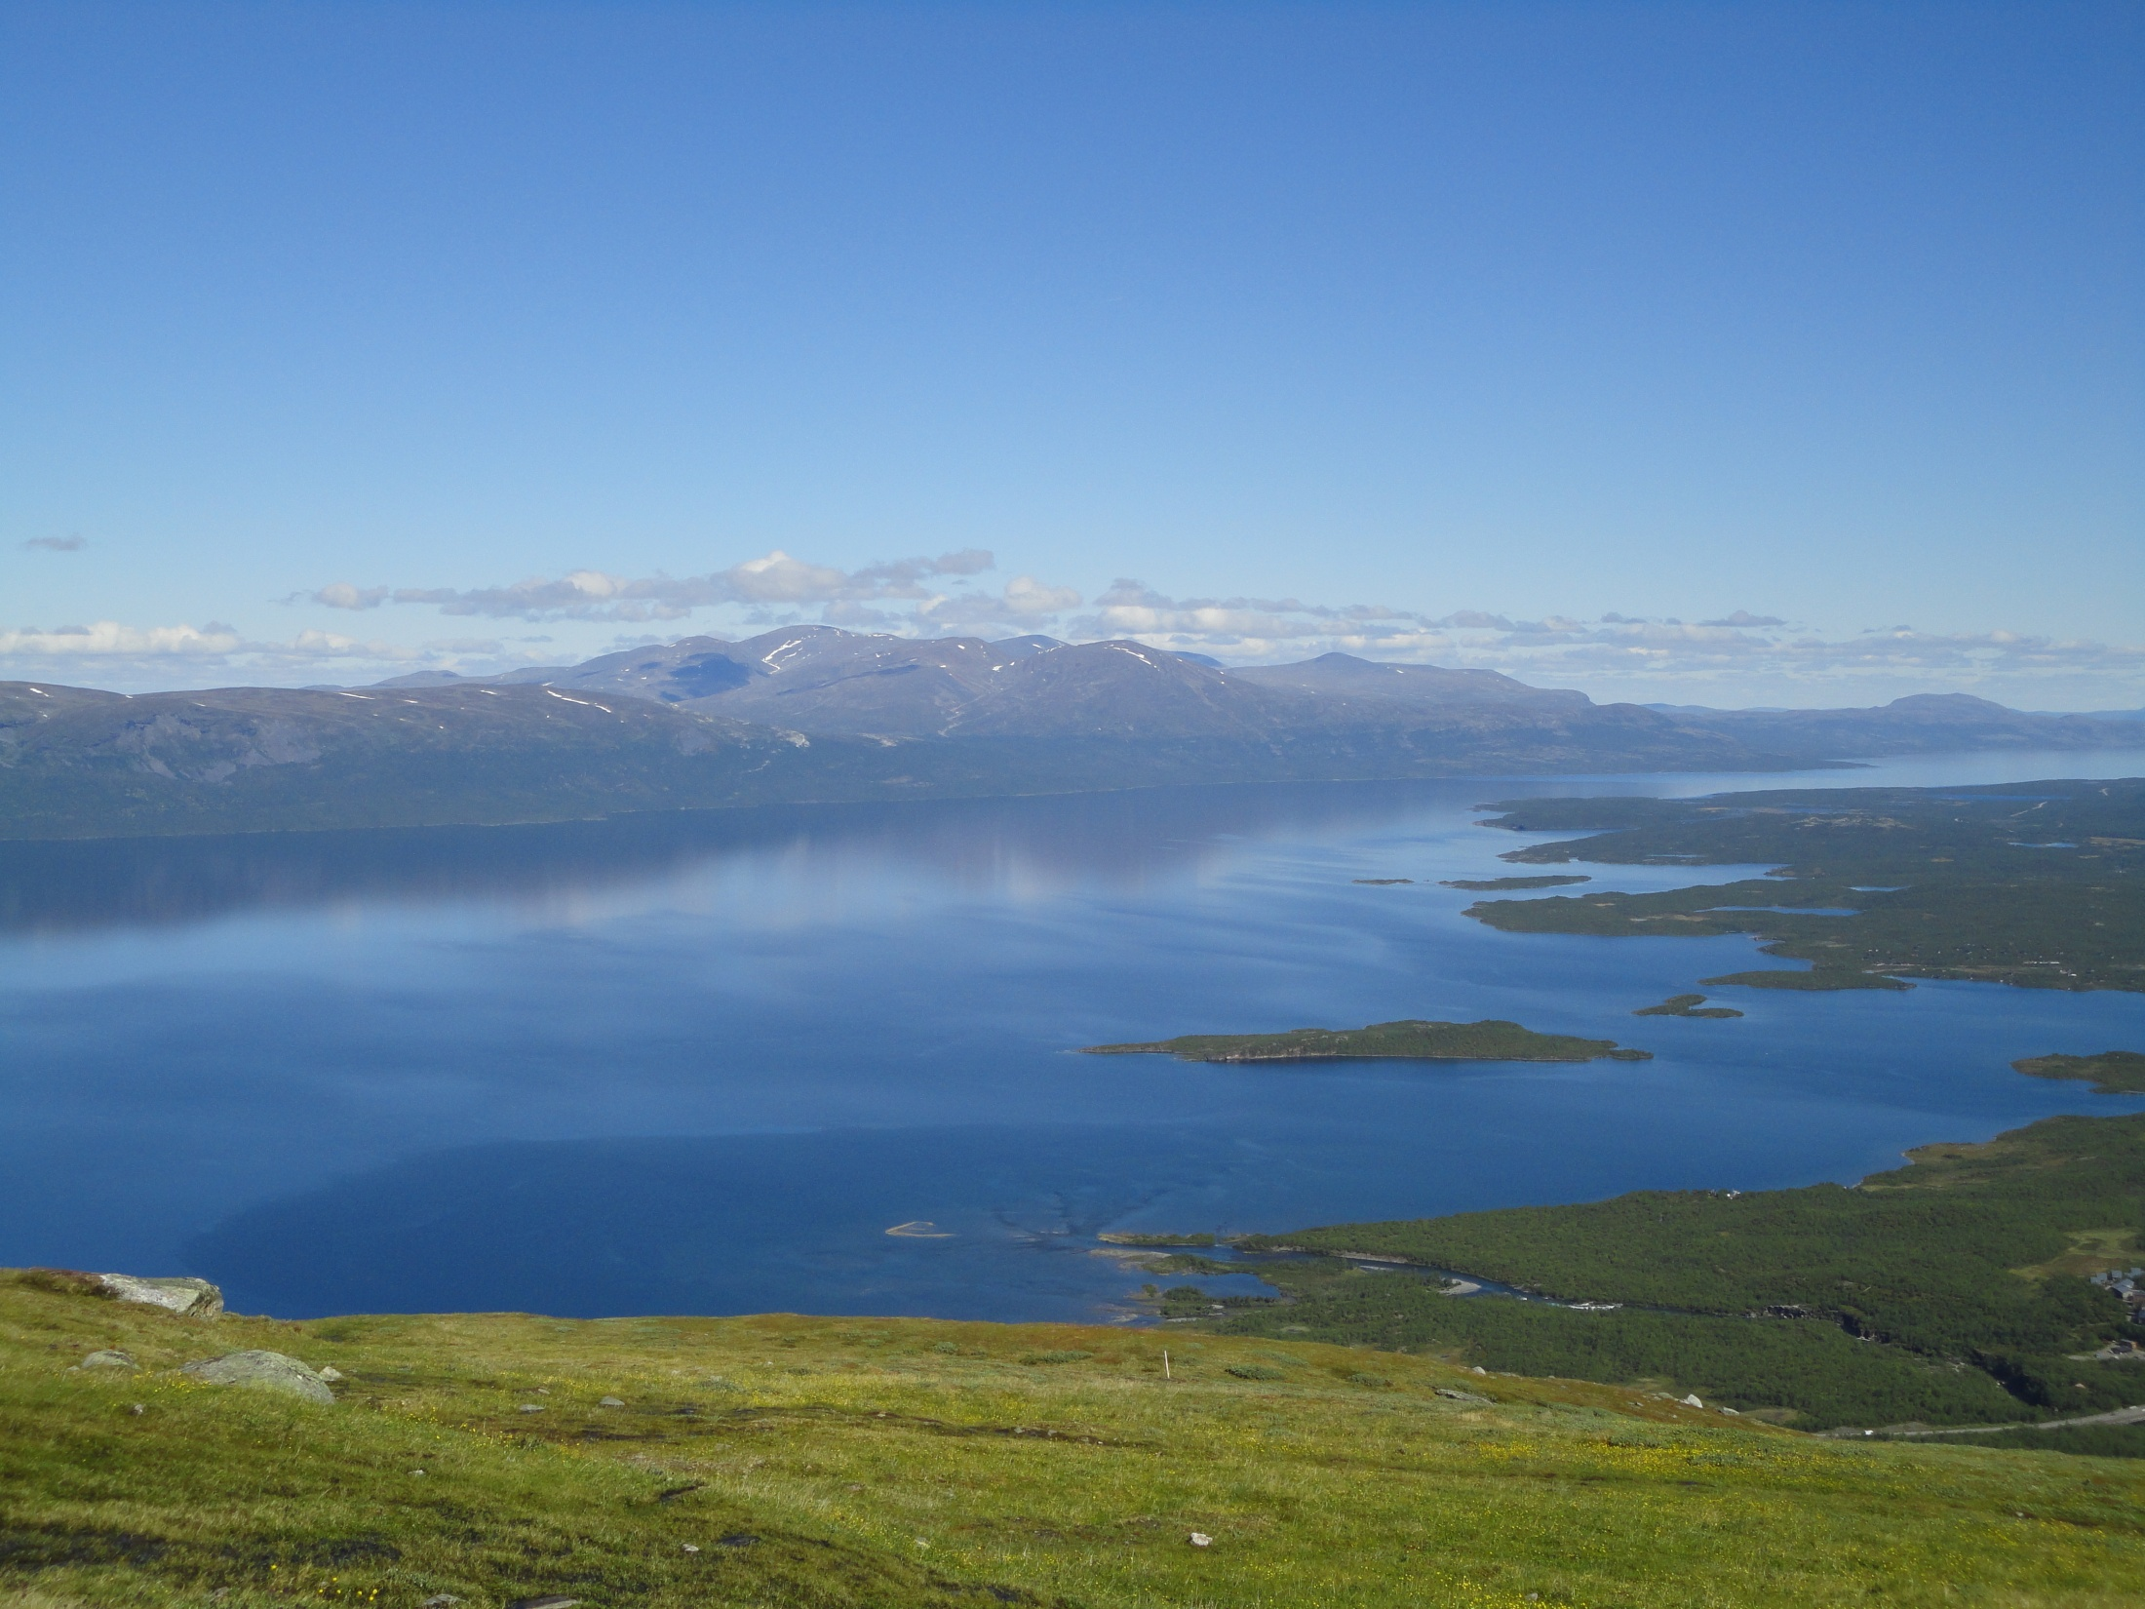
Graduate Students in S2I
Ruth Varner
Research Associate Professor
Institute for the Study of Earth, Oceans and Space and Department of Earth Sciences

Slide 2
Center for Excellence in Geosciences Education
Funded by UNH (May 2011) to:
“bring active geosciences researchers/faculty, education researchers/faculty, and outreach practitioners together to continuously evaluate, develop and administer geosciences education”
Values: Inquiry, authentic experiences and integration of science and education

Slide 3
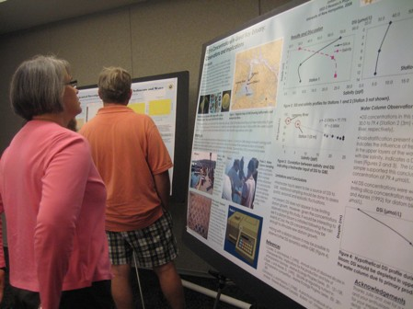
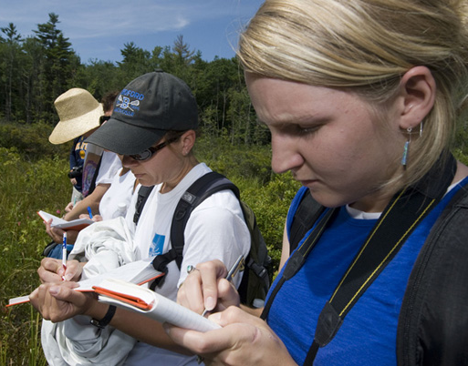
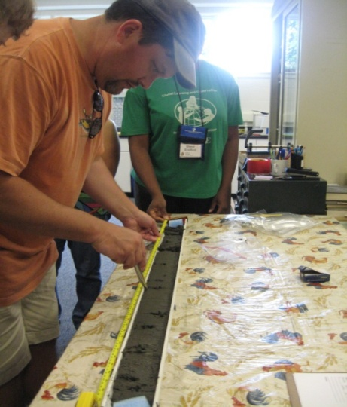
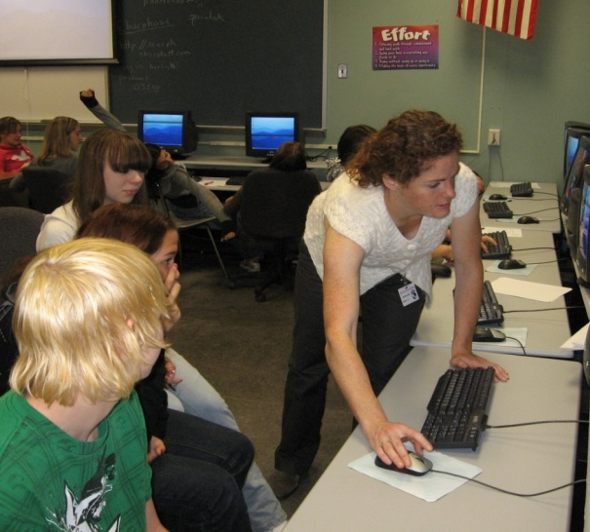
S2I and CEGE
NSF funded programs as a model for graduate student professional development: TESSE and PROBE (GK-12)
Building graduate students’ ability to communicate with the public via partnerships with high school teachers and their students

Slide 4
PROBE (GK-12)
Graduate Fellows from a variety of STEM disciplines
TESSE
Graduate Fellows selected from specific Earth System Science disciplines
Combined Summer Institute for teachers and Graduate Fellows (intensive relationship building) and academic year partnership (extended contact time)
Graduate Fellows partner with teachers to develop inquiry-rich curricula and lesson plans
Graduate Fellow Peer Learning Communities facilitated by a science educator/specialist
Summer Institute lengthened and content specific
Inquiry tied to modeled activities related to content during Summer Institute
Frequency of meetings increased, with additional focus on basic educational theory and classroom techniques

Slide 5
S2I Graduate Professional Development
Graduate Fellows are linked to a specific interdisciplinary research program
Summer Institute will include teachers exposure to labs/research of the Graduate Fellows’
Classroom inquiry/content tied to Graduate Fellows’ research
Graduate Fellows will participate in a program exploring the basic educational theory, classroom techniques and building communication skills

Slide 6
S2I Education thoughts:
Graduate students – recruitment of students with interdisciplinary interests
Summer Institute (2 weeks)
  Recruit high school teachers (physics, math, Earth science)
  Focus content on Sun-Earth system concepts
  Time for teachers to get into the lab/research
  Note that teachers are not prepared to teach current concepts and controversies
  What to do when scientists don’t agree?
Remember that these teachers are scientists – engaging them to bring this information to their classrooms
What are core skills and knowledge that we as a scientific community think are important for our students to have?

