Slide 1
Science Overview – S2I
N. Schwadron

Slide 2
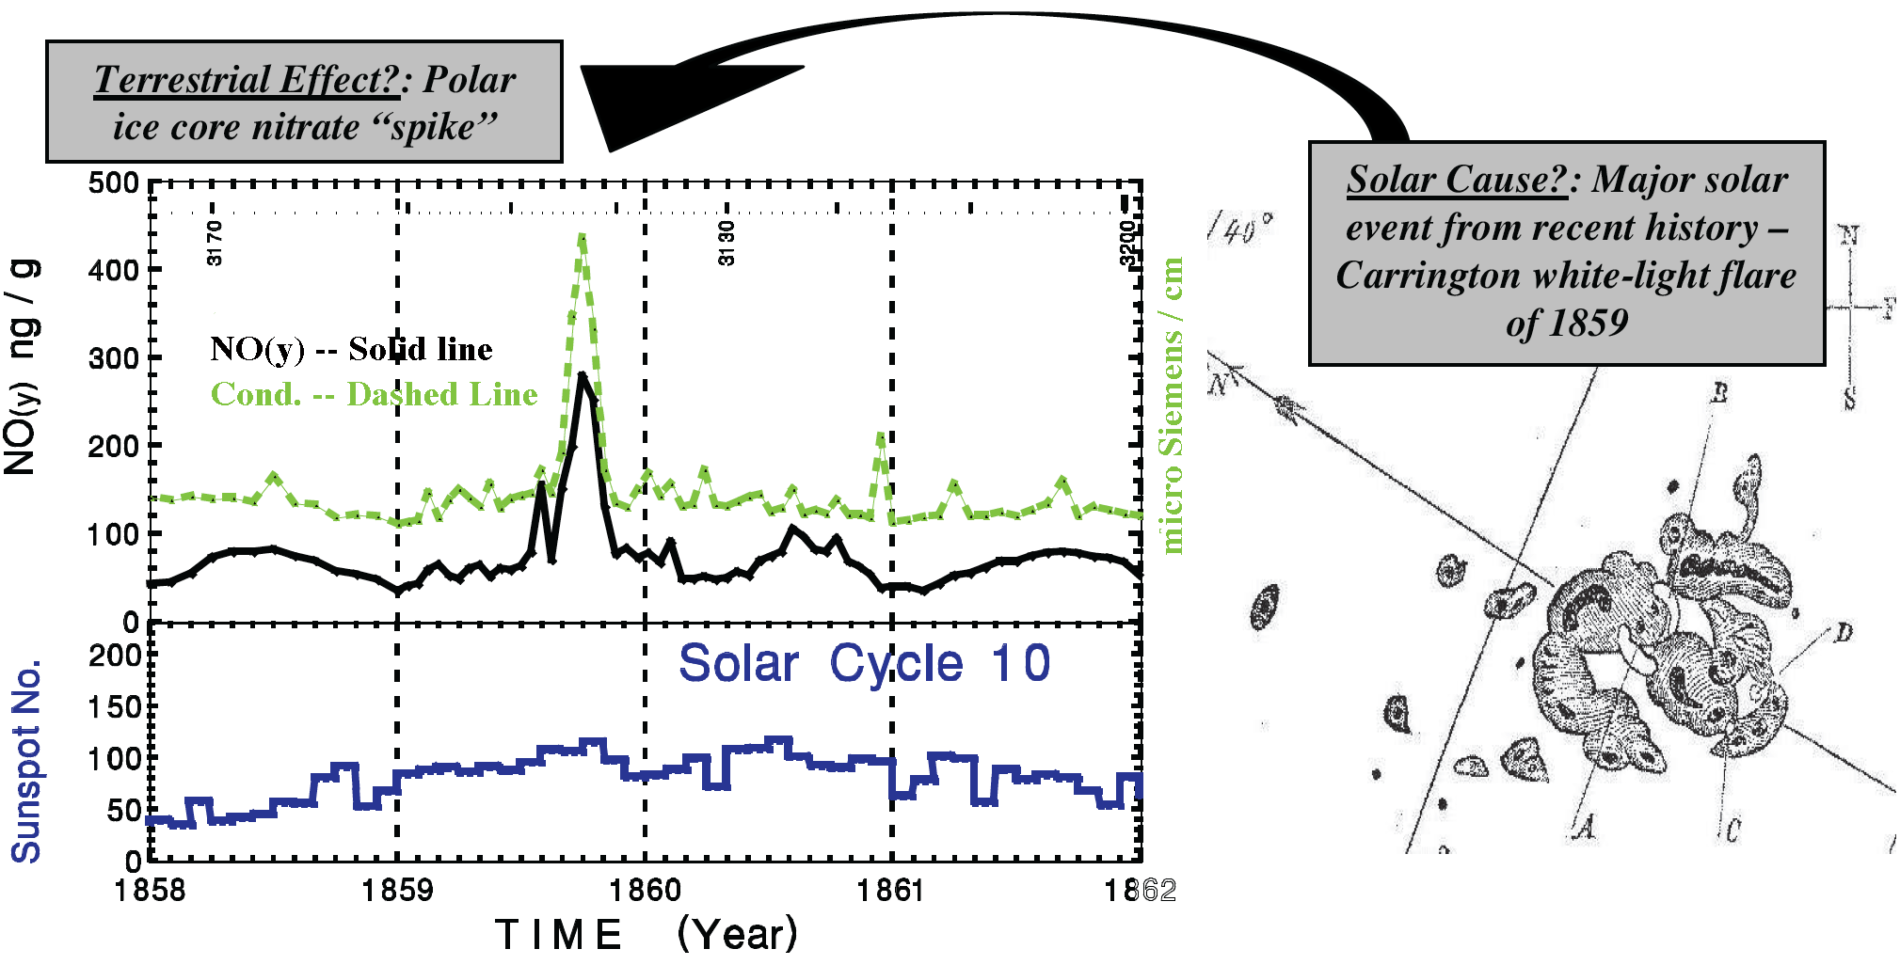
Motivation: Terrestrial Effects of Extreme Events

Slide 3
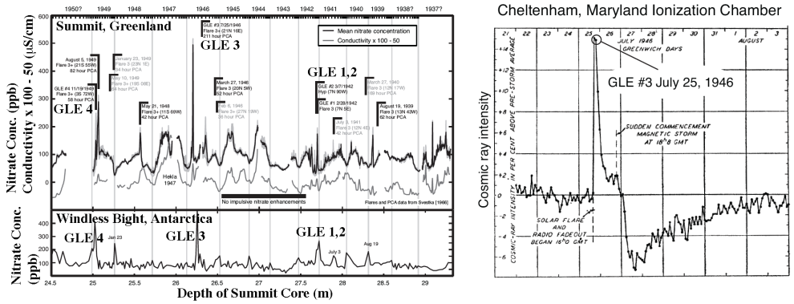
Ice Core Record – GLE Effects
Revisiting the Ice-Core Record
  Is the timing accurate?
  Do similar features exist at other stations
  What are the coincident effects needed to create these enhancements??

Slide 4
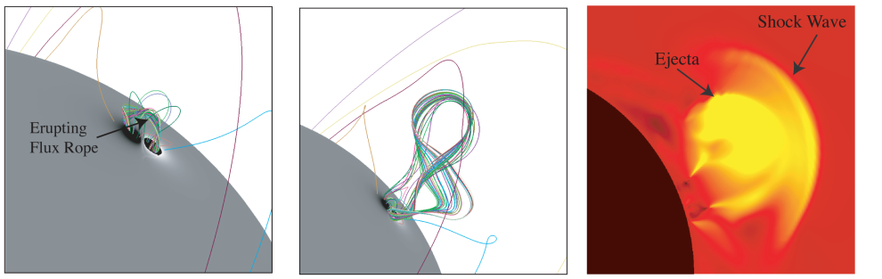
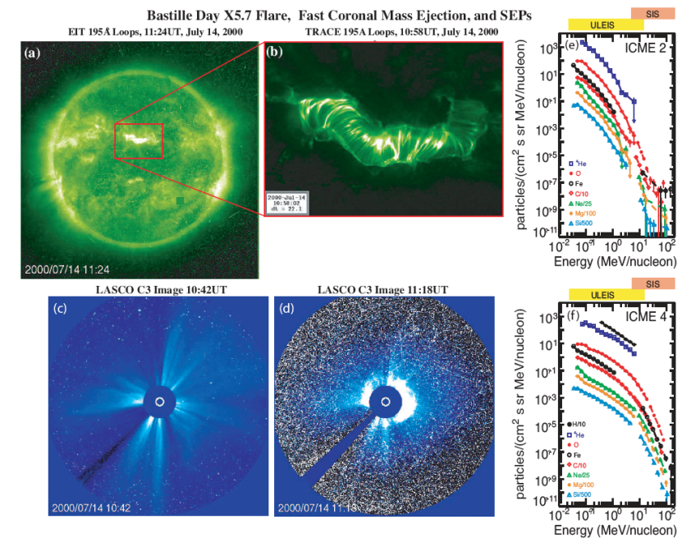
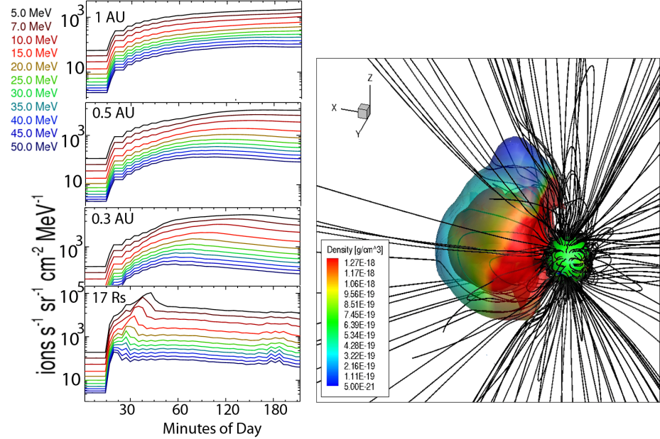
How does the Sun creates Extreme Events?

Slide 5
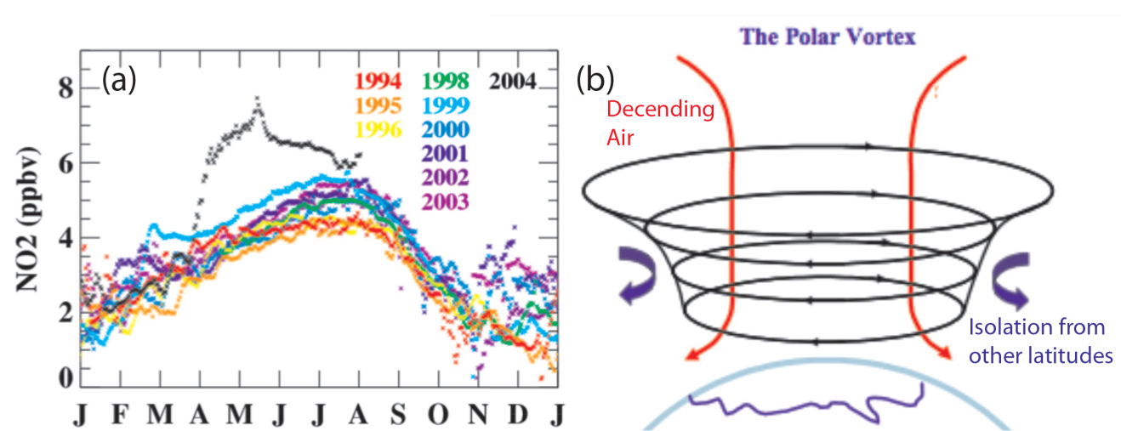
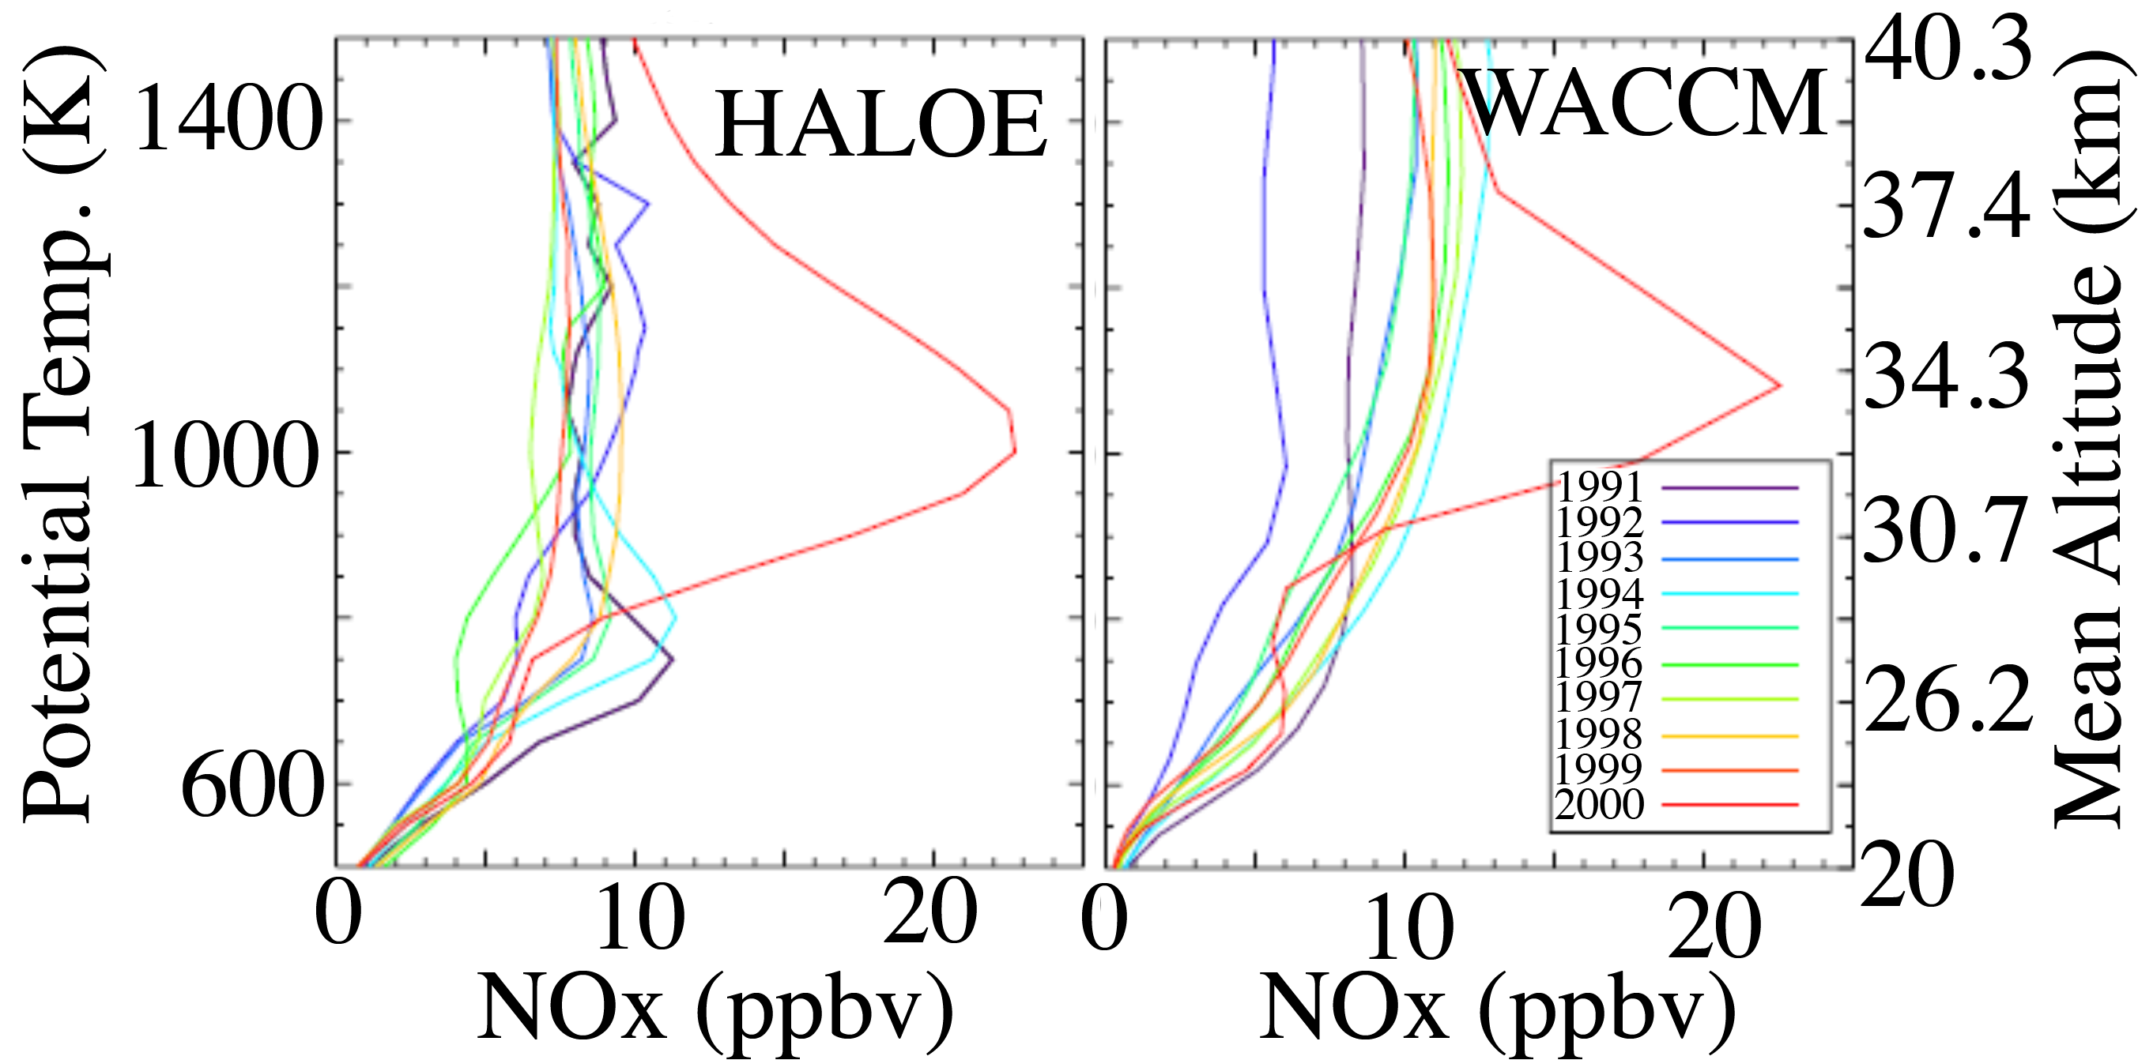
How do polar regions respond to Extreme Events

Slide 6
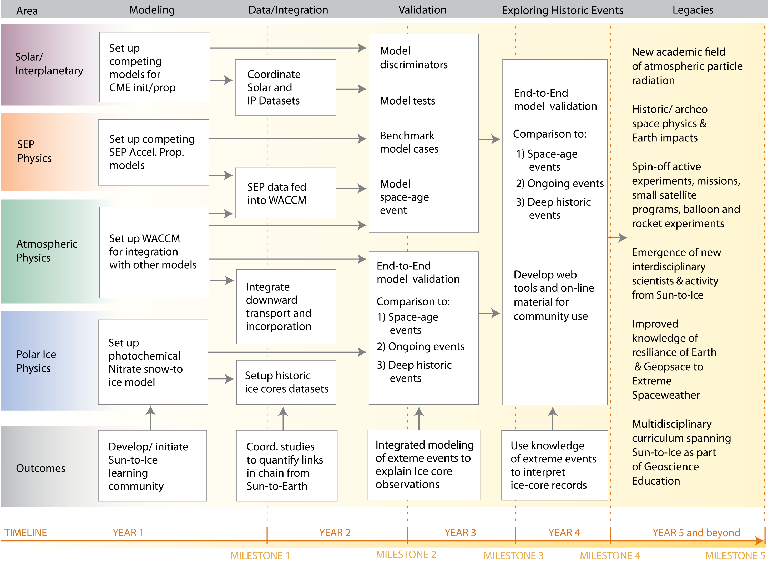

Slide 7
Project Milestones
Milestone 1, model single event throughout Sun-to-Ice system. Model coupling facilitated by simple input-output at this preliminary stage.
Milestone 2, model second event throughout Sun-to-Ice system using an improved framework.
Milestone 3, compare results of model for a space-age event with data-sets from heliophysics and Earth system observations.
Milestone 4, compare results of model for the largest space-age events with existing data-sets from heliophysics and Earth system observations.
Milestone 5, compare results of model for historic events to chemical ice core records.

