Slide 1
The SEP Acceleration and Transport Link of the Chain
J. Giacalone, University of Arizona
Mihir Desai, SWRI
Gang Li, University of Alabama
Nathan Schwadron, UNH
(and others … )
“Sun to Ice” kick-off meeting – Predictive Science Inc., San Diego, Nov 2, 2011

Slide 2
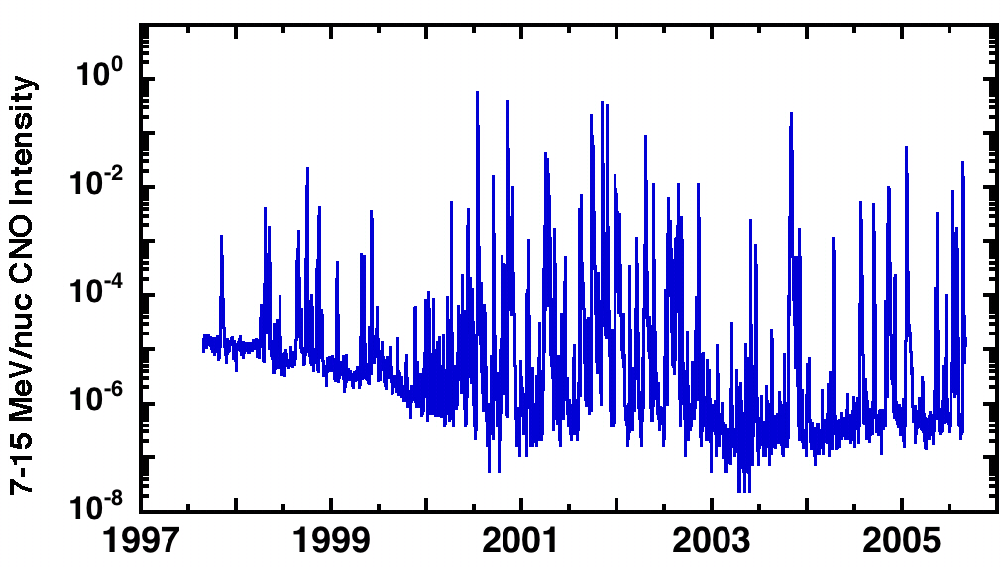
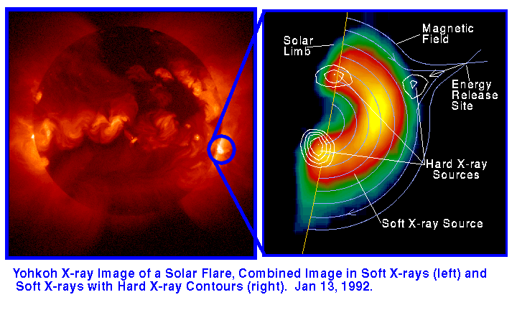
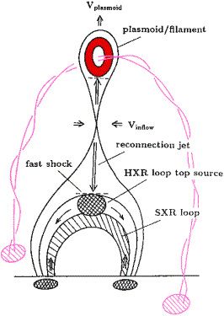
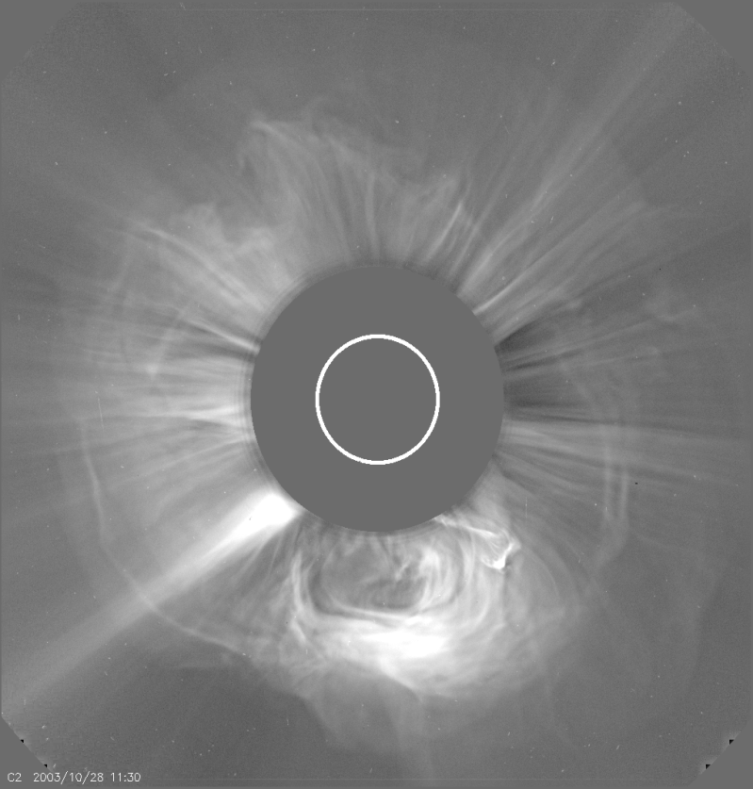
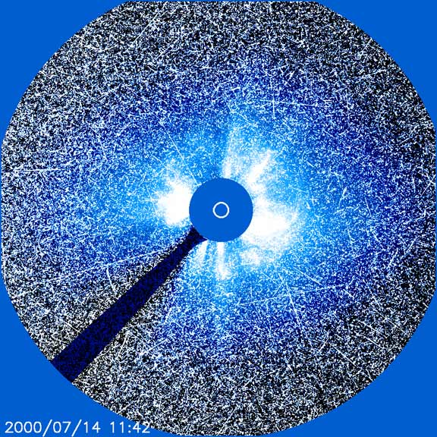
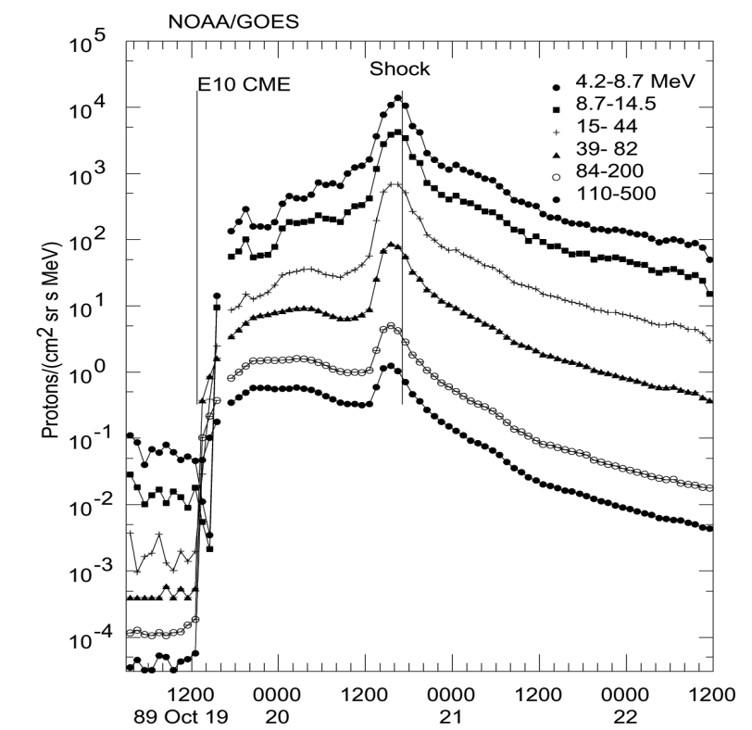
Shock
High-energy SEPs pervade the solar system
Understanding their origin remains one of the most important unsolved problems in heliophysics
Many acceleration mechanisms have been discussed, but acceleration by shocks has received the most attention
Driver
SOHO/LASCO

Slide 3
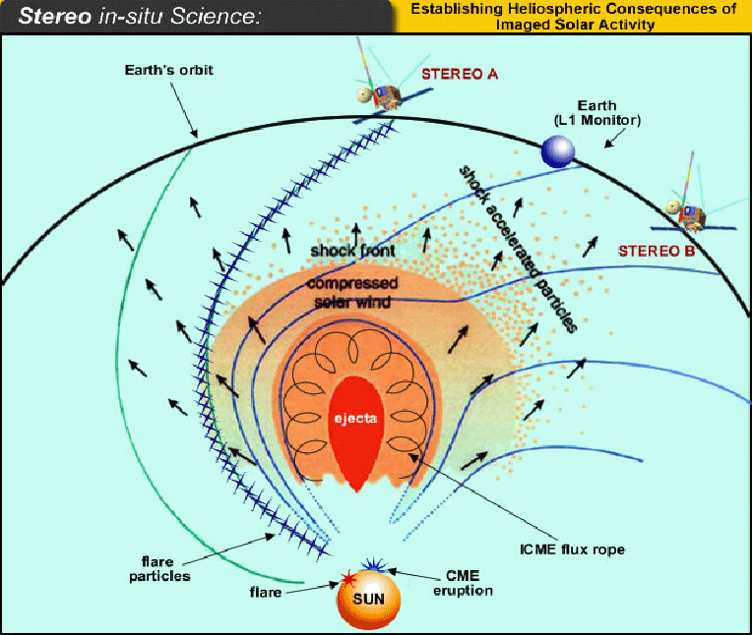

Slide 4
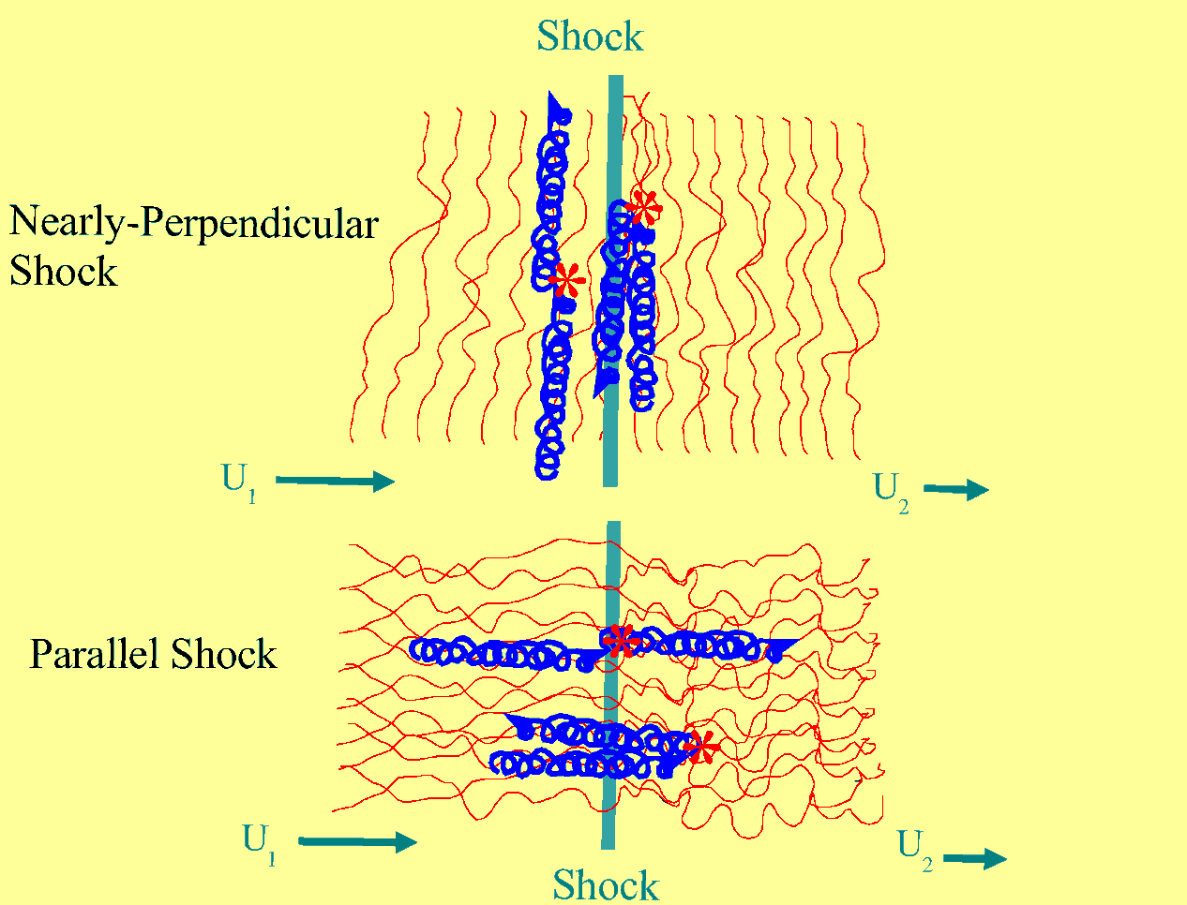
Particle Acceleration at Shocks
Particles gain energy by crossing and re-crossing the shock. The energy gain comes from either the motional electric field, or the wave electric field.
upstream
downsteam
Rapid Acceleration
Slow Acceleration

Slide 5
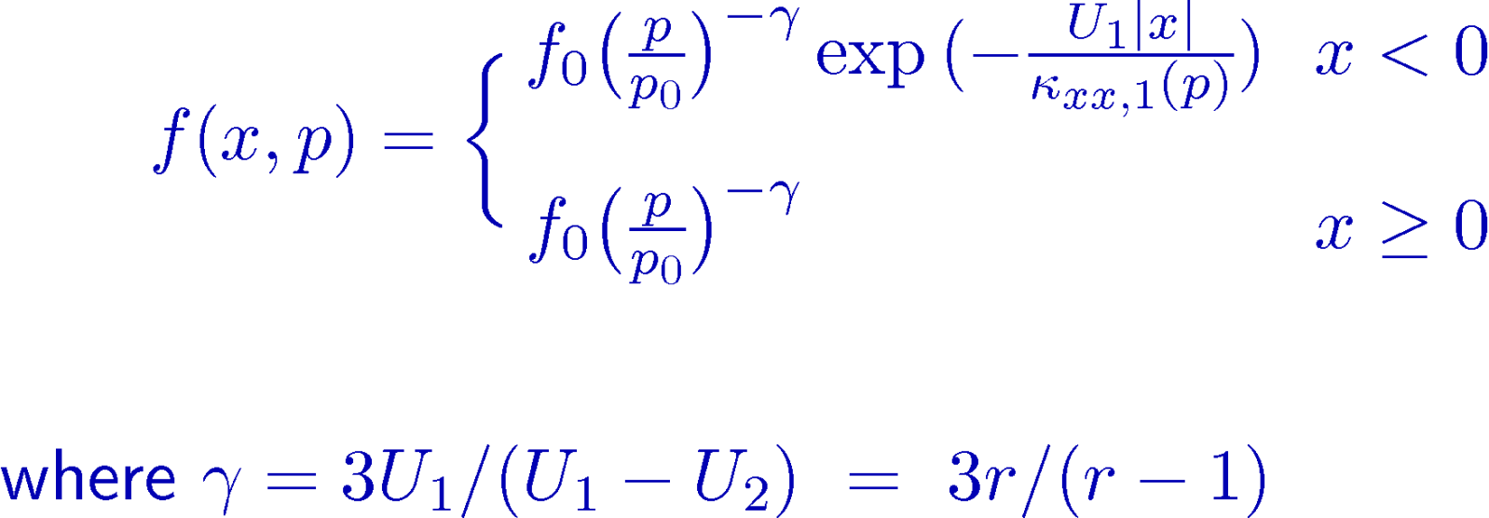
Quantitative predictions of Diffusive Shock Acceleration can be obtained by solving the cosmic-ray transport equation (Parker, 1965)
advection diffusion drift energy change
When applied to a simple, planar shock-like discontinuity, the resulting distribution has the form

Slide 6
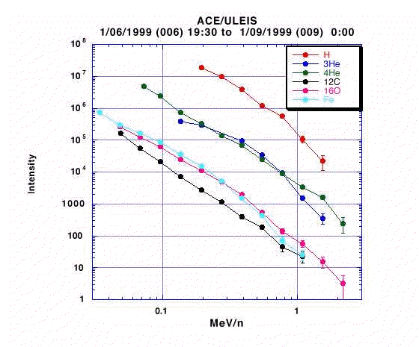
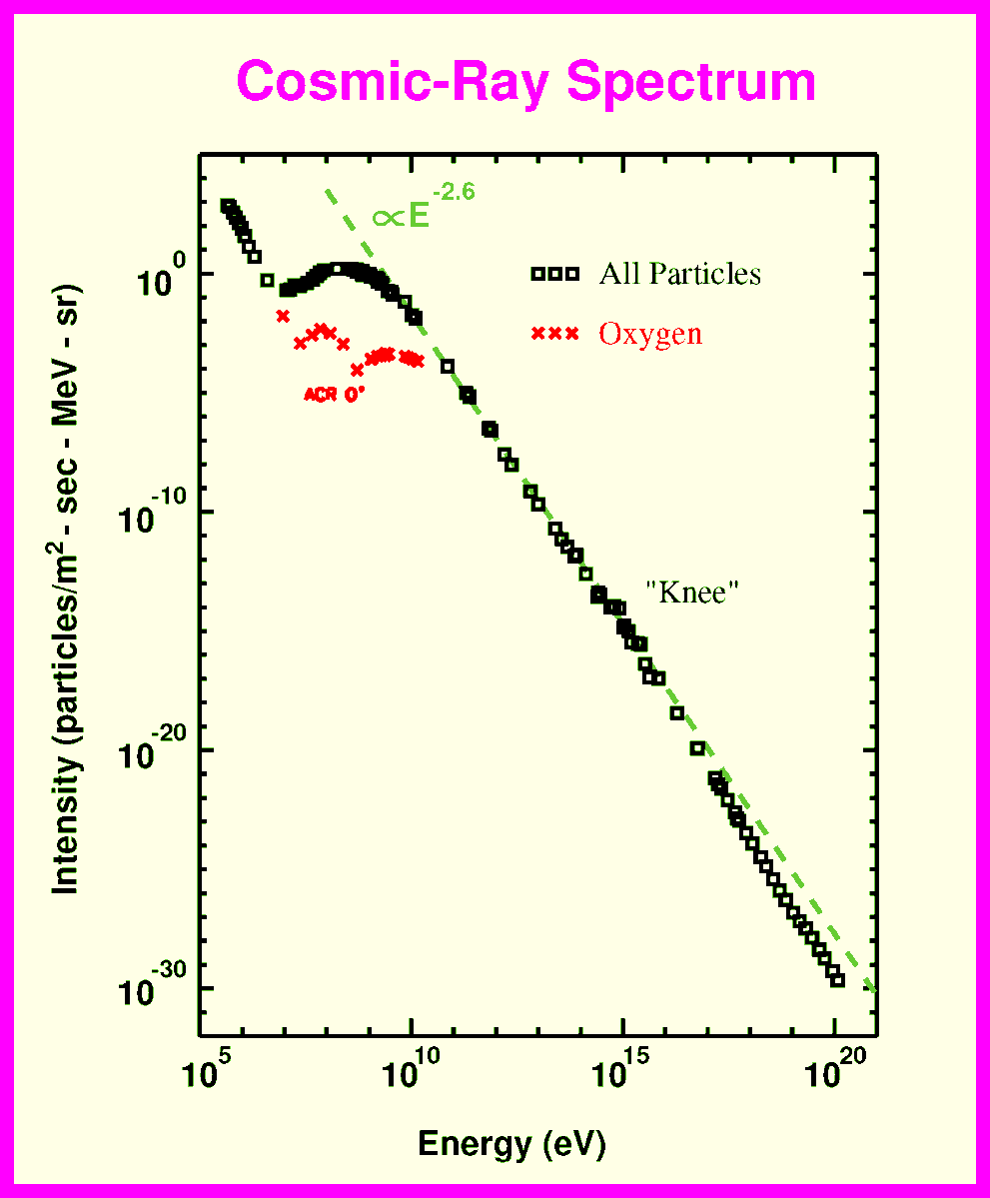
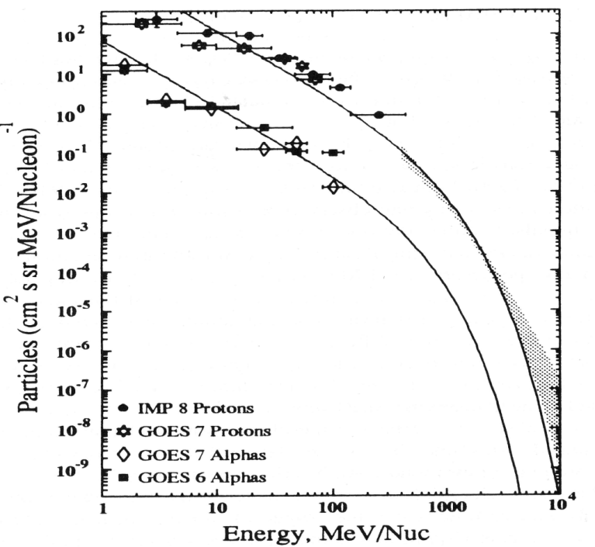
Observed Power-law spectra
Impulsive SEPs
Gradual SEPs

Slide 7
From the first paragraph of the proposal …
“On the morning of 1 Sep 1859, as Richard C. Carrington was observing sunspots on the solar disk, a large and complex active region destabilized, launching an extremely fast Coronal Mass Ejection (CME) toward Earth. …. The ejecta propagated rapidly away from the Sun, generating a fast-mode wave … which … steepened into a fast-mode forward shock. The shock… accelerated suprathermal ions in the ambient solar wind to high energies. “

Slide 8
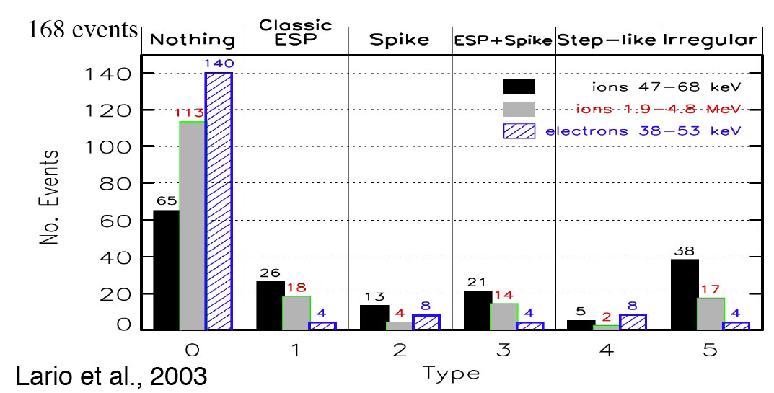
Lario et al. 2003, analyzed many interplanetary shocks and found that many do not have an associated enhancement of energetic particles.

Slide 9
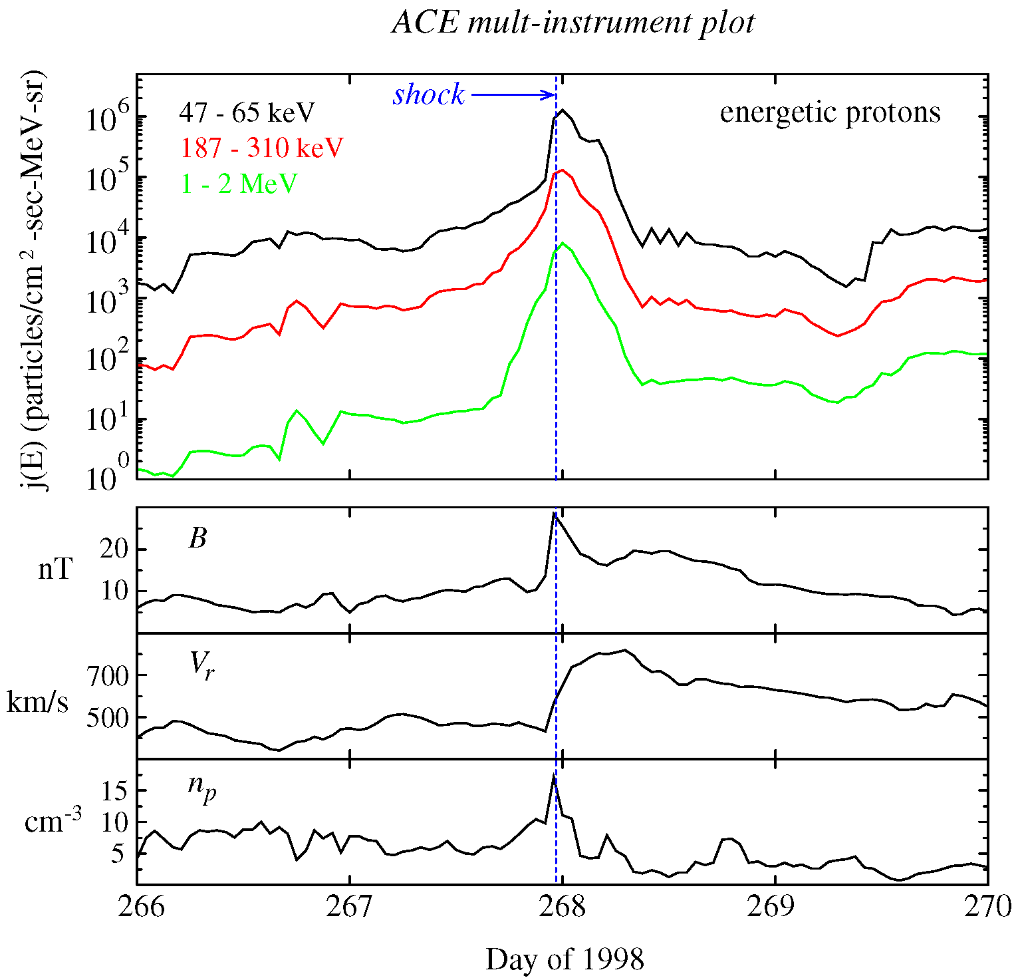
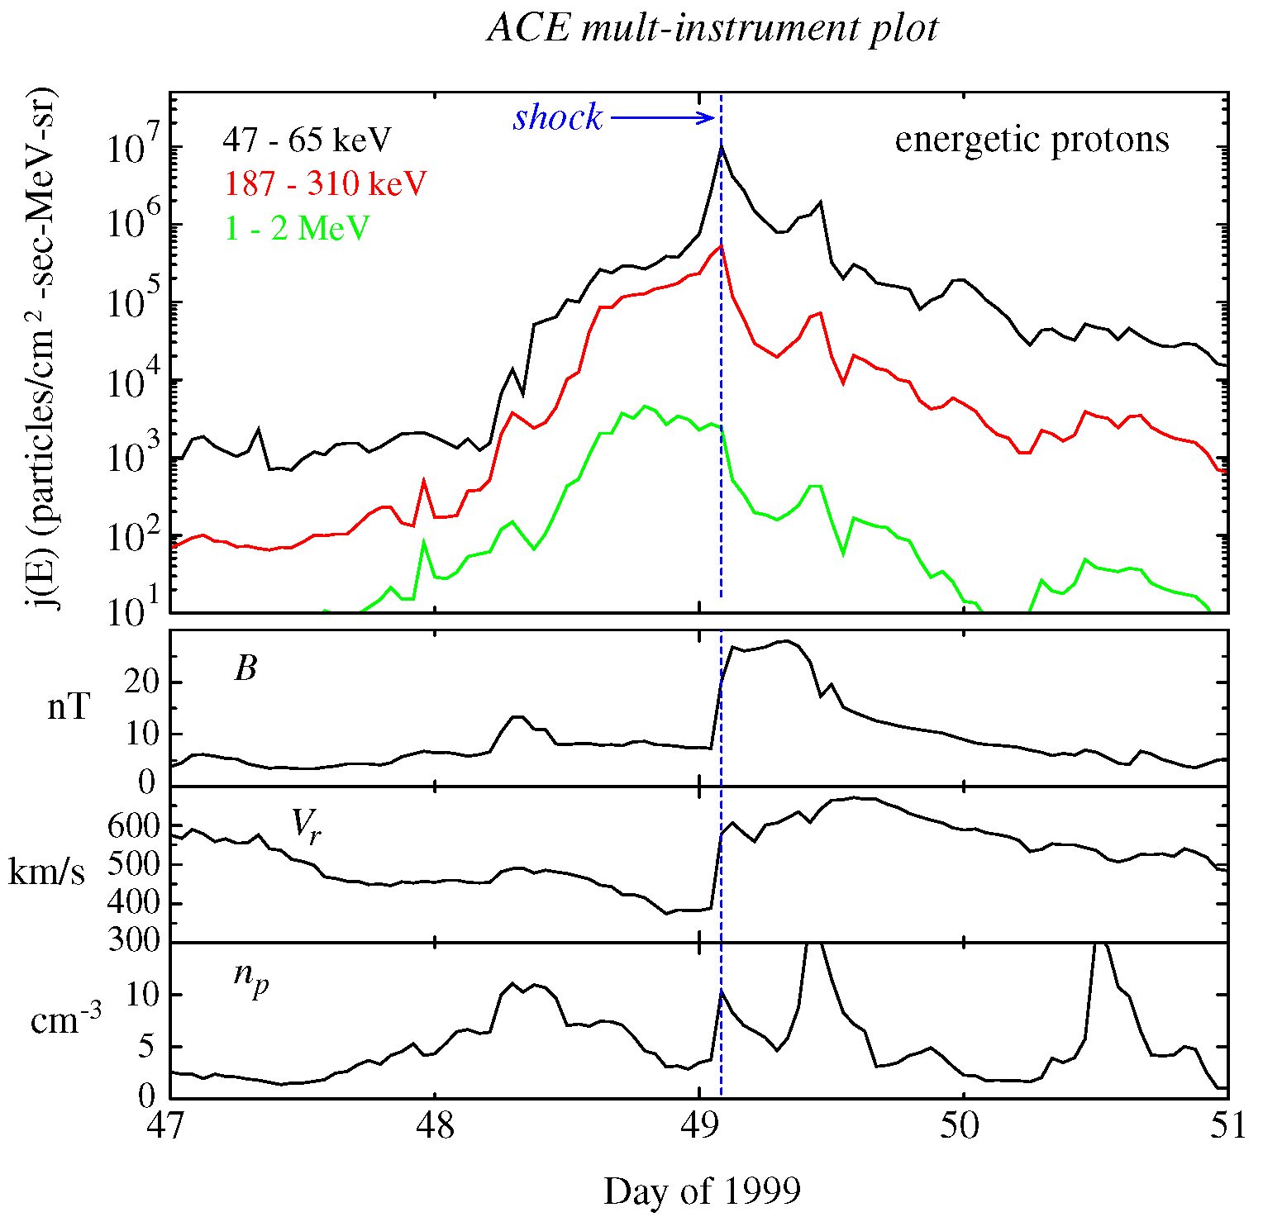
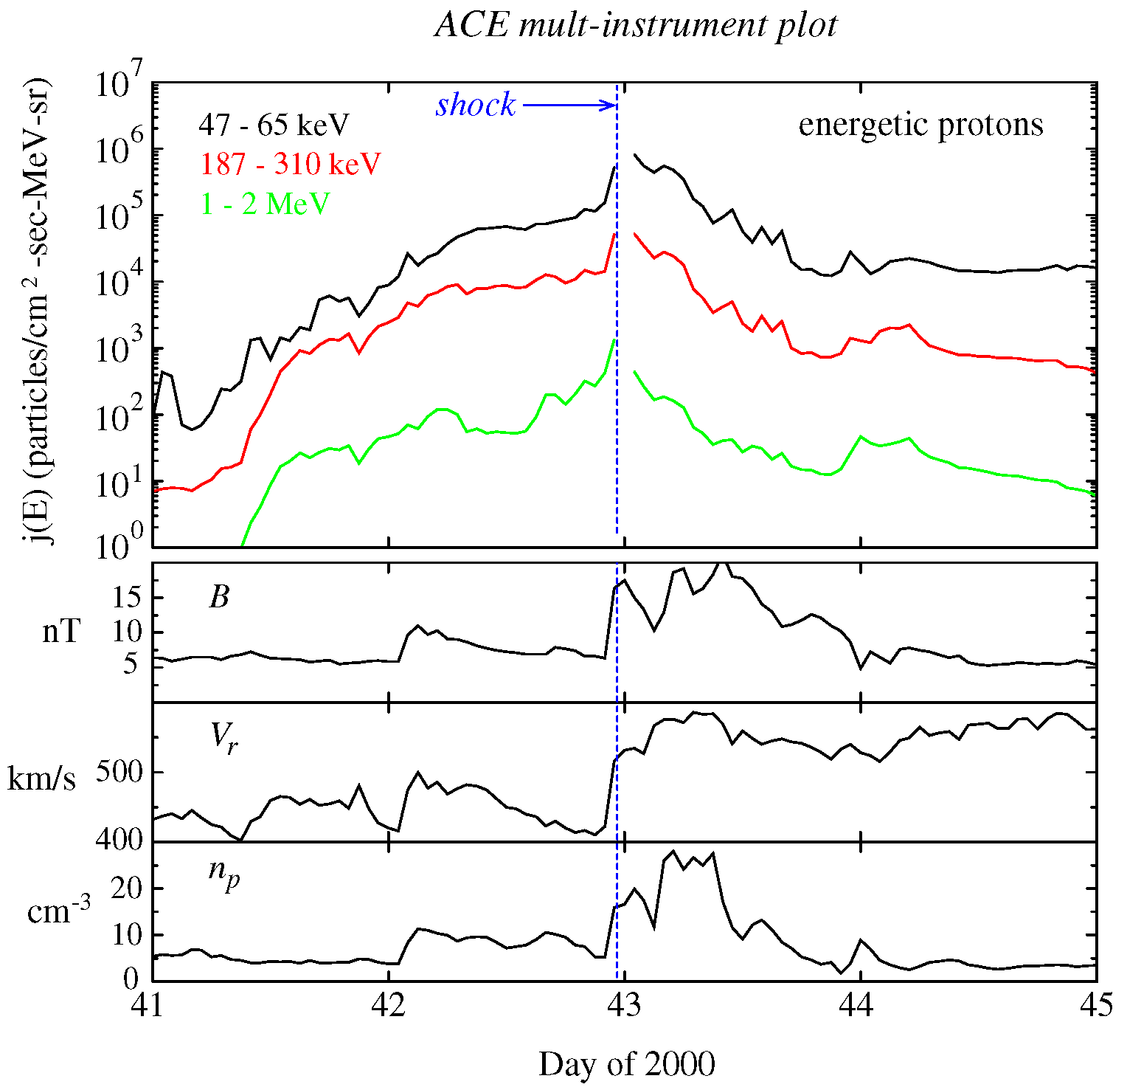
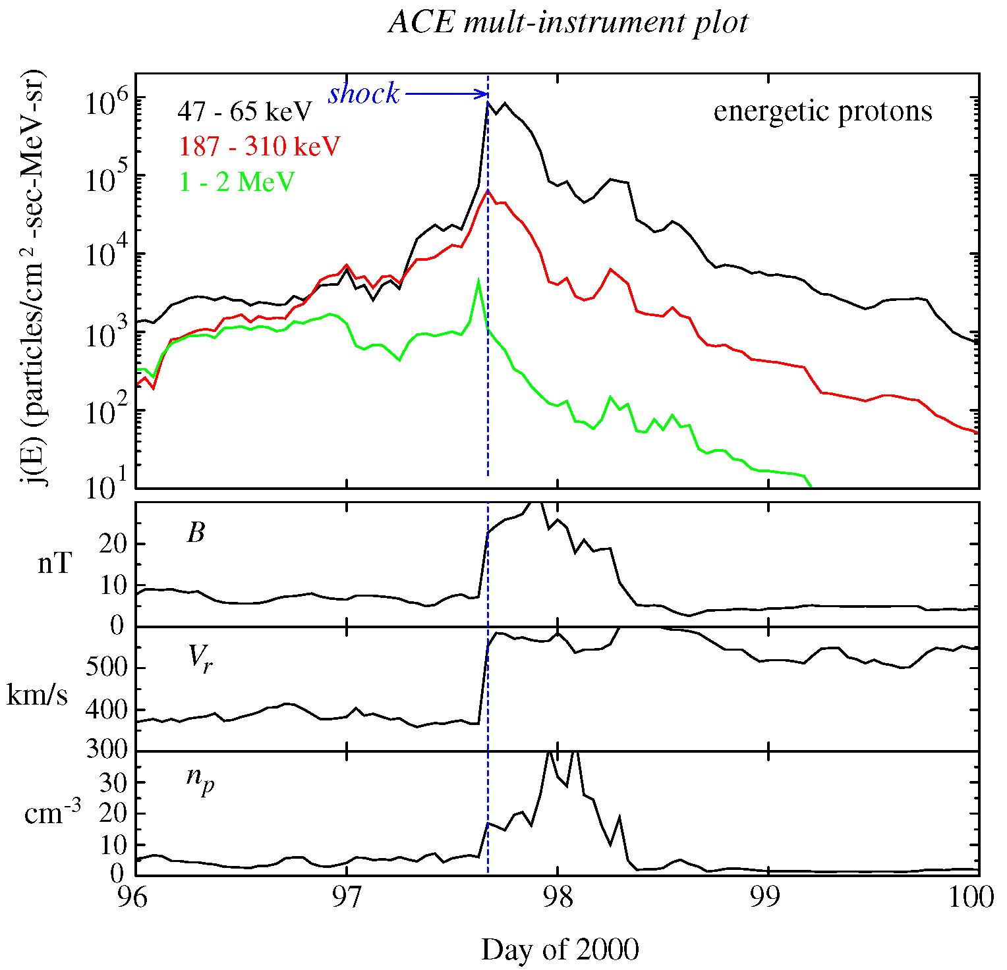
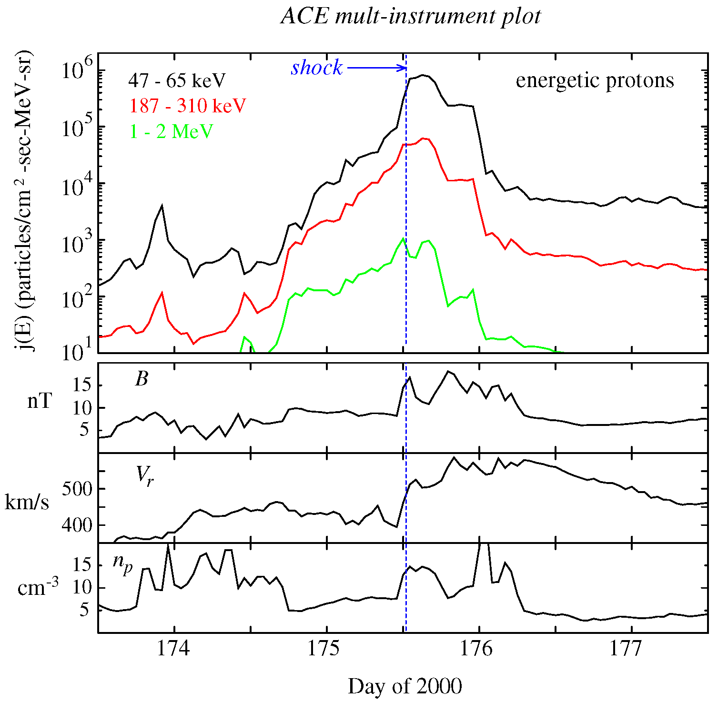
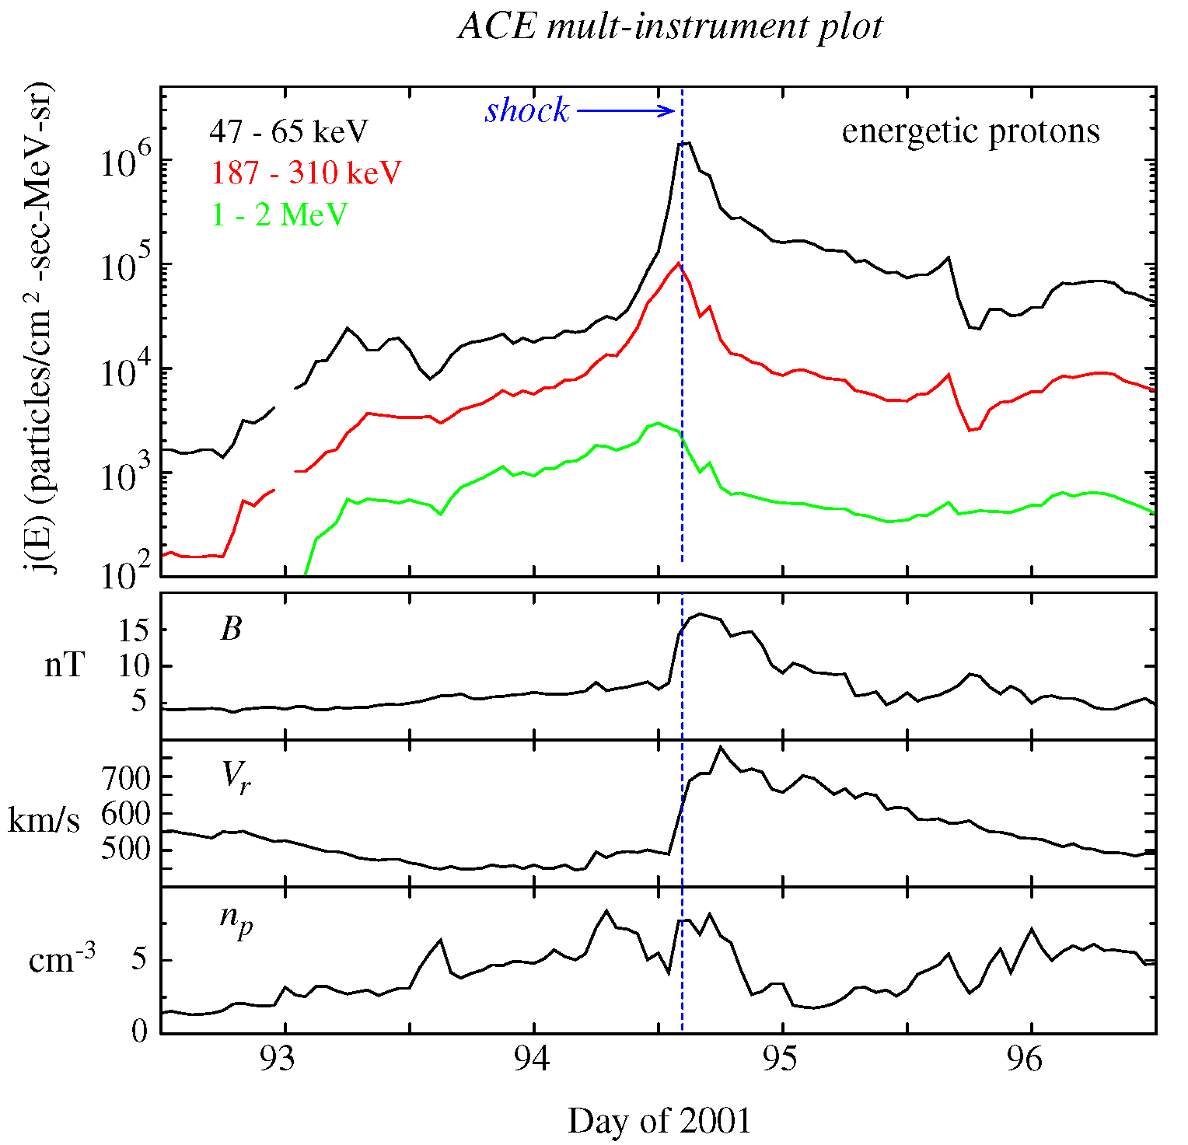
47-65 keV
187-310 keV
1-2 MeV
ACE Multi-instrument data for several SEP events associated with strong interplanetary shocks
Aug. 26, 1998 Feb. 18, 1999 Feb. 11, 2000
Apr. 6, 2000 June 23, 2000 Apr. 4, 2001

Slide 10
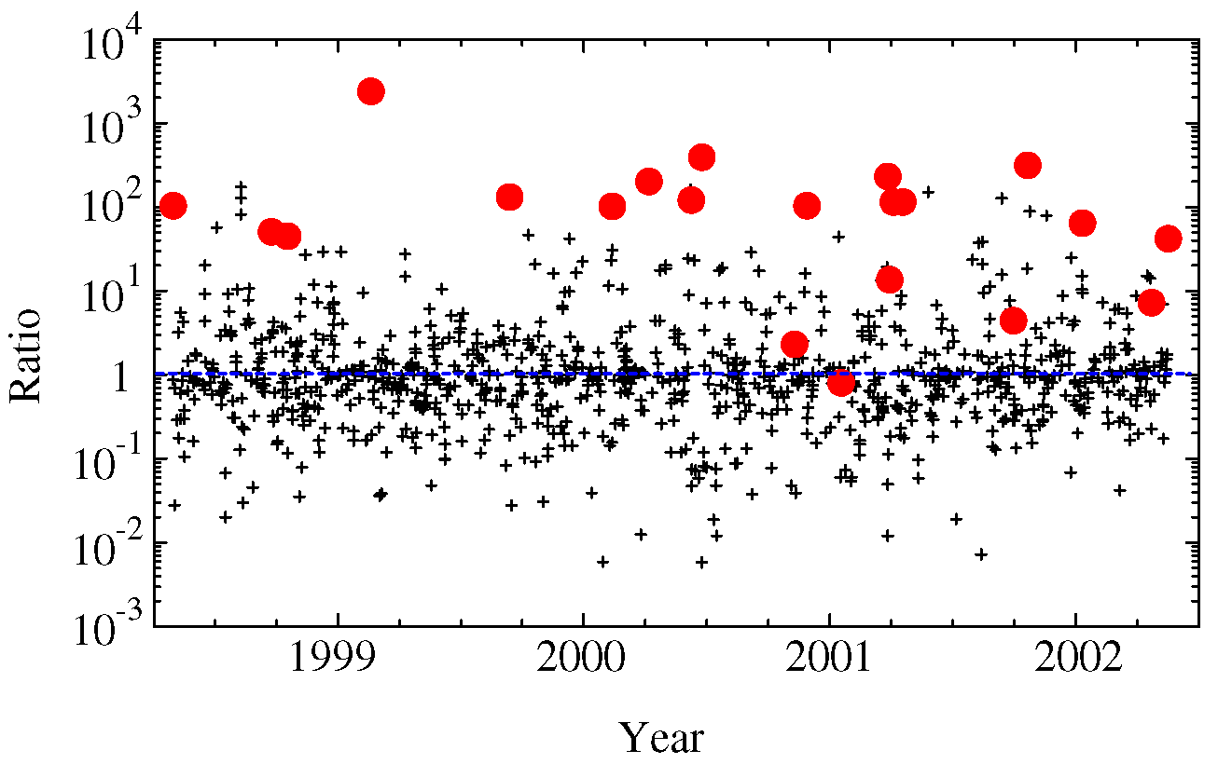
Ratio of the flux of 45-67 keV ions at the shock passage to that 1 day before
Black plusses are ratios of the flux at randomly selected times to that 1 day before

Slide 11
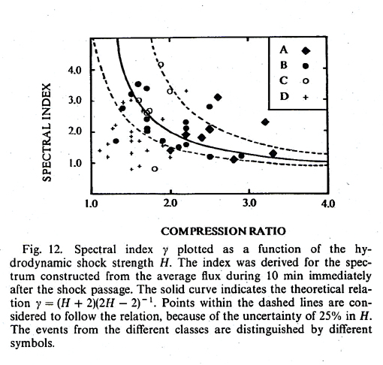
Diffusive Shock Acceleration predicts that the energy spectrum behind a shock wave is a power law (up to some cut-off energy associated with losses and time dependence). In the simplest case, the spectral exponent depends ONLY on the jump in plasma density across the shock
Van Nes et al., 1984
However, the predicted simple relationship between the shock strength and spectral index of energetic particles is not well established by in situ spacecraft observations
This may be related to the effects of turbulence, time dependence, and spatial variations along the shock front

Slide 12
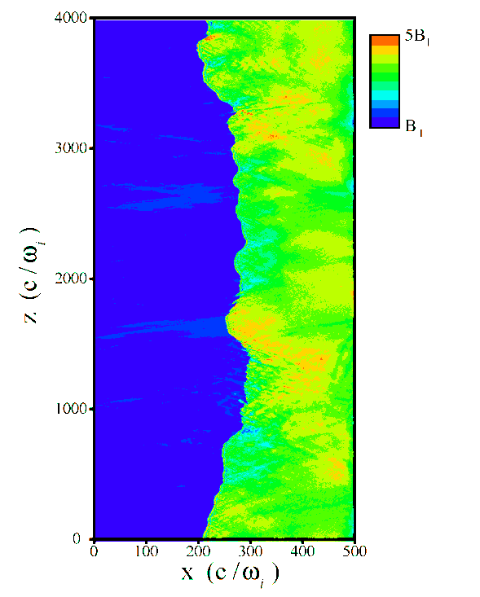
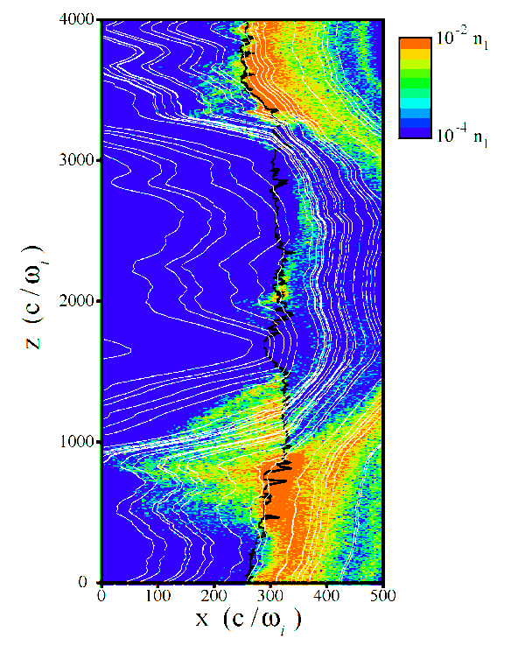
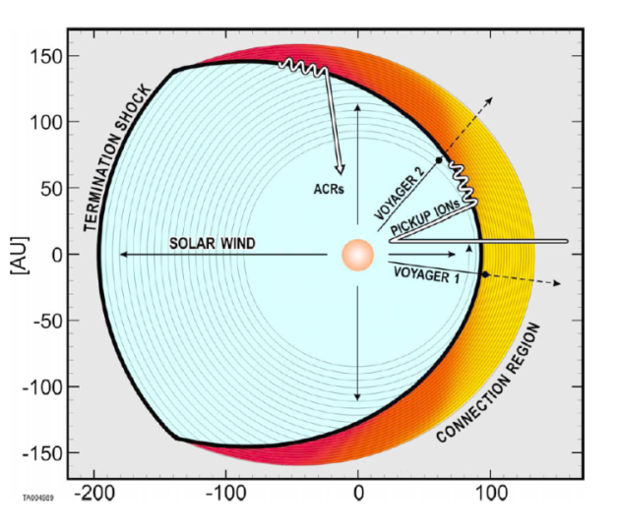
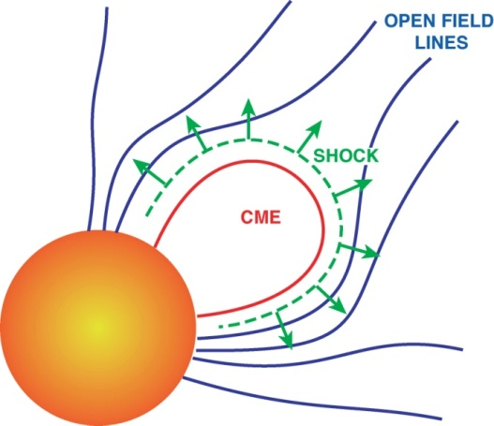
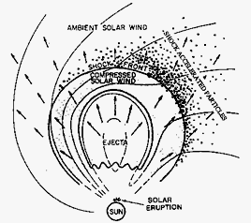
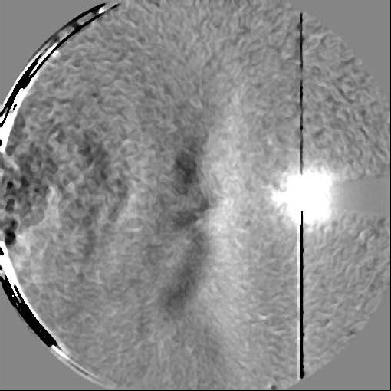
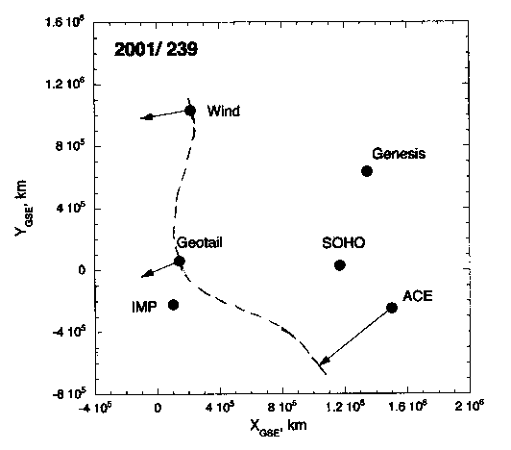
Importance of Turbulence:
ACRs at a blunt termination shock:
Importance of changing geometry along the shock
Magnetic field
Suprathermal ions (E > 5 keV)
SEPs in the inner heliosphere: time dependence + changing geometry along the shock + turbulence

Slide 13
From the first paragraph of the proposal …
“On the morning of 1 Sep 1859, as Richard C. Carrington was observing sunspots on the solar disk, a large and complex active region destabilized, launching an extremely fast Coronal Mass Ejection (CME) toward Earth. …. The ejecta propagated rapidly away from the Sun, generating a fast-mode wave … which … steepened into a fast-mode forward shock. The shock… accelerated suprathermal ions in the ambient solar wind to high energies. As these accelerated particles streamed away from the shock, they excited plasma waves that pitch-angle-scattered the ions, further accelerating them.

Slide 14
Why are self-excited waves important?
The rate of acceleration depends inversely on the diffusion coefficient
  Smaller diffusion coefficient → higher acceleration rate
If the acceleration is rapid, high energies can be achieved
But, estimates of the diffusion coefficient in interplanetary magnetic-field turbulence are too large to account for the observed high energies (several tens of MeV to GeV)
Need to reduce the diffusion coefficient in order to get high energies. One way to do this is to have magnetic fluctuations near the shock. (Another way to do this is perpendicular shocks! i.e. perp diffusion is much smaller than parallel diffusion).
These fluctuations are created by the particles, but also help trap them near the shock where they are accelerated.

Slide 15
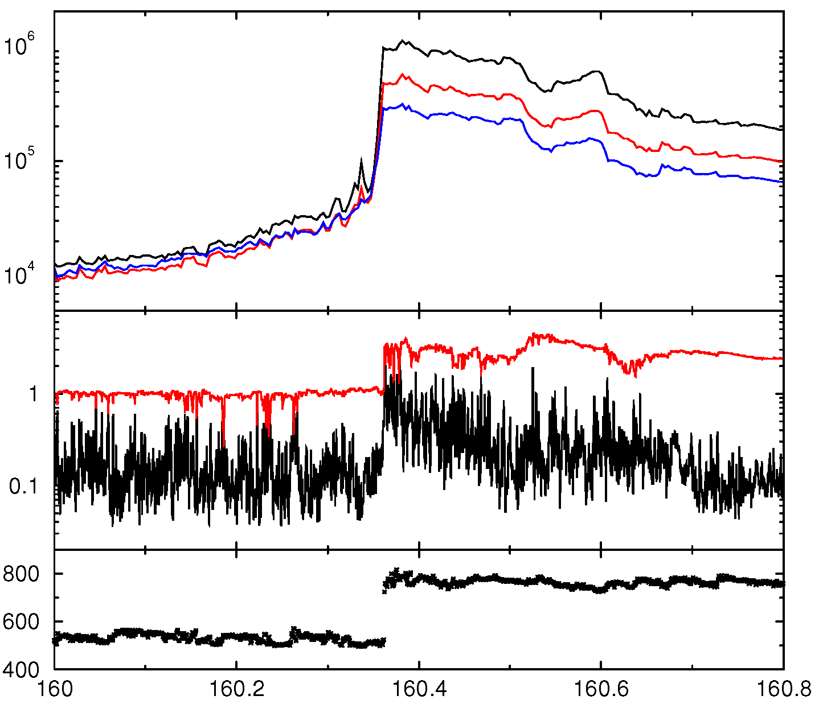
ACE/Multi-instrument
θ_{Bn} = 48º
M_{A} = 4.6
Ions
47-65 keV
65-112 keV
112-187 keV
Flux (cm² s MeV sr)
EPAM
0.5*(LEMS30+LEMS120)
60-sec rms
fluctuations
B/B₁
<dB²> ^{½}/B₁
MAG
U (km/s)
SWEPAM
Day of 2000

Slide 16
ACE/Multi-instrument
θ_{Bn} = 48º
M_{A} = 4.6
Ions
47-65 keV
65-112 keV
112-187 keV
Flux (cm² s MeV sr)
EPAM
0.5*(LEMS30+LEMS120)
60-sec rms
fluctuations
B/B₁
<dB²> ^{½}/B₁
MAG
Where are the waves?
U (km/s)
SWEPAM
Day of 2000

Slide 17
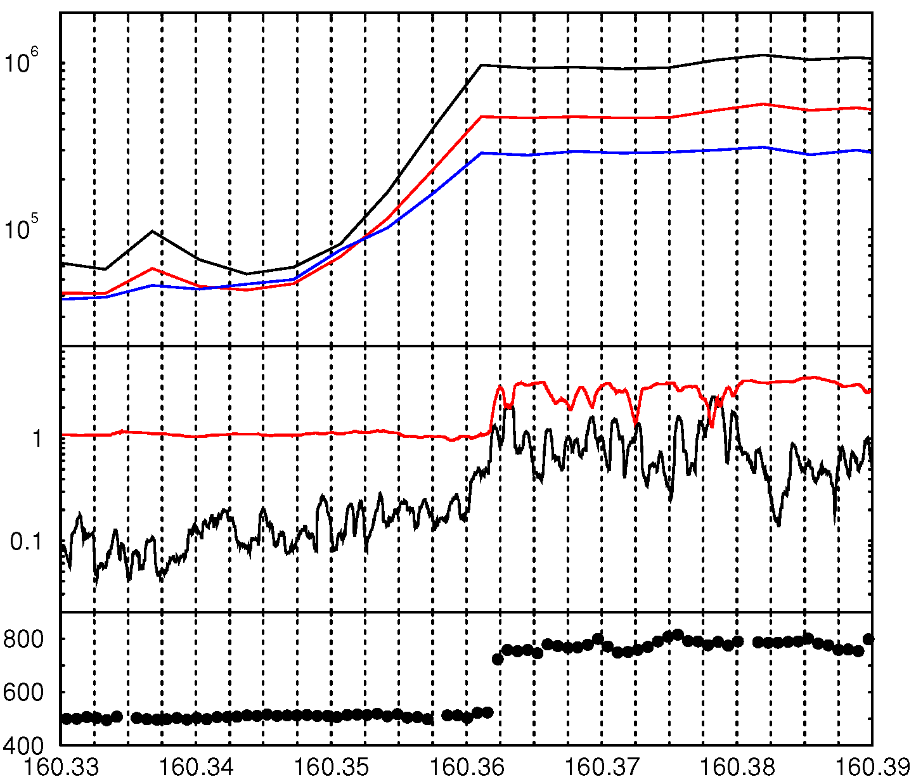
216 seconds
θ_{Bn} = 48º
M_{A} = 4.6
Ions
47-65 keV
65-112 keV
112-187 keV
Flux (cm² s MeV sr)
60-sec rms
fluctuations
B/B₁
<dB²> ^{½}/B₁
U (km/s)
Day of 2000

Slide 18
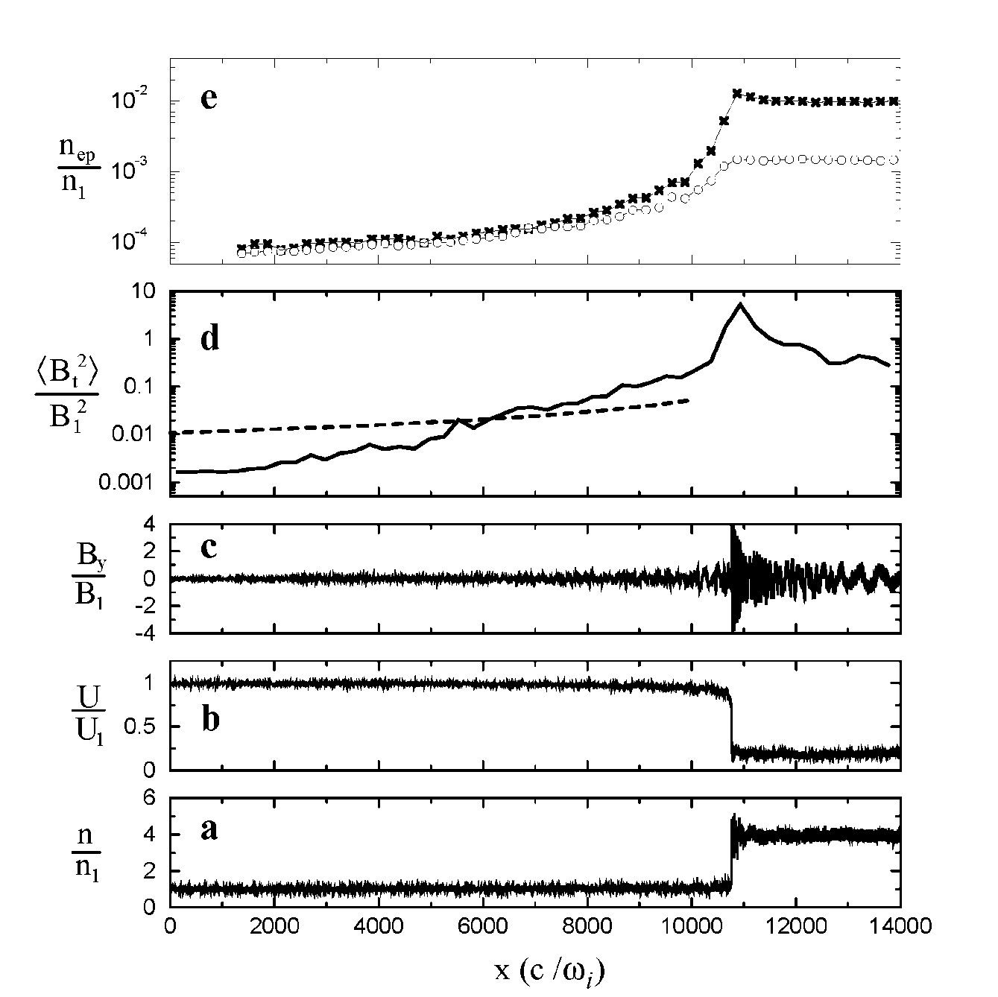
Is the physics of shock-accelerated particles and coupled hydromagnetic waves well understood?
Suprathermal protons
Self-consistent plasma simulations of a parallel shock
The self-generated waves are generally weaker than expected from theory, but they do increase from the upstream up to the shock.
IMF background rms
theory

Slide 19
From the first paragraph of the proposal …
“On the morning of 1 Sep 1859, as Richard C. Carrington was observing sunspots on the solar disk, a large and complex active region destabilized, launching an extremely fast Coronal Mass Ejection (CME) toward Earth. …. The ejecta propagated rapidly away from the Sun, generating a fast-mode wave … which … steepened into a fast-mode forward shock. The shock… accelerated suprathermal ions in the ambient solar wind to high energies. As these accelerated particles streamed away from the shock, they excited plasma waves that pitch-angle-scattered the ions, further accelerating them. Some of the energetic ions escaped, racing ahead of the shock. As they streamed through the heliosphere, they amplified ambient resonant plasma waves, simultaneously undergoing pitch-angle scattering by them. Propagating through an ever-weakening magnetic field, the particles were focused and decelerated. The first of these so-called Solar Energetic Particles (SEPs) arrived at Earth within an hour, although peak intensity of the particle distribution arrived with the shock ~17.5 hours later. … “

Slide 20
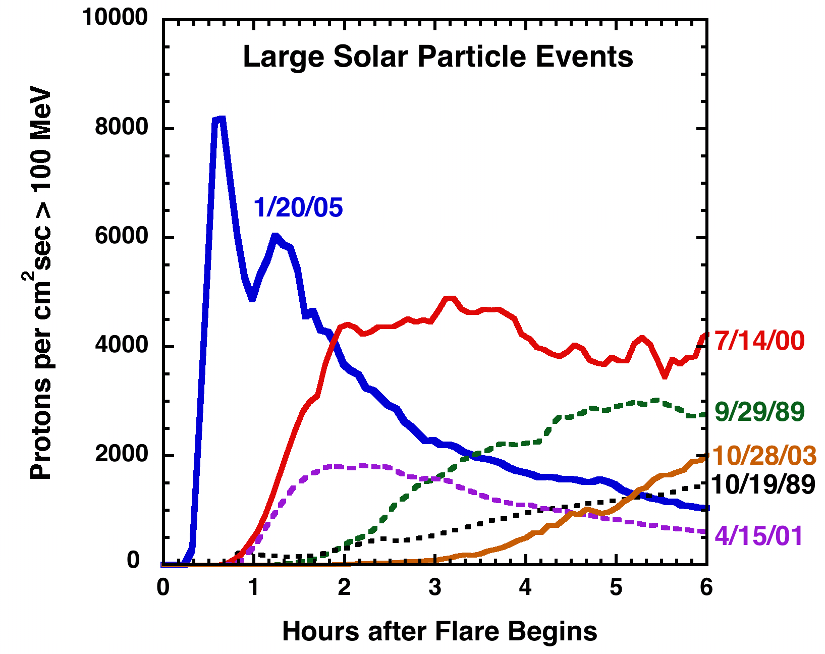
Rise-to-maximum times can vary from event to event. Is this well understood?
(GOES Proton data)
Mewaldt et al. (2005)

Slide 21
What we proposed to do …
“We propose to study, model, and test the following interlinked, multi-disciplinary physical processes: “
What are dominant acceleration mechanisms for particles accelerated at strong shocks?
How do acceleration profiles change along the shock front?
What factors contribute to shape (spectral hardness, roll-over) and temporal history of SEP spectra and intensities?
What role does suprathermal seed population variability play in injection and acceleration of CME-related SEP events?
What is the role of particle transport away from the shock in determining SEP characteristics?

Slide 22
Why this problem is difficult
Particles are accelerated close to the Sun and the magnetic fields there – which are vital to determining the intensity of any SEP given event at 1 AU – are not known. They are not measured.
We know there is additional acceleration between the Sun and 1 AU -- but how much? This strongly depends on the nature of the particle transport, which depends strongly on the nature of the interplanetary magnetic field and turbulence.
There are challenging technical issues involved with combining CME/SEP models:
  large dynamic range (in space, time, and energy)
  How confident are we that we are accurately modeling the coronal magnetic field evolution?
  How well do we understand energetic charged particle transport?
  How well do we know the characteristics of the source (suprathermal particles)?
  Etc.

Slide 23
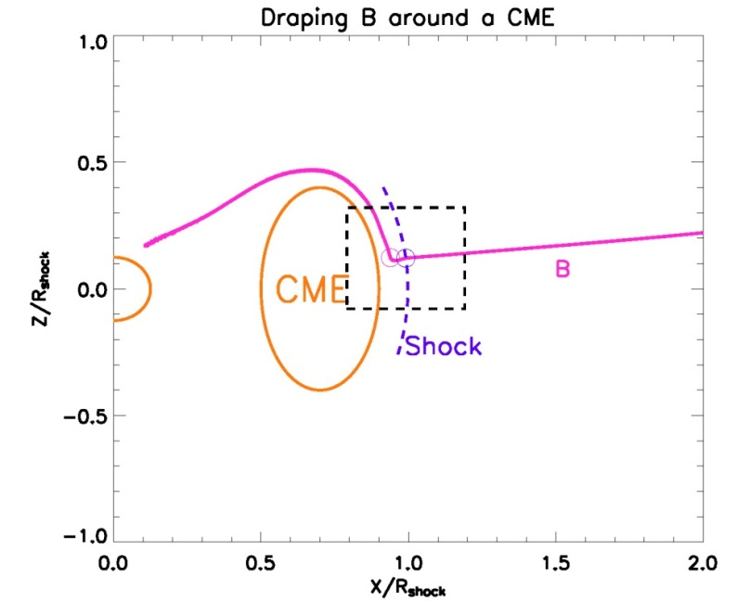
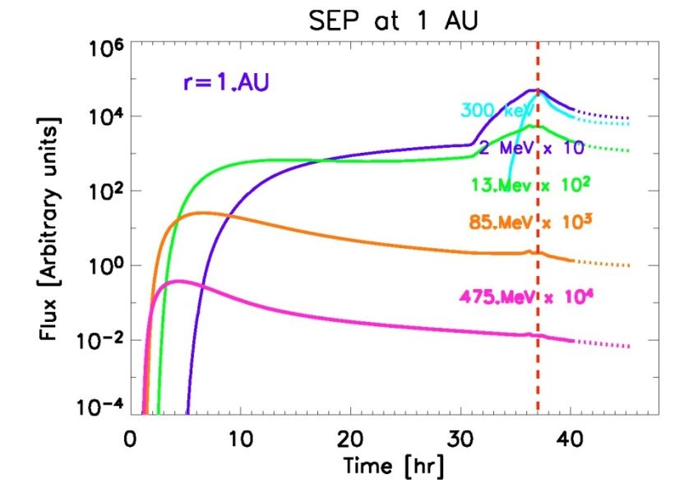
Combined CME/SEP modeling
The new trend in SEP modeling is to combine MHD/CME calculations with SEP transport/acceleration
  SEP part is often done by extending the Parker equation to include anisotropies – so-called focused transport (e.g. EMMREM)
  Can also include self-excited waves ab initio (e.g. PATH)
  neglects cross-field transport
  Initial results are promising, but more work needs to be done.
  Ideally, this work may even help distinguish between CME-eruption models.
UNH group developed the EMMREM model, which uses focused transport. The UAH group developed the PATH model which models self-excited waves and particle transport in evolving CME shock
Kota et al 2005

Slide 24
A plan
Clearly we need to continue developing and refining models that combine CME evolution and SEP transport.
This has been done to some extent already (PATH, EMMREM, etc.), but this work is still in its infancy. Probably needs additional physics.
We have the right team to do this.
  But, there are several details to work out!
  Giacalone can work with the PSI group to develop a new model.
  At the same time, EMMREM and PATH should be used for a variety of CME events and also enhanced, modified, etc.
  We should often compare notes
In parallel, we must also work to solve some of the basic physics issues outlined in the proposal

Slide 25
Combining MHD models of the Solar Corona and Interplanetary Space with Energetic-Particle Transport:
Some things to consider …
The models must be run in at least 2D. In addition to time evolution of CME shocks, the changing geometry along the shock front must be modeled.
Solar-wind turbulence, field-line meandering, and other solar-wind structures are not included in these models but are likely to be important.
Multiple CMEs must also be modeled since it seems that this is related to the largest SEP events
Technical issues representing severe challenges:
  Diffusive skin depth MUST be greater than the grid cell size. Actually, it must be greater than the width of the shock
    This gets very restrictive at perpendicular shocks, which is the most efficient and rapid accelerator (will produce the highest energies)
  Energetic particle transport must incorporate cross-field transport. This is important for acceleration at nearly perpendicular shocks.

