Slide 1

Energetic Particle Impacts in the Atmosphere
Charley Jackman¹, Dan Marsh², Cora Randall³, Stan Solomon²
¹Goddard Space Flight Center
²National Center for Atmospheric Research
³University of Colorado
Sun-to-Ice Kickoff Meeting • San Diego, California • 2 November 2011

Slide 2
A Simplified Overview of the Particle-to-Nitrates Chain
• Energetic particles enter the atmosphere, predominantly in the polar regions
  Mostly electrons and protons
  Penetration depth depends on energy (more energy — deeper penetration)
• Particles impact atmospheric gases, causing ionization, dissociation, excitation
  Most important process is ionization, which also leads to dissociation, excitation
• Ionization produces secondary electrons
• Secondary electrons dissociate molecules, primarily molecular nitrogen (N₂)
• The majority of nitrogen atoms are left in excited metastable states (N(²D), N(²P))
• Excited N react with molecular oxygen (O₂) to produce nitric oxide (NO)
• NO is long-lived at night, esp. in the polar winter, and can be transported downward
• NO reacts with odd-oxygen, particularly ozone (O₃) to produce nitrogen dioxide (NO₂)
• NO₂ reacts with O₃ and hydroxyl radical (OH) to produce nitric acid (HNO₃)
• HNO₃ attaches to water (H₂O)
• Acidified water enters troposphere and ultimately precipitates?

Slide 3
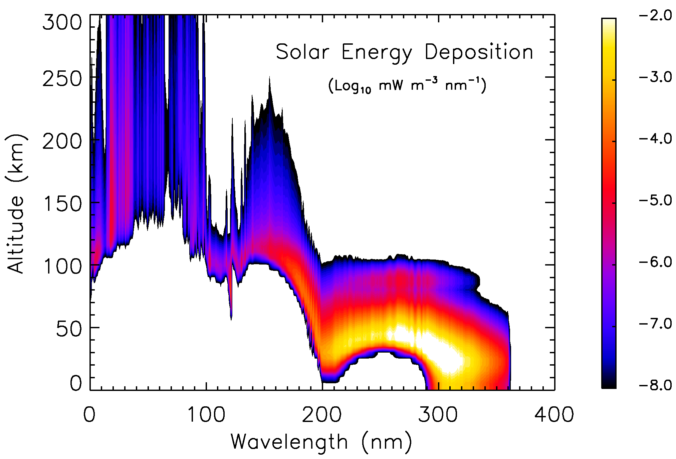
A Few Words About Photons

Slide 4
Direct and Indirect Effects of Particle Precipitation
H⁺
e⁻
Direct Effect:
High-energy particles sporadically produce NO_{x} directly in stratosphere
Indirect Effect:
Lower energy particles routinely produce NO_{x} in MLT
  NO_{x} can descend to stratosphere during polar night
Direct Effect
Indirect Effect
thermosphere
NO
mesosphere
stratosphere
NO
troposphere
Notes:
High energy: (>300 keV e-, 30 MeV p+)

Slide 5
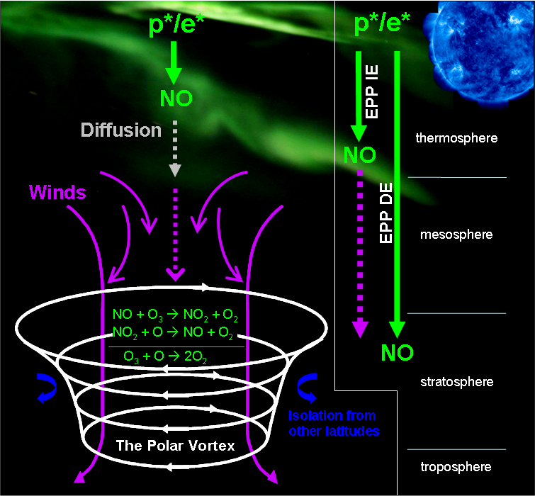
Direct and Indirect Effects of Particle Precipitation
Notes:
5

Slide 6

Electron Precipitation
Lower energy
Auroral electrons → auroral zone [~62-75º geomag. lat.]
80º
90ºN geomagnetic
70º
60º
50º
40º
Medium & high energy electrons
→ subauroral zone [~55-65º geom. lat.]

Slide 7
Proton Precipitation
Solar protons
Polar Caps
>~60º geomag. lat.
80º
90ºN geomagnetic
70º
60º
50º
40º
Very intense solar events
push polar cap boundaries Equatorward

Slide 8

1 keV
electron
125
10 keV
electron
1 MeV proton
Thermosphere
100
100 keV
electron
Mesosphere
10 MeV proton
75
1 MeV
electron
Altitude (km)
Middle
Atmosphere
50
(Bremsstrahlung
X-rays can
penetrate further)
100 MeV proton
Stratosphere
25
1 GeV proton
(mostly GCRs)
Troposphere
0

Slide 9
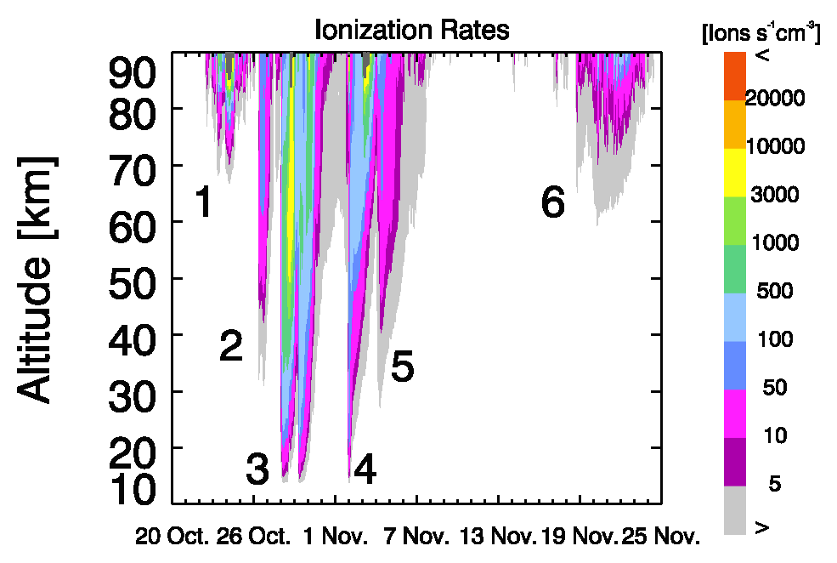
Ionization in the Northern Polar Cap
During the 2003 “Halloween” Storm

Slide 10
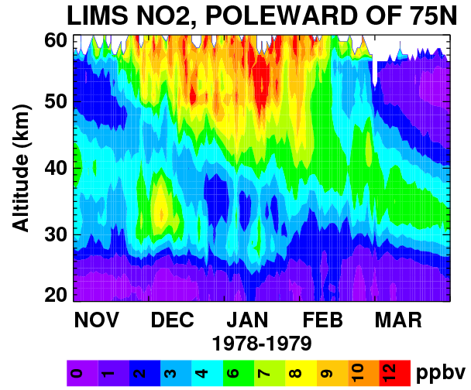
First Satellite Observations of NOx
Generated by Energetic Particles
Northern Hemisphere, 1978-1979
EPP is the ONLY source of mesospheric NO_{x} in the polar winter
Based on Russell et al., 1984

Slide 11
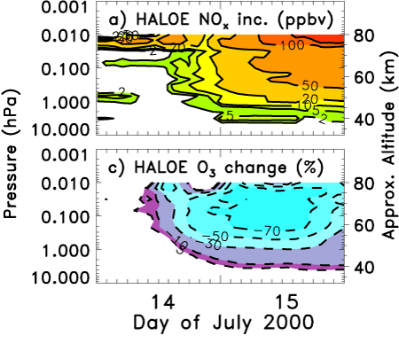
HALOE NOx and O₃ Measurements

Slide 12
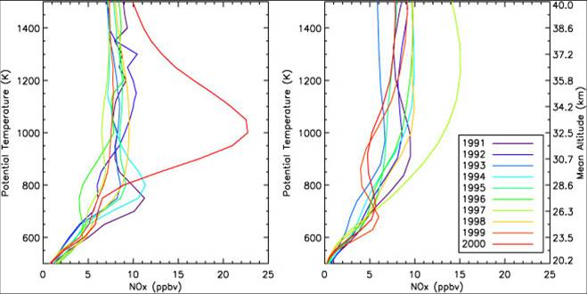
NO_{x} (NO+NO₂) in SH Polar Vortex in Sep./Oct. 2000
UARS HALOE
40.0
Interannual
Variability
1991-1999
37.2
34.2
2000
Mean Altitude (km)
30.7
26.3
20.2
0 5 10 15 20 25
NO_{x} (ppbv)
from Randall et al. (2001)

Slide 13
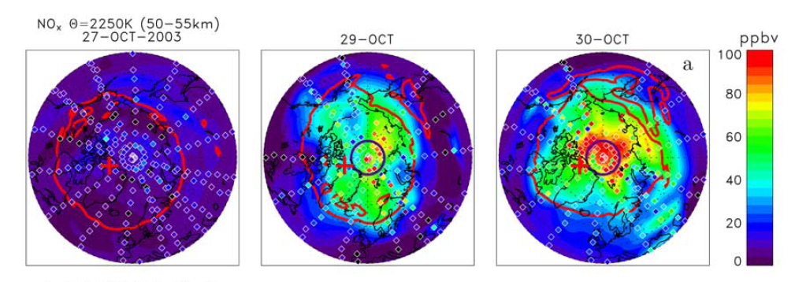
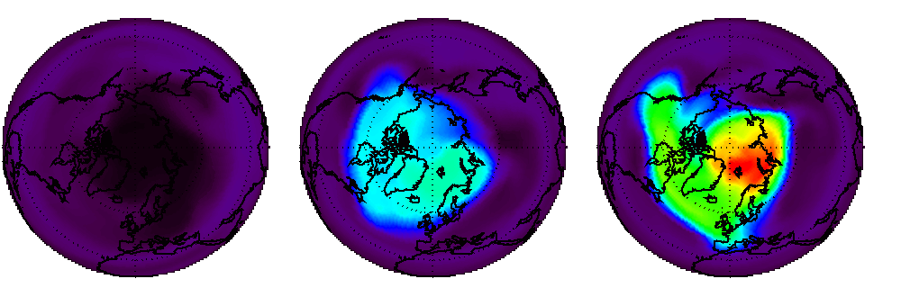
MIPAS NO_{x} (NO+NO₂) in 50-55 km (Northern Hemisphere)
Enhancements by Halloween 2003 Solar Energetic Particles
27-Oct-2003
29-Oct-2003
30-Oct-2003
Polar vortex edge
Geomagnetic pole
WACCM NO_{x} (NO+NO₂) vmr 55 km
from López-Puertas
et al. [2005a]

Slide 14
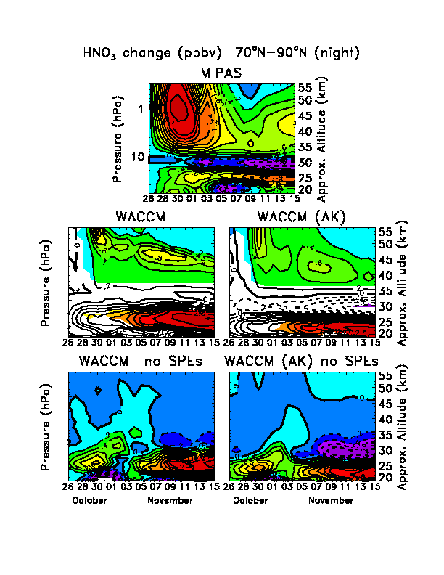
MIPAS HNO₃ Change (ppbv) in 70-90ºN (night)
Relative to 26 Oct. 2003
ΔHNO₃
2.5
0.2
0.4
2
0.8
1
0.6
0.8
Primary (?): OH + NO₂ + M → HNO₃ + M
from López-Puertas
et al. [2005b, updated]

Slide 15
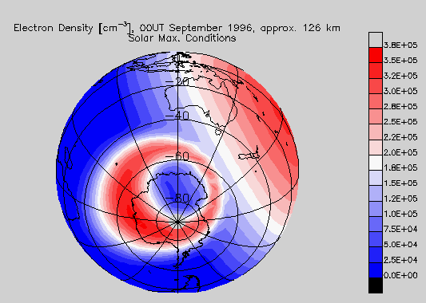
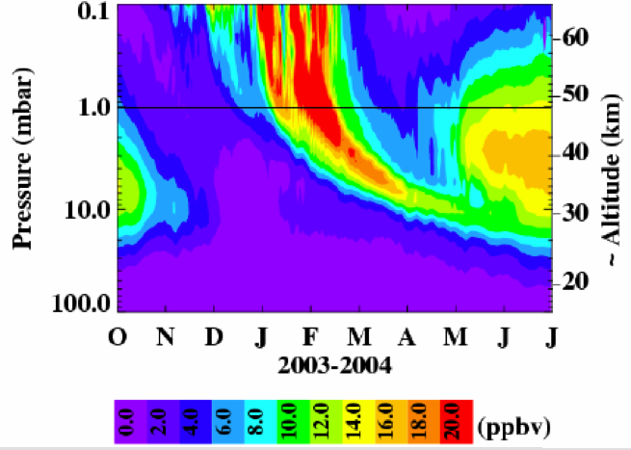
Whole Atmosphere Community Climate Model (WACCM)
• A single-code synthesis of CAM, MOZART, and the TIME-GCM
• WACCM v.4 extends from the surface to ~140 km altitude
• Released as part of NCAR CESM, online documentation, regular community workshops, etc.
• Interdivisonal NCAR development group (ACD, CGD, HAO)
• WACCM-SD “specified dynamics” incorporates measured troposphere-stratosphere dynamical state, enabling event-specific studies.
• WACCM-X development in progress to eXtend to ~500 km, including full thermosphere-ionosphere coupling
• Now a working group of the CESM
http://www.cesm.ucar.edu/working_groups/WACCM

Slide 16
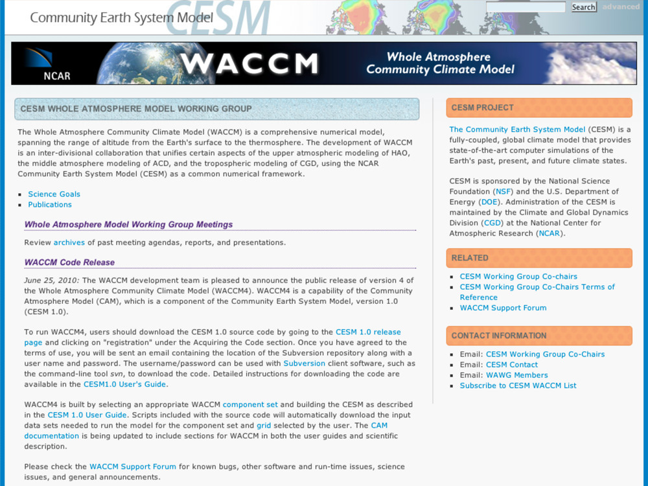

Slide 17
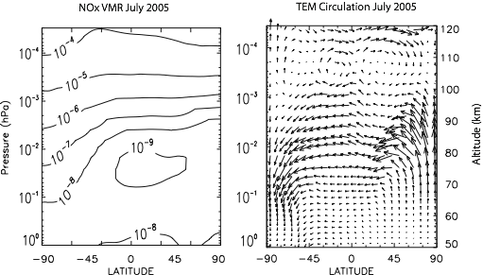
The Role of Dynamics in Odd-Nitrogen Distributions
NO_{y} transport by:
Diffusion
(4 orders of magnitude in vmr with height from 70-110 km)
Residual Circulation

Slide 18
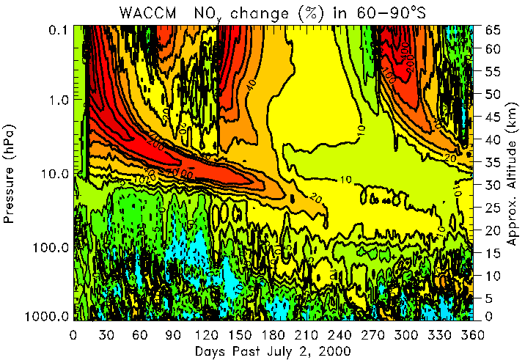
WACCM - NO_{y} % change
60-90ºS
Nov. 2000
SPE
Apr. 2001
SPE
Pressure (hPa)
J A S O N D J F M A M J
Year 2000 Year 2001

Slide 19
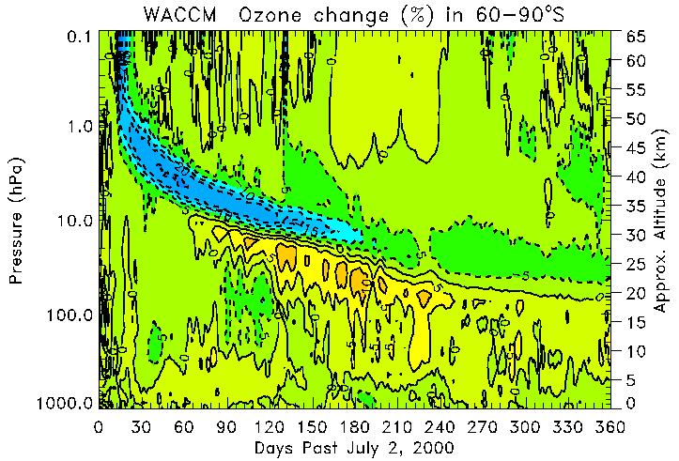
WACCM - Ozone % change
60-90ºS
Pressure (hPa)
Ozone decrease
→ more NO_{y}-induced O₃ loss
Ozone increase
→ NO_{y} interferes with Cl and Br chemistry
J A S O N D J F M A M J
Year 2000 Year 2001

Slide 20
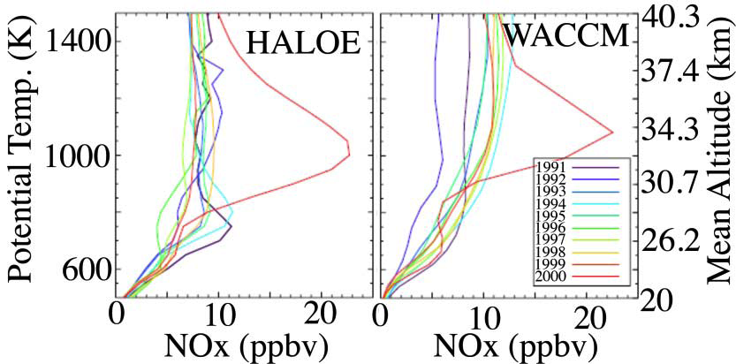
Comparison of HALOE Measurements to WACCM Simulation

Slide 21
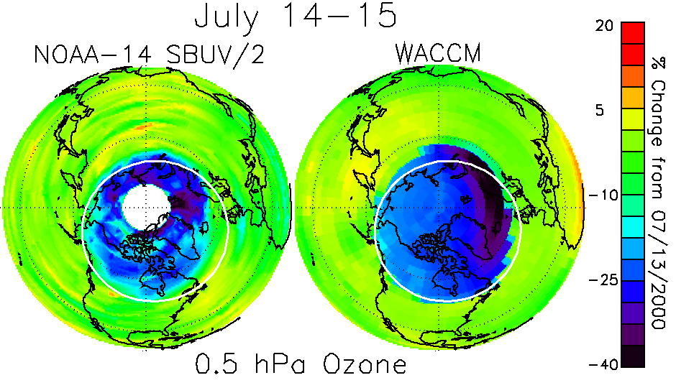
Comparison of NOAA-SBUV Ozone Measurements to WACCM Simulation
15-35%
depletion

Slide 22
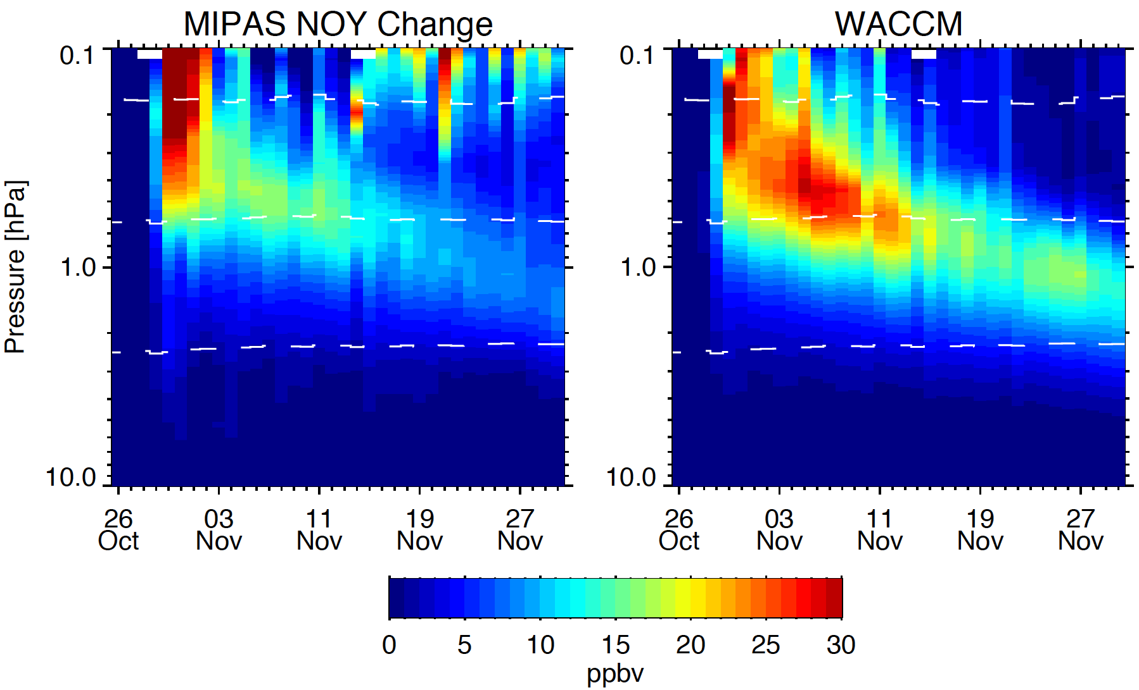
Comparison of MIPAS Measurements to WACCM Simulation
“Halloween Storm,” 2003
Funke et al., Atmos. Chem. Phys., 2010

Slide 23
NO_{x} enhances larger family NO_{y}
N, NO, NO₂, NO₃, N₂O₅, HNO₃, HO₂NO₂, ClONO₂, BrONO₂)
  Lifetimes can be long (~months to years)
  Recent Work on Other Constituent Observations
N₂O Production (MIPAS): Funke et al. (2008a,b)
HCl Destruction (HALOE): Winkler et al. (2009)
N₂O₅ Production (MIPAS): López-Puertas et al. (2005b); Jackman et al. (2008)
HO₂NO₂ Production (MIPAS): Funke et al. (2011)
CO Destruction (MIPAS): Funke et al. (2011)

Slide 24
High Energy Particle Precipitation in the Atmosphere (HEPPA)
• International affiliation that studies energetic particle transport and effects
• Primarily the middle-atmosphere community
• Conferences every two years or so, generally in attractive venues
• Next meeting is October 8~12, High Altitude Observatory, Boulder, Colorado

