Slide 1
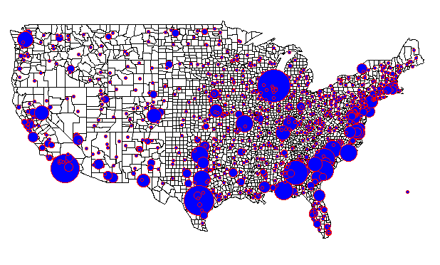
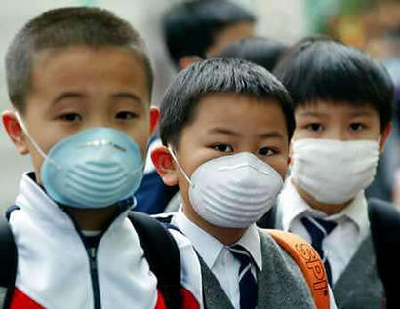
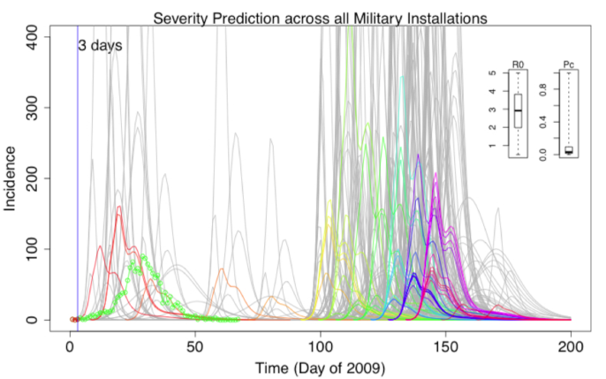
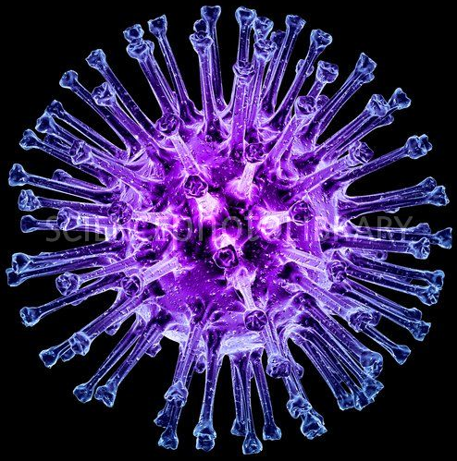
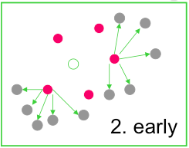
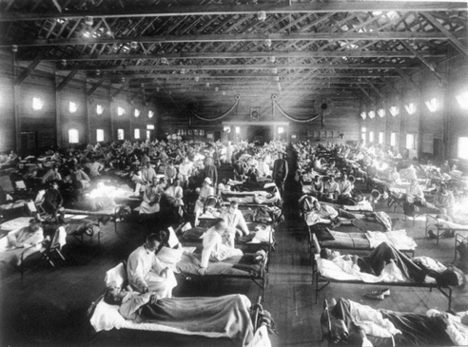
Rapid assessment of pandemic impact using clinical episode data from spatially distinct military populations
January, 2013
David P. Bacon
Director
Center for Atmospheric Physics
SAIC
Steven Riley
Pete Riley
Predictive Science Inc.
David P. Bacon
Science Applications International Corporation

Slide 2
Acknowledgements
NCMI / DTRA / AFHSC
Funded by NCMI contract W81XWH-10-A-0026/DO001 to SAIC
Predictive Science
Imperial College London

Slide 3
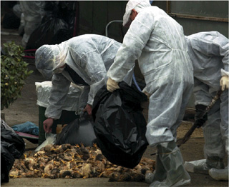
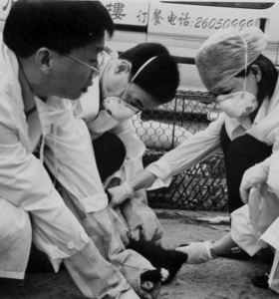

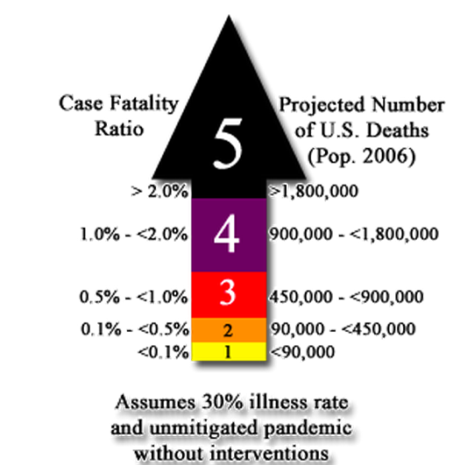

Slide 4
Alternate models for interaction of ecological science and health policy

Slide 5
Overview
Background and key parameters
Features of the 2009 pandemic
Disease dynamics of 2009
Simulating worrisome future scenarios
Conclusions and future work
Notes:
Scientific intro
Description of data - patterns seen
Estimating properties of 09 pandemic
Simulation of possible future pandemics
Future work

Slide 6
Severity matrix
High
Explicit interventions unlikely to be justified either for containment or mitigation
Implement most stringent interventions and watch carefully for the population response to the new infection: apparently high Ro may drop rapidly when high CFR fully appreciated
R0
Consider carefully the cost of non-containment then the costs and benefits of mitigation
Most stringent
Intervention, for containment or effective mitigation
Low
Low
IFR
High
Adapted: WER 2009

Slide 7
The basic reproductive number
“The average number of secondary cases generated by a typically infectious individual over the entire course of their infection”
2
1
3
4

Slide 8
Simple epidemic models explain the trajectory of incidence
S
I
R

Slide 9
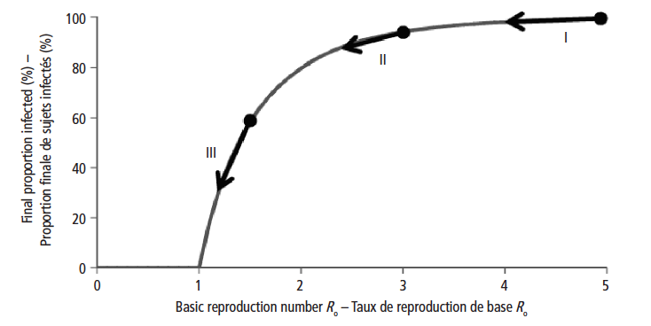
R₀ and the cumulative attack rate
Source: WER 2009

Slide 10
Severity pyramid
Deaths
CFR
Severe cases
IFR
Cases
Infections

Slide 11
Severity matrix
High
Explicit interventions unlikely to be justified either for containment or mitigation
Implement most stringent interventions and watch carefully for the population response to the new infection: apparently high Ro may drop rapidly when high CFR fully appreciated
R0
Consider carefully the cost of non-containment then the costs and benefits of mitigation
Most stringent
Intervention, for containment or effective mitigation
Low
Low
IFR
High
Adapted: WER 2009

Slide 12
Overview
Background and key parameters
Features of the 2009 pandemic
Disease dynamics of 2009
Simulating worrisome future scenarios
Conclusions and future work
Notes:
Scientific intro
Description of data - patterns seen
Estimating properties of 09 pandemic
Simulation of possible future pandemics
Future work

Slide 13
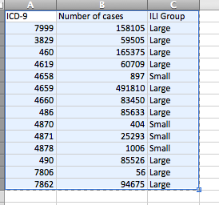
The Marsden-Haug “ILI-small” criteria consistent with CDC ILI cases.
Number of cases matching ICD-9 codes in the AFHSC dataset.
Notes:
For reference, these are the definitions of the ICD codes:
The “ILI-large” and “ILI-small” groups are based on whether the codes are used more than 75,000 times during the 4-year period studied by Marsden-Haug et al. (2007).
“ILI-large” is defined by any one of the following codes:
079.99 (7999) = Viral infection NOS
461.9 (4619) = Sinusitis, acute, NOS
465.9 (4659) = Upper respiratory infection, acute, NOS
466.0 (4660) = Bronchitis, acute
486 (486) = Pneumonia, organism unspecified
490 (490) = Bronchitis, not specified as acute or chronic
780.6 (7806) = Fever, nonperinatal
786.2 (7862) = Cough
The “ILI-small” is defined by one of the following codes:
465.8 (4658) = Infectious upper respiratory, multiple sites, acute NEC
487.0 (4870) = Influenza w/ pneumonia
487.1 (4871) = Influenza w/ other respiratory manifestations
487.8 (4878) = Influenza with manifestation NEC

Slide 14
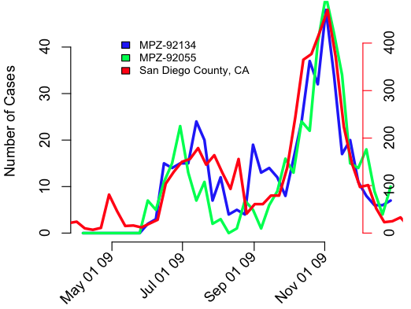
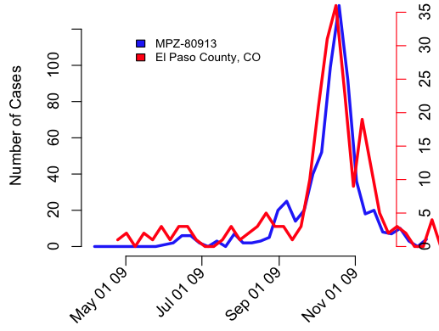
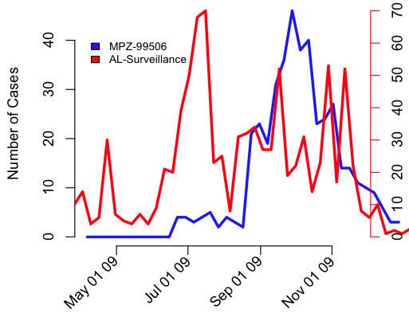
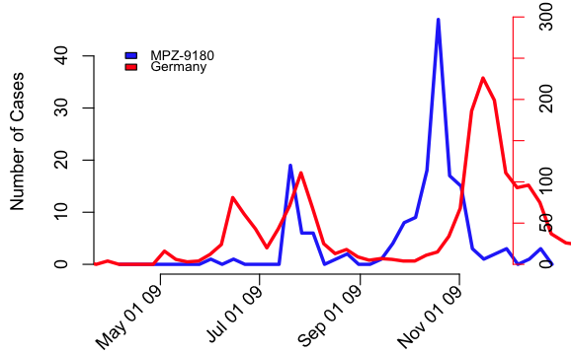
Synchronisation between civilian and military populations
AK

Slide 15
Correlation of peak times
Outliers: Camp Lejune, Quantico.
Notes:
Camp Lejune-28547
-Marine base in North Carolina in Onslow County
-Marine Training facility supported by 5 satellite facilities:
-Marine Corps Air Station New River
-Camp Geiger
-Stone Bay
-Courthouse Bay
-Camp Johnson
-Greater Sandy Ridge Training Area
- More than 12,000 Marines going through Marine Combat training yearly
-More than 150,000 active duty, dependent, retirees and civilians supported
-Has several schools on base that are part of the Camp Lejeune Dependent Schools
Quantico-22134-Marine
-Located near Traingle, Virginia in Southern Prince William County, northern Straffod County and southeastern Fraquier County.
-3,460 Family members
-1,227 Students
-2,232 Civilian employees
-Major training institution for Marine and federal law enforcement agencies
-There are 4 schools located at Quantico, 3 primary schools and one middle/high school. They are part of the DDESS-DODEA

Slide 16
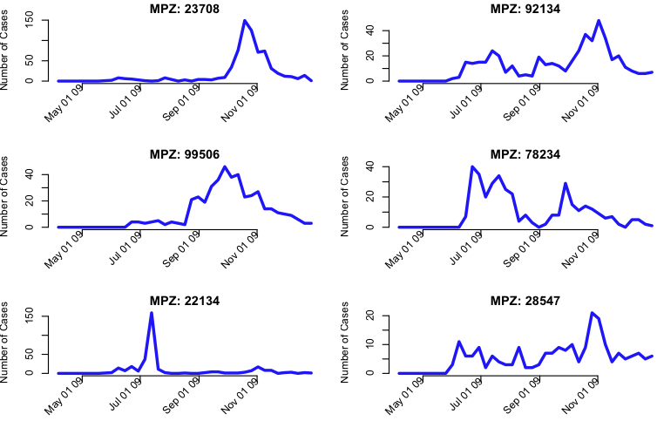
Base epidemic profiles

Slide 17
Overview
Background and key parameters
Features of the 2009 pandemic
Disease dynamics of 2009
Simulating worrisome future scenarios
Conclusions and future work
Notes:
Scientific intro
Description of data - patterns seen
Estimating properties of 09 pandemic
Simulation of possible future pandemics
Future work

Slide 18
Transmissibility changes over time
R
t1
R1
R0
t0
duration
Time

Slide 19
Estimation of Severity for 2009 Pandemic

Slide 20
Estimation of Severity for 2009 Pandemic

Slide 21
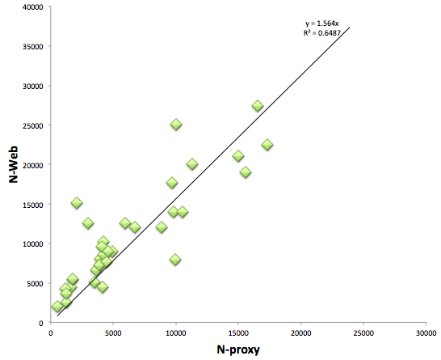
Estimate of Ntotal from AFHSC clinical visits
Outliers: Mayport naval Station, 29 Palms, Ft. Riley,
Notes:
(2000,15000): Mayport Naval Station-32228
-15 miles from Jacksonville, Florida
-15,150 Active duty
-32,000 Family Members
-1,260 Civilians
(3000,12500): Twentynine Palms-92278-Marine
-Located in 29 Palms California, 60 miles from Palm Springs
-12,500 Active duty
-24,000 family members
-21,000 DoD contractors
-1,200 retirees
(10000,25000): Ft. Riley- 66442
-Located in Northeast Kansas on the Kansas River between Junction City and Manhaten in Greary and Riley Counties.
-Has a daytime population of 25,000
-Population assigned served: 42,264
-9,252 Active duty enlisted
- 1,117 Officers
-12,020 family members
- 16,249 retirees
-3,626 Civilian employees
-Geary County Unified School District 475-5 elementary schools and 1 middle school located on campus

Slide 22
The largest 8 military populations by zip code

Slide 23
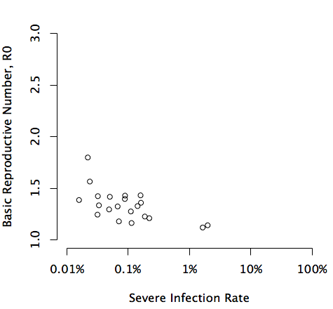
The model fit estimates R₀ and pC for each base over 10,000
Implement most stringent interventions and watch carefully for the population response to the new infection: apparently high Ro may drop rapidly when high CFR fully appreciated
High
Explicit interventions unlikely to be justified either for containment or mitigation
Best case R0
Consider carefully the cost of non-containment then the costs and benefits of mitigation
Most stringent
Intervention, for containment or effective mitigation
Low
Low
Worst case IFR
High
Outliers: Ft. Stewart, Ft Bragg
Notes:
pC=0.8: Ft. Stewart-31314-Army
-Located in Hinesville, Liberty County, Georgia. Near Savannah Georgia
-Soldier population of 15,875
-3,356 Civilian Employees
-20,035 Soldiers
-4,087 Civilian Employees
-32, 751 military family
-total population of 56,873
-Used to train 50,000 reserve component soldiers yearly.
-DoDEA operates 3 elementary schools on base
pC = 0.99999: Ft. Bragg-28310- Army
-Located in Cumberland and Holk Counties in North Carolina
-52,800 Active Duty Soldiers
-12,624 Reserve and temporary duty students
-8-757 Civilian employees
-3,516 Contractors
-62,962 Family members
-98,507 army retirees and family members

Slide 24
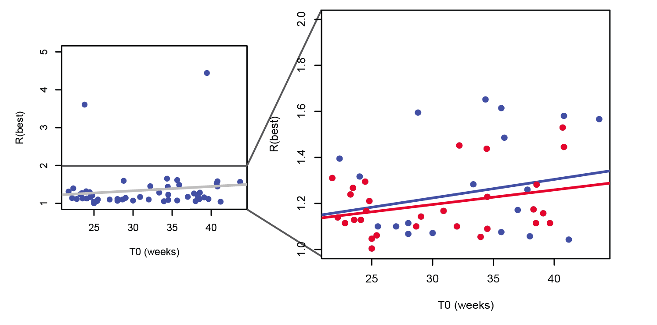
Increasing intrinsic seasonality
Red points are the top 30 bases.
Notes:
Red points are the top 30 bases.

Slide 25
Overview
Background and key parameters
Features of the 2009 pandemic
Disease dynamics of 2009
Simulating worrisome future scenarios
Conclusions and future work
Notes:
Scientific intro
Description of data - patterns seen
Estimating properties of 09 pandemic
Simulation of possible future pandemics
Future work

Slide 26
Pandemic prediction based on estimates from early bases

Slide 27
Pandemic prediction based on estimates from early bases

Slide 28
Pandemic prediction based on estimates from early bases

Slide 29
Pandemic prediction based on estimates from early bases

Slide 30
Overview
Background and key parameters
Features of the 2009 pandemic
Disease dynamics of 2009
Simulating worrisome future scenarios
Conclusions and future work
Notes:
Scientific intro
Description of data - patterns seen
Estimating properties of 09 pandemic
Simulation of possible future pandemics
Future work

Slide 31
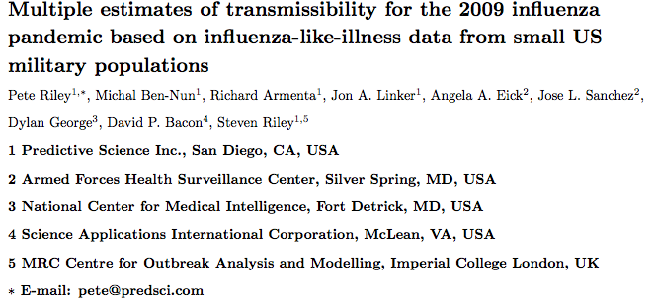
Manuscripts
Paper 1 in revision for PLoS Computational Biology:
Paper 2:
  Rapid assessment of pandemic impact using clinical episode data from spatially distinct military populations, Pete Riley, Michal Ben-Nun, Angela A. Eick, Jose L. Sanchez, Dylan George, David P. Bacon, and Steven Riley, In prep.

Slide 32
Conclusions
DMSS data could be useful in real-time for assessing pandemic severity
“Simple models” of 2009 capture key parameters
Accurate population size will improve estimates
Single analytical framework can address planning and response goals

Slide 33
Future Directions
  A prototype tool to perform analysis described here
  Clearly adds to available tool set
  Substantial additional motivation for making key data be available more quickly
  Additional modeling science to enable seasonal use
  Winter 12/13 proving to be an excellent example
  Process of ongoing tool / scientific refinement

