Slide 1
(Thoughts on the 1D-3D debate and) development of new geomagnetic storm ground response scaling factors for utilization in hazard assessments
Pulkkinen, A.
In collaboration with EPRI/B. Arrit, J. Gannon, E. Bernabeu, R.S. Weigel, A. Kelbert, E. J. Rigler, P. Bedrosian and J. Love

Slide 2
Personal thoughts part

Slide 3
Misc. 1D vs 3D points
In modeling of any physical system, the general goal is to represent the setting at appropriate level of accuracy/approximation given the needs of the application in mind.
  For example, for geospace applications single fluid MHD approximation is generally sufficient to capture the key dynamics of the system. We don’t usually need to carry out individual particle level modeling of the system.
  Similarly, in GIC applications the workhorse 1D modeling has been sufficiently accurate (waveform, peak amplitudes) approximation for many regions of interest.

Slide 4
Misc. 1D vs 3D points
Example out-of-sample validations of GIC modeled using empirically derived 1D ground models
Pulkkinen et al. (2010)
Pulkkinen et al. (2007)
Ngwira et al. (2008)

Slide 5
Local application of multiple 1D models
One can think of local linear approximation of non-linear curve as a (dimensionally) simplified analogy.
~100 km (dependent on 𝜔 and 𝜎)
Yes, far away from the location of interest the approximation breaks, but that is why we approximate only locally
Fewer degrees of freedom sufficient to represent the local behavior of the curve
Far away from the location of interest the approximation breaks, but that is why we approximate only locally. All this is fully physical and Maxwell’s equations are not violated.

Slide 6
Misc. 1D vs 3D points
So, in GIC applications the key point is not as much 1D vs 3D modeling but how the information about the local ground conductivity was derived. Direct empirical observations are more reliable than indirect derivation from other types of geological data.
  It would be more meaningful to talk about “Fernberg models vs empirical MT impedances” rather than “1D vs 3D.”
We also should not blindly trust the derived MT surface impedances. Usage in GIC applications needs to be understood and validated. Especially the locality of the E-field response a possible concern.
The above in mind, we do want to contemplate how to use the best empirical information in the NERC GMD benchmark framework.

Slide 7
Collaborations part

Slide 8

1-in-100 year benchmark event
Temporal waveform of the geoelectric field benchmark is based on the March 1989 Ottawa geophysical observatory recordings.
Peak geoelectric field amplitude is expressed as:
$$E_{peak}=8 × α × β$$
[V/km]
Extreme value estimate referenced to Quebec 1D ground response
Local ground conductivity “beta” scaling referenced to Quebec 1D ground response
Geomagnetic latitude scaling

Slide 9
The 1D beta factors
P. Fernberg (2012), One-Dimensional Earth Resistivity Models for Selected Areas of Continental United States and Alaska, EPRI Technical Update 1026430, Palo Alto, CA.

Slide 10
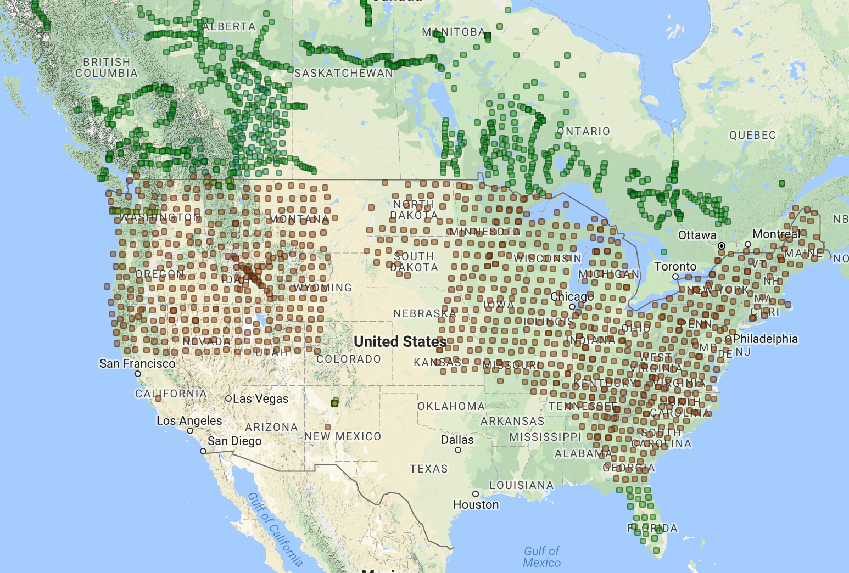
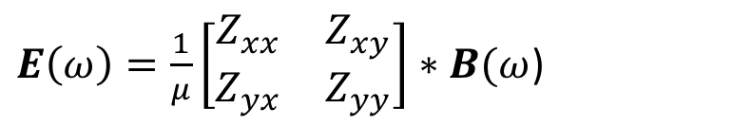
3D MT survey beta factors
Building on the work by Love et al. (2016), we applied MT impedances from EarthScope and MT surveys available from the IRIS database (Kelbert et al, 2011).
We used the full surface impedance tensors and March 1989 Ottawa reference waveform to compute the new beta factors, i.e. peak geoelectric field amplitudes referenced to the field computed using the Quebec 1D ground model.
$E\left(ω\right)=\frac{1}{μ}\left[\begin{matrix}Z_{xx} & Z_{xy} \\ Z_{yx} & Z_{yy}\end{matrix}\right]∗B(ω$)
http://ds.iris.edu/spud/emtf
2018-01-27; SPUD_bundle_2018-01-27T03.15.48

Slide 11
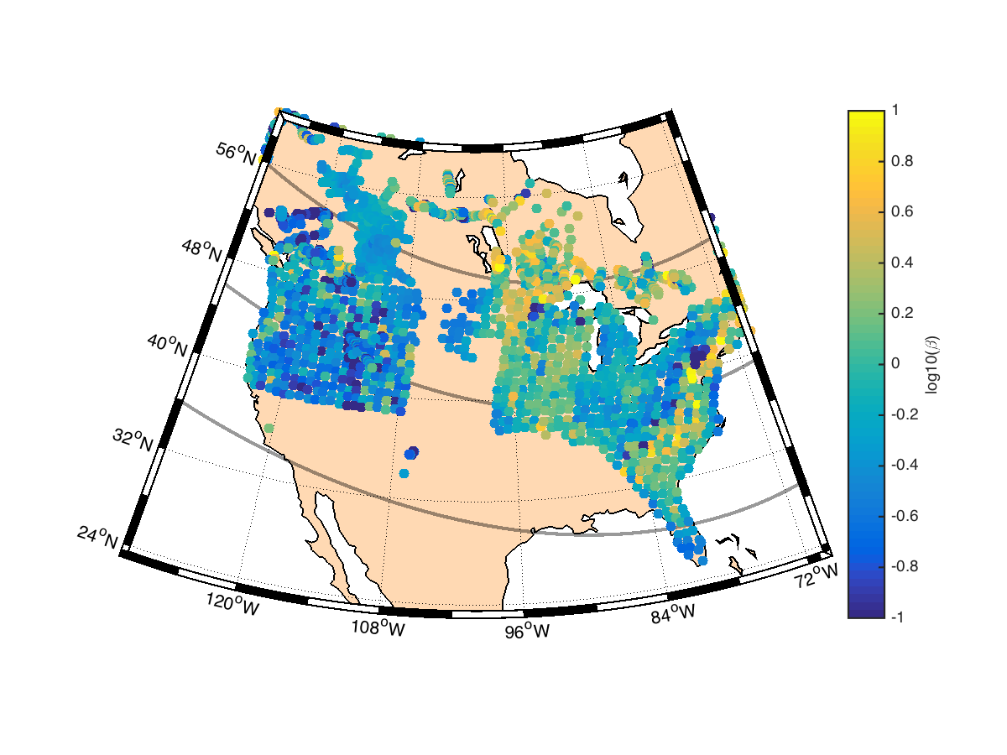
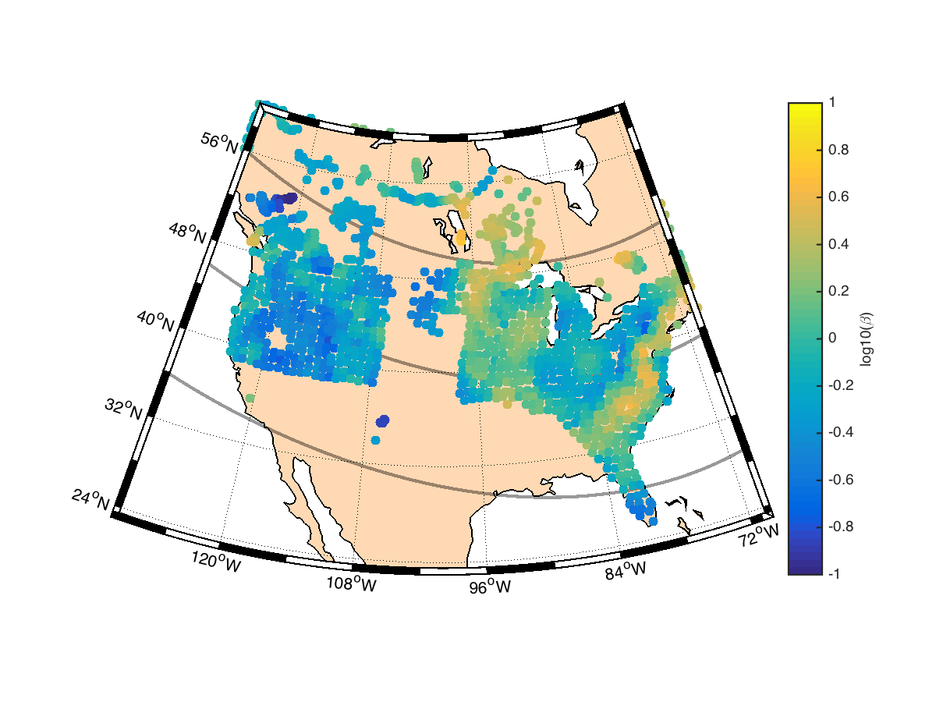
3D MT survey beta factors
Raw scaling factors
Smoothed scaling factors*
*100 km radius averaging mask applied
PRELIMINARY - NOT FOR FURTHER USE

Slide 12
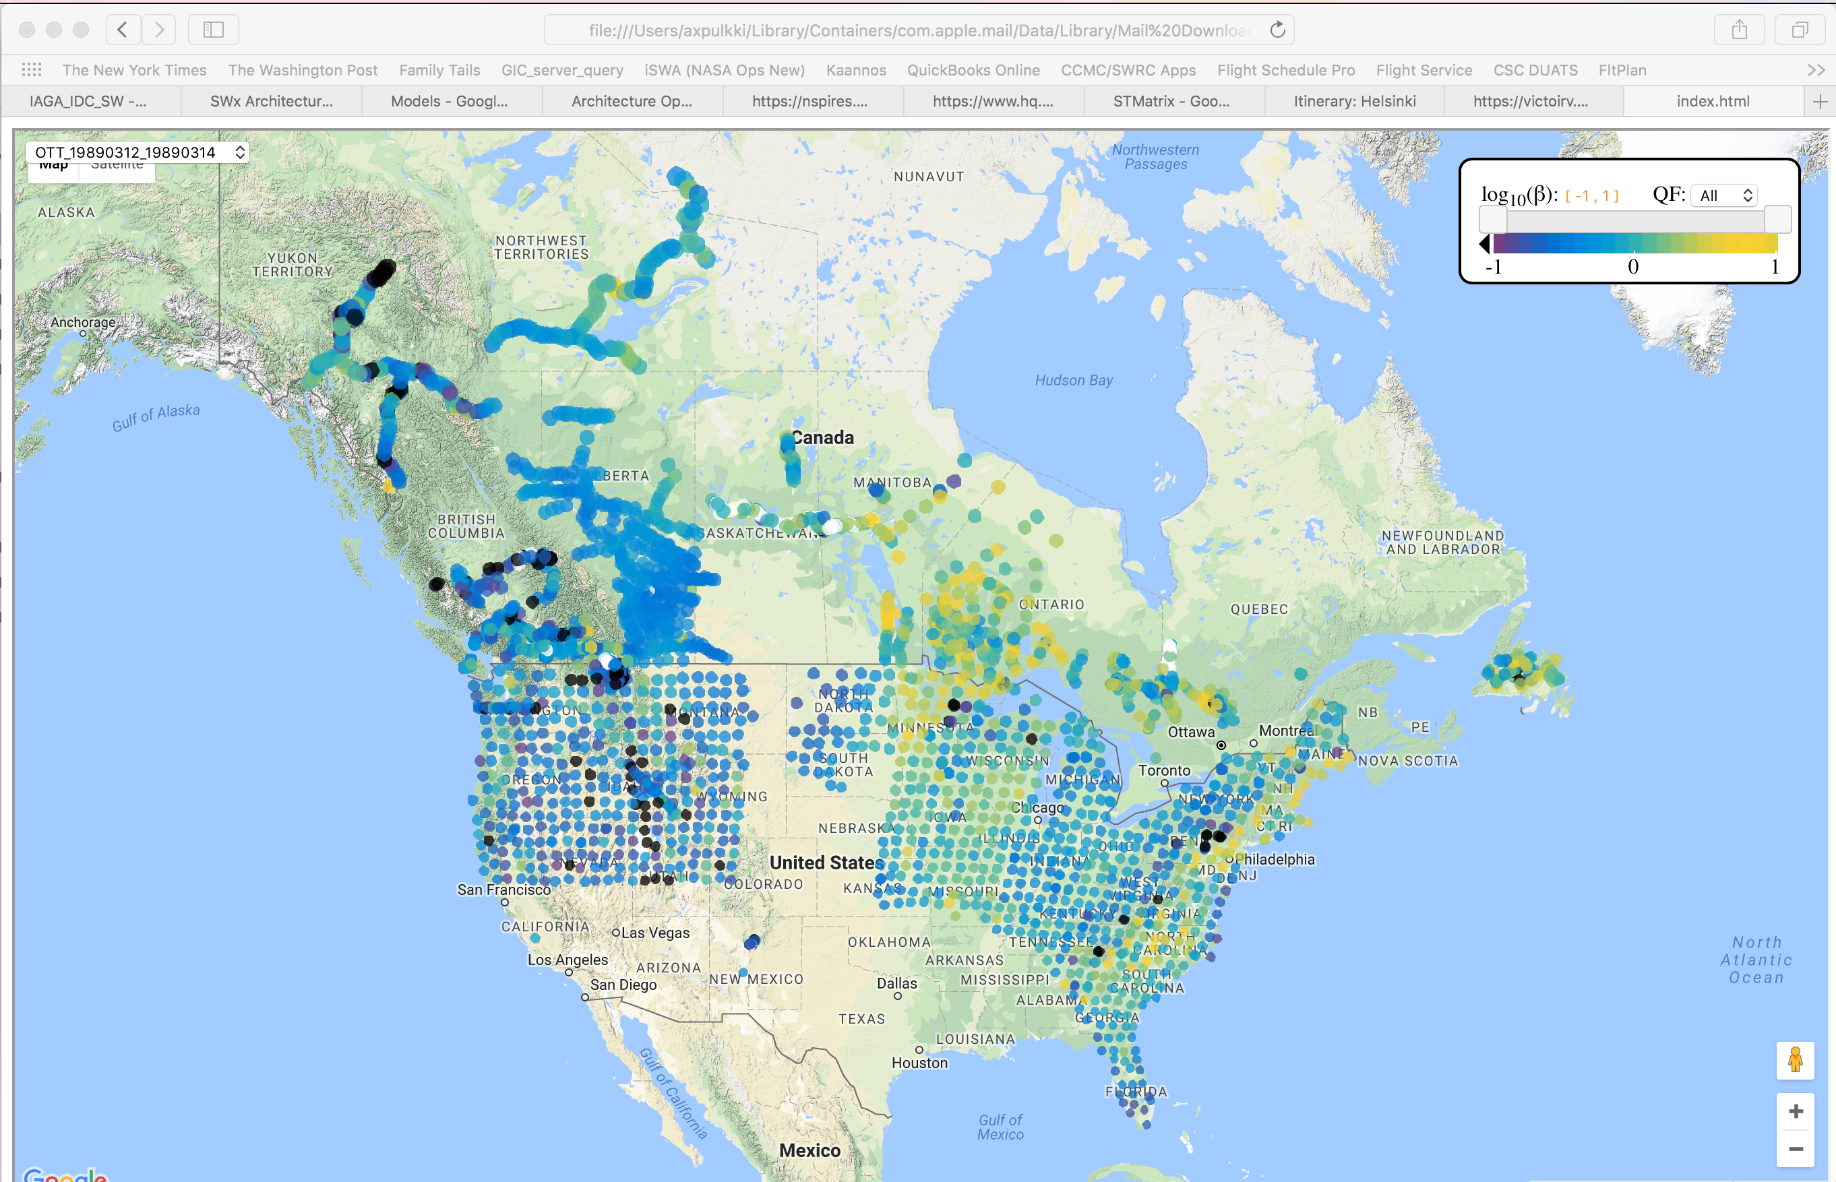
3D MT survey beta factors
One way to present the beta factors in an actionable form could be: https://rweigel.github.io/scalingfactors/.
Credit: R. Weigel, George Mason University
PRELIMINARY - NOT FOR FURTHER USE

Slide 13
Conclusions
In this preliminary investigation, we utilized ~3000 full EarthScope and IRIS MT surface impedances to characterize the ground response in the NERC benchmark event framework.
The computed new “beta” scaling factors can be applied directly in the TPL-007-1 context.
See Pulkkinen et al. (2018, under preparation) for details.

